Slide 1
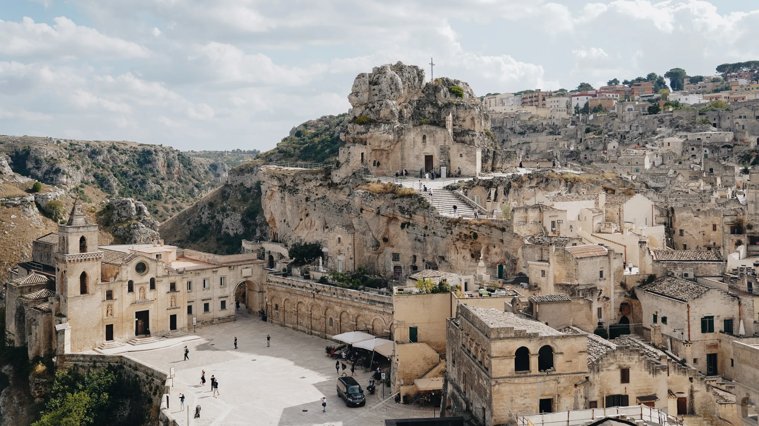
SSoLDAC 2023
Frontends and LBD
Alex Donkers
Jeroen Werbrouck

Slide 2
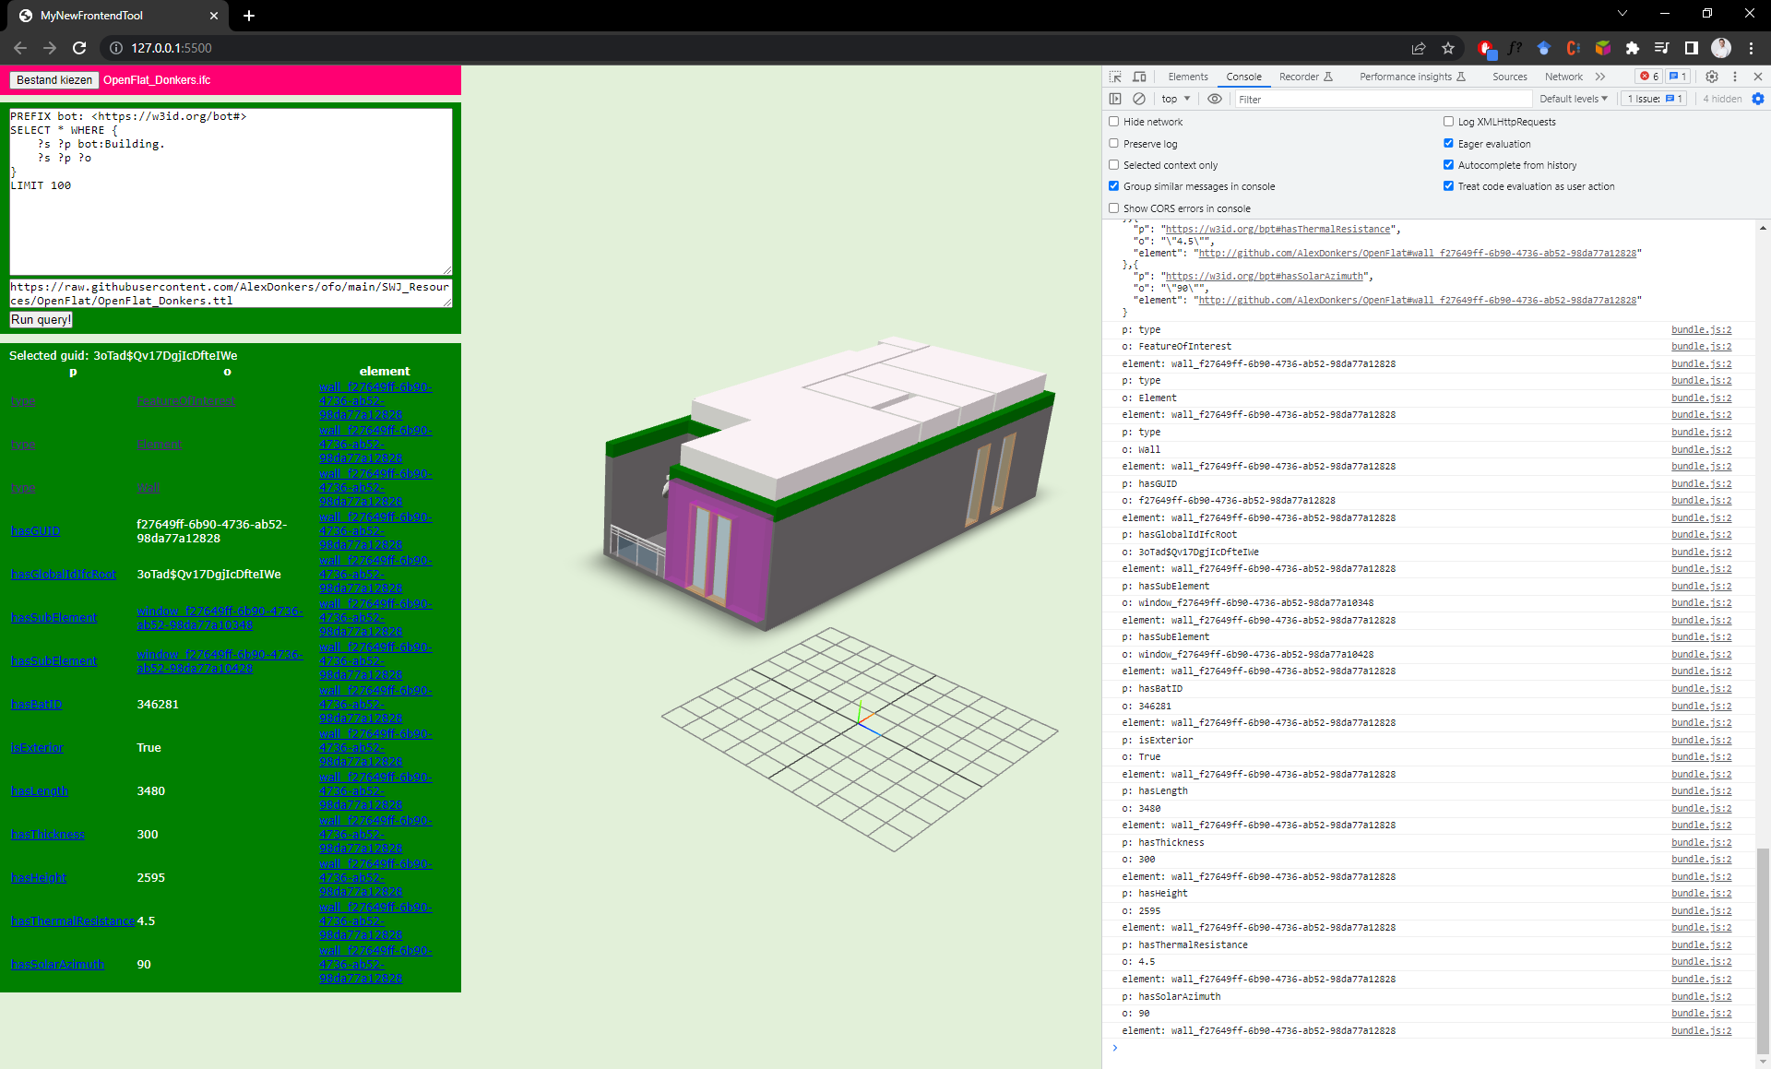
Content
PART I: introduction
Browser-based interfaces
Frontends and LD
Prototype platforms
Cool libraries
PART II: hands-on session

Slide 3
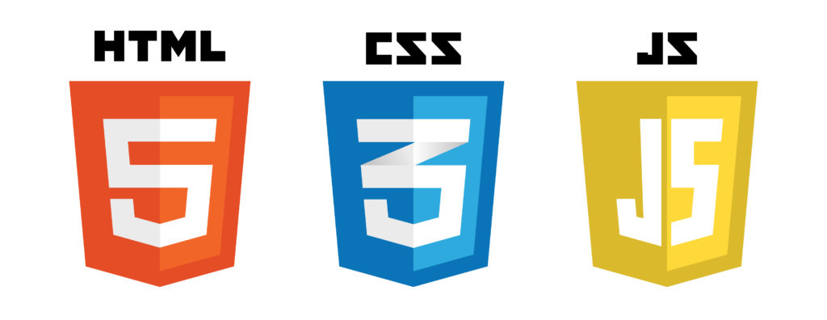
Browser-based interfaces
Flexible environment for interacting with data on the Web
Cross-OS compatibility
Well-established technology stack
Minor (but existing) cross-browser differences

Slide 4
Frontends and LD
Direct / Indirect / Hybrid interaction
In-memory / server-based querying
Direct interaction | Indirect interaction
SPARQL query pane, endpoint URLs | Buttons, 3D models, sliders …
Full expressivity for the client | “Hard-coded” expressivity
LD-specialist | Domain expert

Slide 5
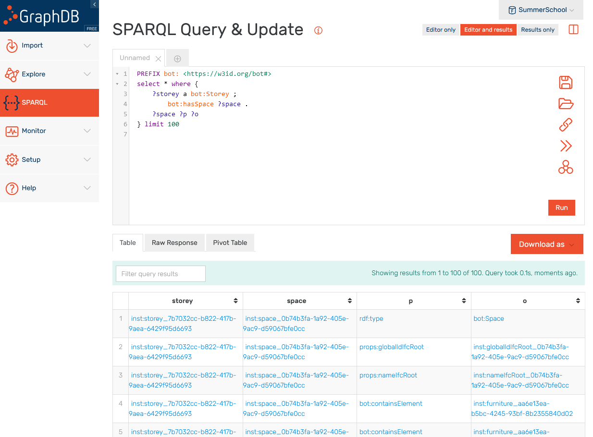
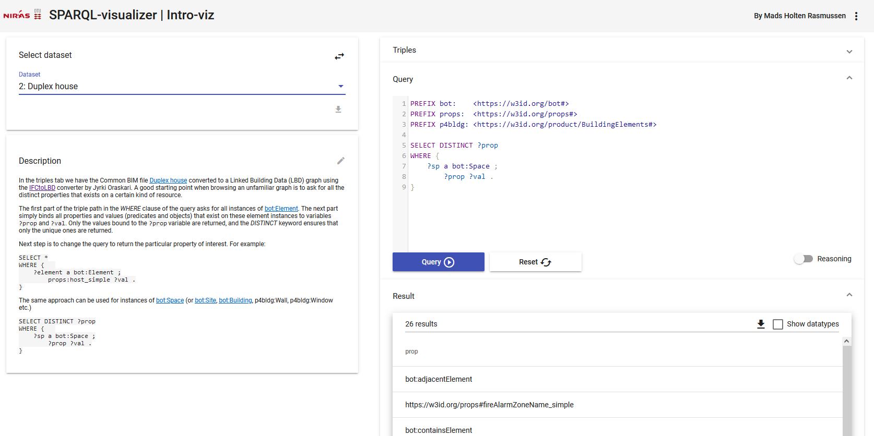
Direct Interaction
https://graphdb.ontotext.com/
https://madsholten.github.io/sparql-visualizer/

Slide 6
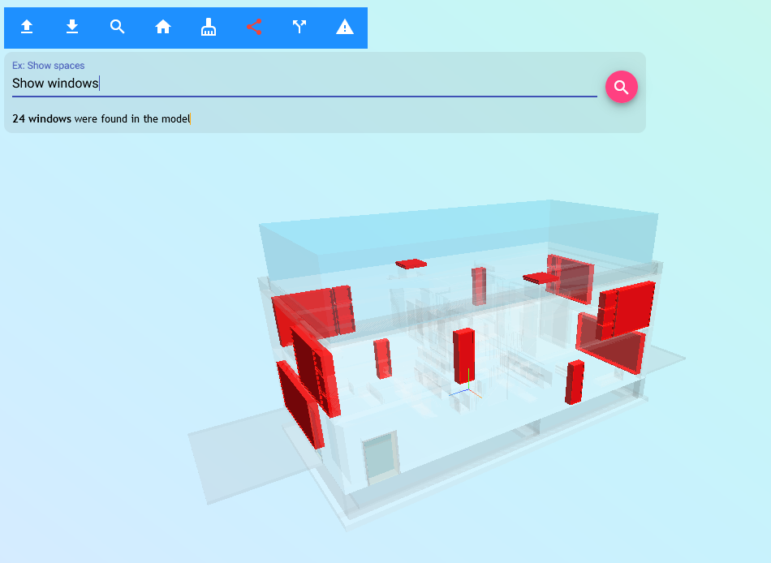
Indirect Interaction

Slide 7
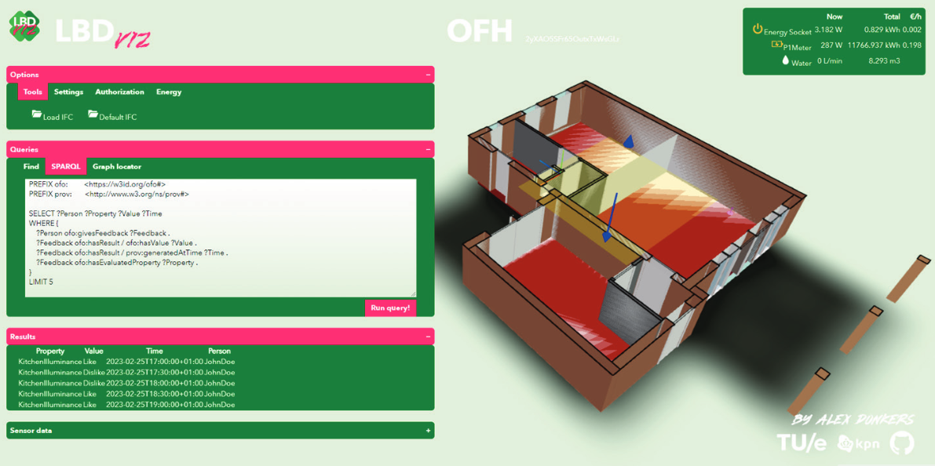
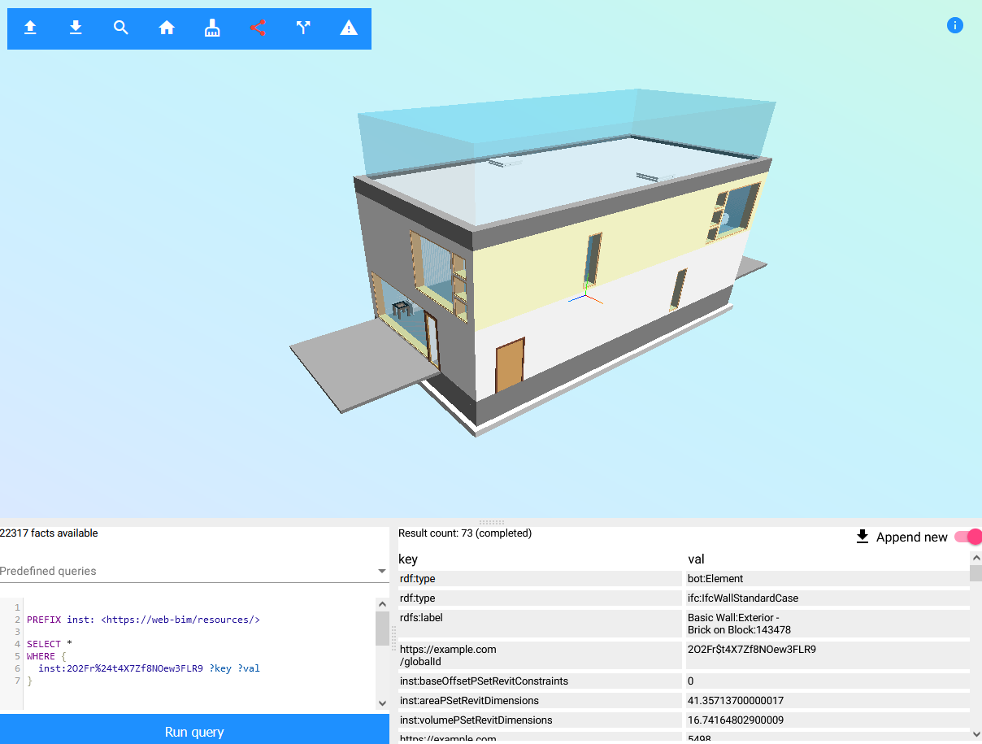
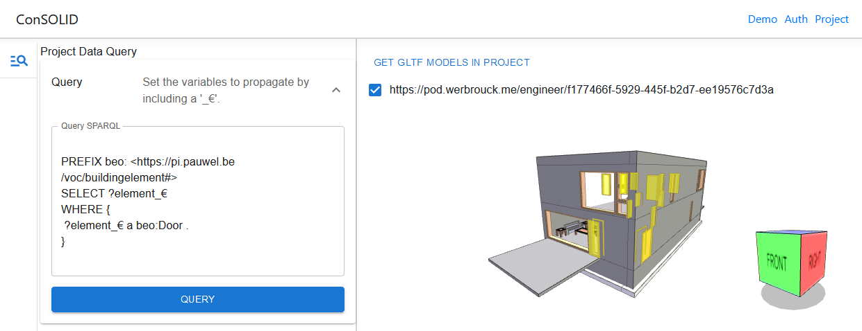
Hybrid interaction
https://ld-bim.web.app/?duplex=true
https://aecostore.werbrouck.me/

Slide 8
Prototype platforms
LD-BIM: https://ld-bim.web.app/
LBD-viz:
AECOstore: https://aecostore.werbrouck.me

Slide 9
Cool libraries
Oxigraph: in-browser triple store
Comunica: query federated RDF hypermedia (files, SPARQL, TPF…)
LDflex: treat graphs on the Web as local Javascript Objects

Slide 10
PART II: Hands-on
Hand-out link:

Slide 11
http://alexdonkers.github.io/Frontends-and-LBD/MyNewFrontendTool
http://alexdonkers.github.io/Frontends-and-LBD/

