Slide 1
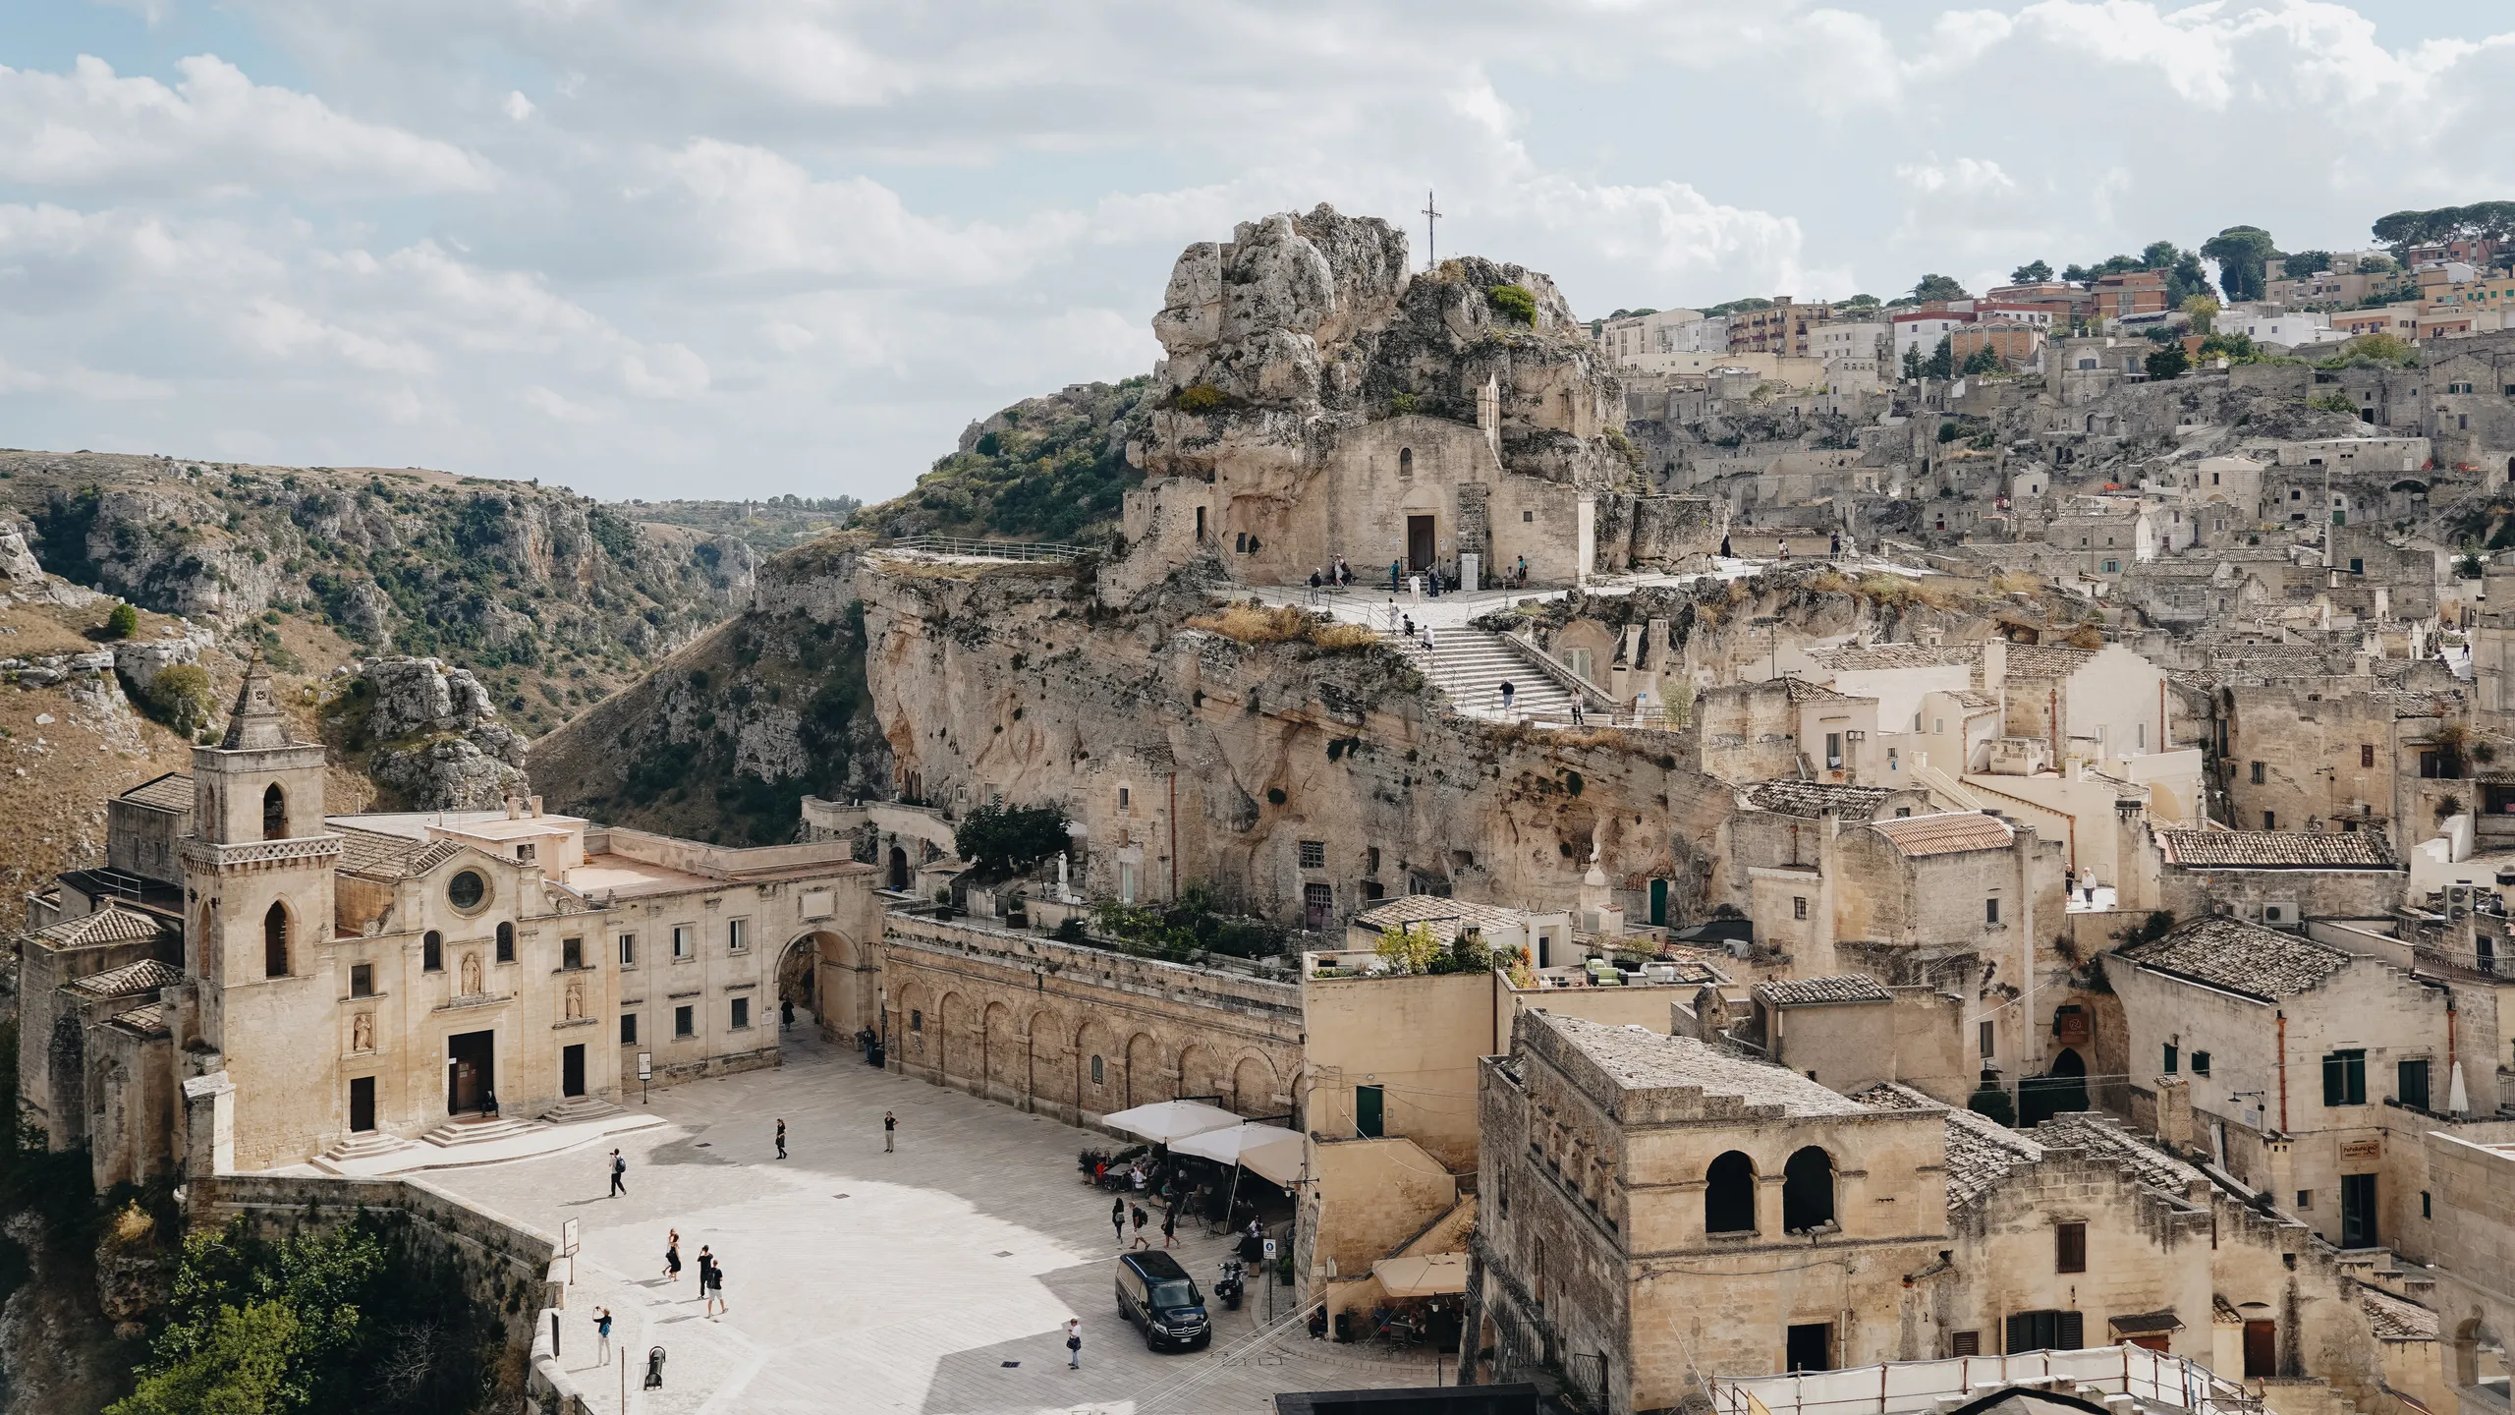
SSoLDAC 2023
Federated Knowledge Graphs / CDEs
Jeroen Werbrouck

Slide 2
Before we start …
Create a folder for this Summer School session
Navigate to the folder (e.g. cd C:\Documents\SummerSchool\Lecture_federation)
cd C:\Documents\SummerSchool\Lecture_federation
Clone the Solid Server from Github (alternatively: download as ZIP)
git clone https://github.com/CommunitySolidServer/CommunitySolidServer solid
Navigate to the directory where the Solid Server was cloned (e.g. solid)
cd solid
Install the necessary packages
npm install

Slide 3
Before we start …
Clone the following repository / SSoLDAC branch
git clone -b SSoLDAC https://github.com/LBD-Hackers/consolid-demo.git demo
Navigate to the demo folder
cd demo
Install the necessary packages
npm install

Slide 4
PART I: Background
Jeroen Werbrouck

Slide 5
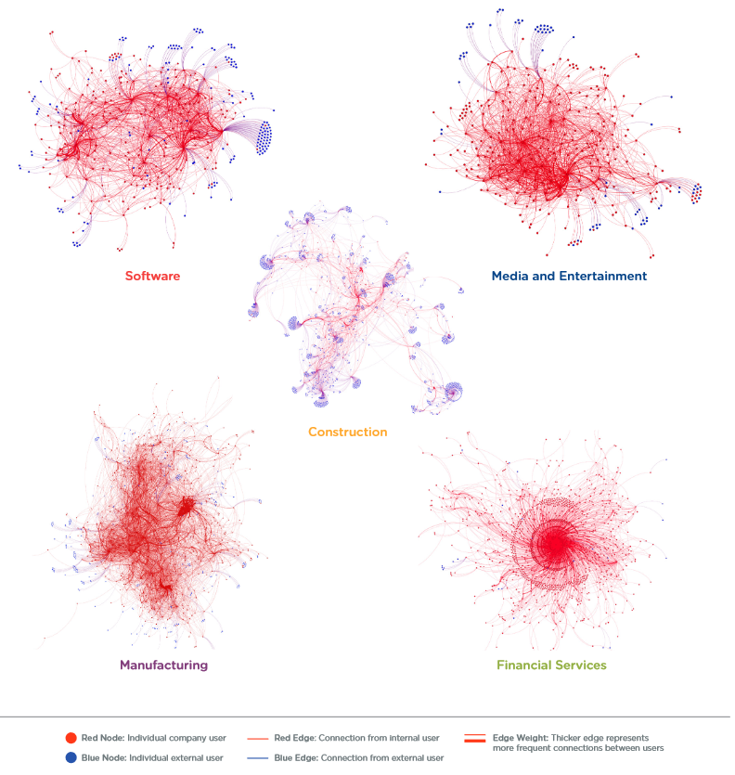
The AEC Industry
https://cloud.app.box.com/v/information-economy-report
Notes:
AEC industry is extremely decentralized compared to other industries

Slide 6
The AEC(OOHHGGQSDFXYZ🍕) Industry
Ever-increasing need for domain-independent information reuse
The longer the “project” exists, the more interdisciplinary & heterogeneous it becomes, and the more difficult to centralise
Architecture
Engineering
Construction
Operations
Owner
History & Heritage
Geospatial
Government
User Preferences
…
!
Notes:
Information reuse requires a domain-agnostic approach
Don’t talk about “BIM” => your model is just one of potentially many useful datasets to address a problem

Slide 7
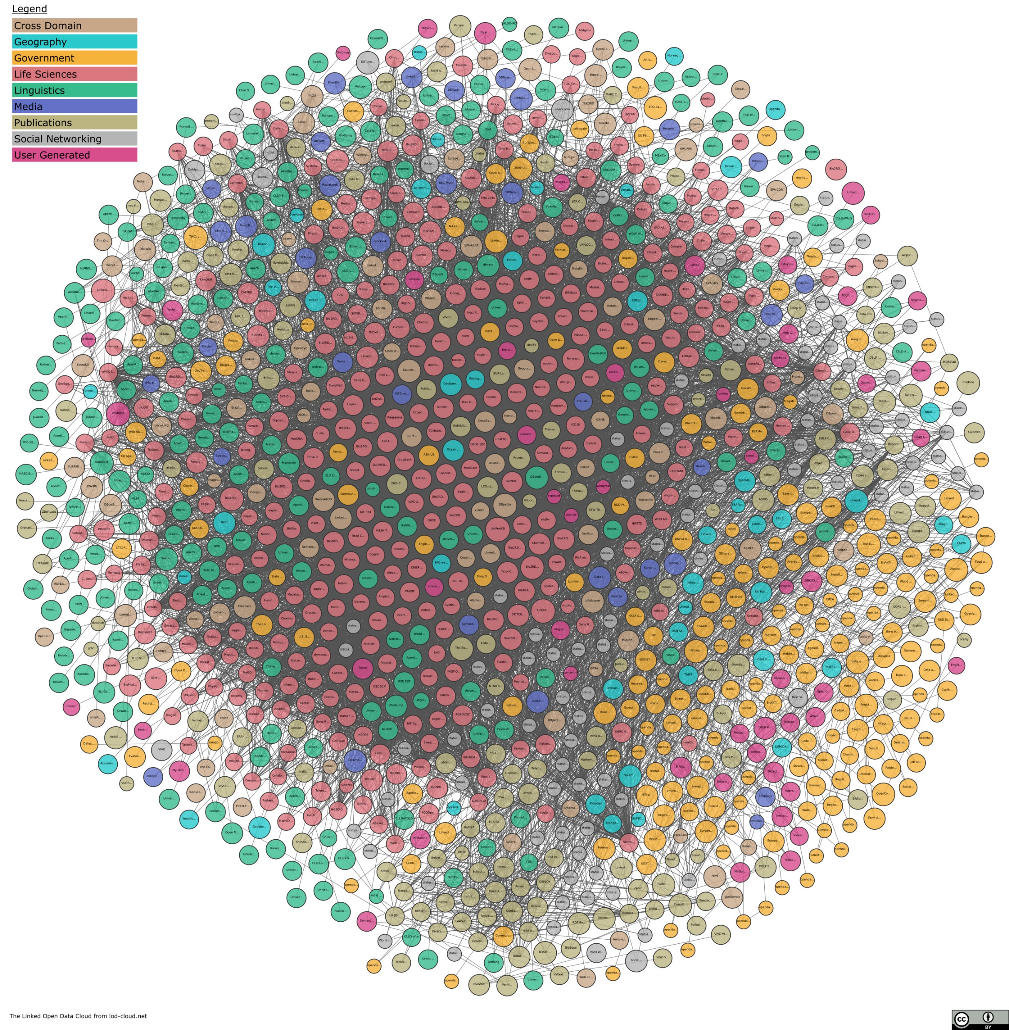
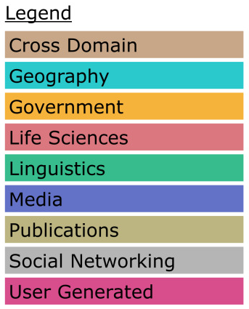
The Web as a CDE
Federated “Hybrid” Knowledge Graph
Triple store vs. “RDF in the wild”
Cross-domain linking
Link traversal / explorative
https://lod-cloud.net/

Slide 8
What is a “Project” then?
A combination of open and access-restricted heterogeneous datasets …
… as a subset of data on the Web …
… aggregated to address a specific question or aid in a specific activity.
A “federated multi-model”

Slide 9
Multi-models
A collaborative construction project will always be a set of heterogeneous resources that can be interlinked (IFC, CSV, RDF, JPEG …)
Information Container for Linked Document Delivery (ICDD | ISO 21597):
“Container-based multi-models”
Linksets connect related sub-document information

Slide 10
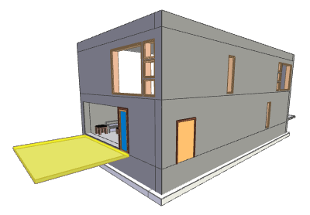
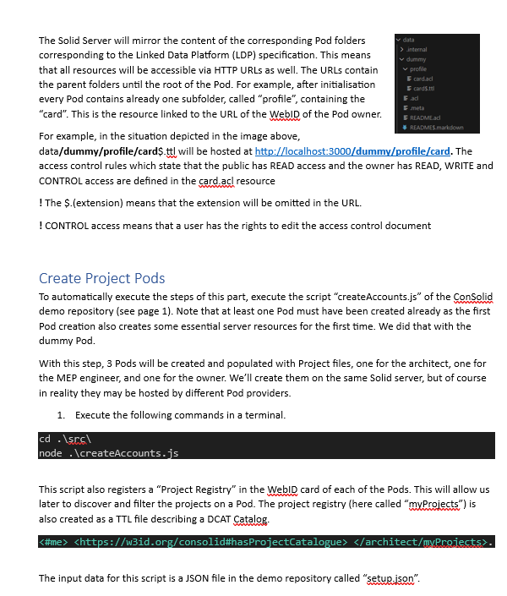
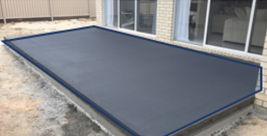
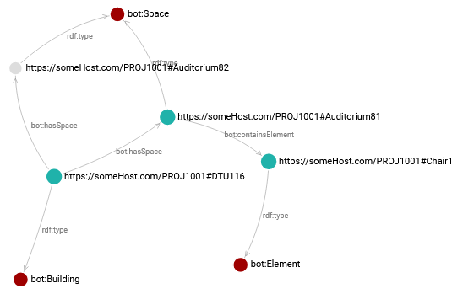
Multi-model Linksets
Linkset / Concept

Slide 11
A federated multi-model
Anyone can say Anything about Anything (AAA)
(… but of course you don’t need to believe it)
You cannot enforce datatypes/ontologies/…
… but you can connect them on a metadata level using RDF…
… which is based on URIs and thus allows you to go web-wide / federated
Notes:
Might seem a bit contradictory at first sight: can be everything, but connect with RDF. Separate between project data and metadata

Slide 12
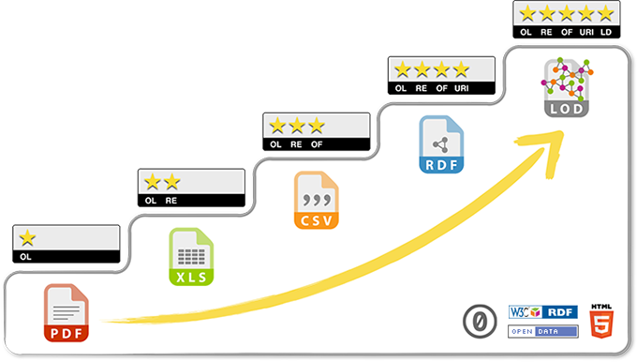
A federated multi-model
https://5stardata.info/en/

Slide 13
Federated Querying
As data is spread over the Web, it needs to be aggregated at some point
Strategies:
SPARQL service federation: include external services in your query
Aggregate & Query client-side (e.g. Comunica)
Link-traversal: Discover information on-the-go by following URLs

Slide 14
Federated, Heterogeneous CDE?
Decentral storage Store data where you want, access with remote API
Decentral authentication Use Web-wide, standardised AUTH protocols
Aggregation-based Use metadata to discover relevant datasets
(Heterogeneous Use metadata to align heterogeneous datasets)
Notes:
Access with remote APIs: decouple storage from functionality / usage of open formats is recommended but cannot be enforced. The same holds for RDF, which can allow 5 star data but cannot be enforced in a general-purpose ecosystem
Decentral authentication: even if you are not related to the “CDE” hosting the data you want to inspect, you still must be able to authenticate yourself

Slide 15
PART II: Technology Identification
Hand-out link:

Slide 16
Guidelines: FAIR-principles
Findable
Accessible
Interoperable
Reusable
Metadata
Machine-readable
Identifier-based
Searchable
…
FAIR does not necessarily mean “open”
Semantic Web technologies can fulfil the FAIR requirements
!
https://www.go-fair.org/fair-principles/

Slide 17
Storage & Auth: the Solid ecosystem
WebID: a URL representing an actor on the Web
Data Pod: personal data storage linked to a WebID
Identity Provider: instance allowing to use your WebID as a username
Hosts/dereferences
Makes this a username
https://jeroen.werbrouck.me/pod/profile/card#me
IDENTITY PROVIDER
Pod = my private server
WebID = identifies me on the Web
!
Self-hosting your IDP is possible
https://solidproject.org/

Slide 18
Aggregation, Discovery and Filtering
See FAIR principles:
Data is described with rich metadata
(Meta)data are assigned a globally unique and persistent identifier
Metadata clearly and explicitly include the identifier of the data they describe
Data Catalog (DCAT) ontology
W3C recommendation
Recommended for FAIR data points

Slide 19
Aggregation, Discovery and Filtering
<http://somearchitect.com/pod/myProject> a dcat:Dataset;
dcat:dataset <http://somearchitect.com/pod/myModel_meta> .
Link-traversal
<http://somearchitect.com/pod/myModel_meta> a dcat:Dataset;
dcterms:created "2023-06-08T13:35:46.592Z";
dcat:distribution <http://somearchitect.com/pod/myModel>.
<http://localhost:3000/architect/modelArchitecture.gltf>
dcat:downloadURL <http://localhost:3000/architect/modelArchitecture.gltf>;
dcat:mediaType <https://www.iana.org/assignments/media-types/model/gltf+json>.
https://www.w3.org/TR/vocab-dcat-3/

Slide 20
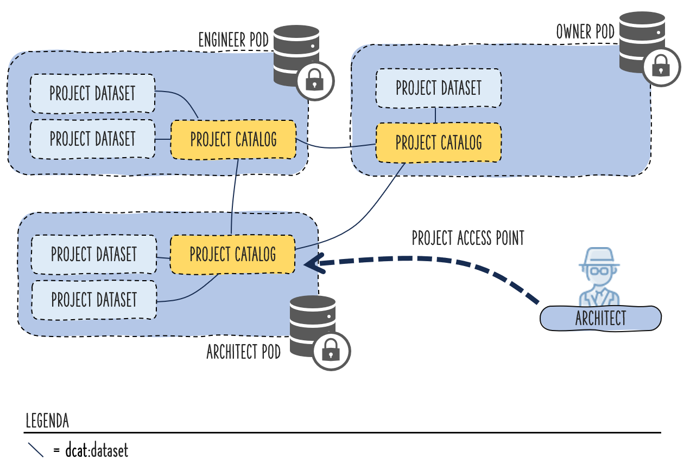
Aggregation, Discovery and Filtering
EXTERNAL DATASET
Link-traversing, recursive query
SELECT DISTINCT * WHERE {
<url-catalog> dcat:dataset+ ?dataset .
?dataset dcat:distribution ?distribution .
}
“+” establishes a property path to find all datasets that can be reached from this subject
!

Slide 21
PART III: Hands-on exercise
Hand-out link: https://github.com/SSoLDAC-2023/SS_Lectures/tree/main/Federated%20Datasets

Slide 22
Scenario: Catalog / Dataset federation

