Slide 1
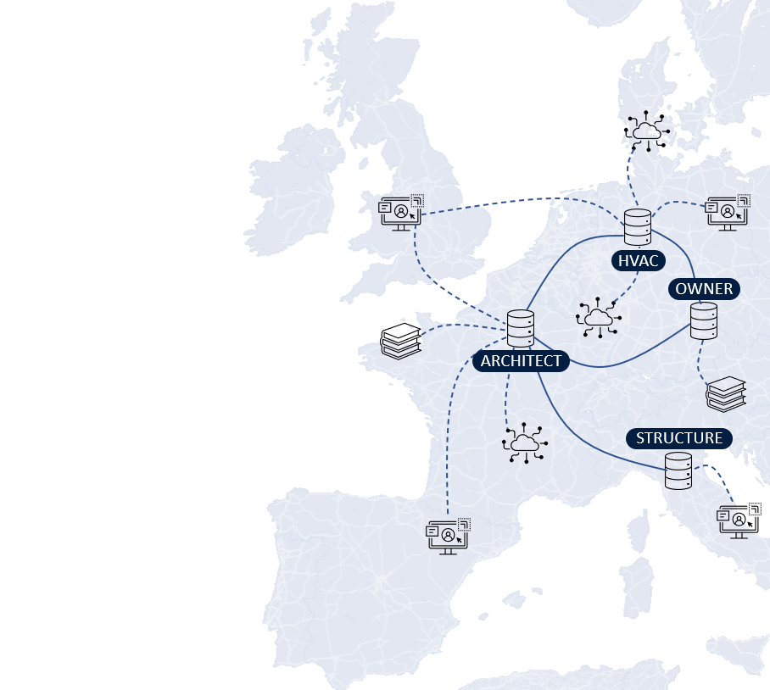
LBDserver Data patterns for the Organisation of Federated Linked Building Data
Jeroen Werbrouck – Pieter Pauwels – Jakob Beetz – Erik Mannens

Slide 2
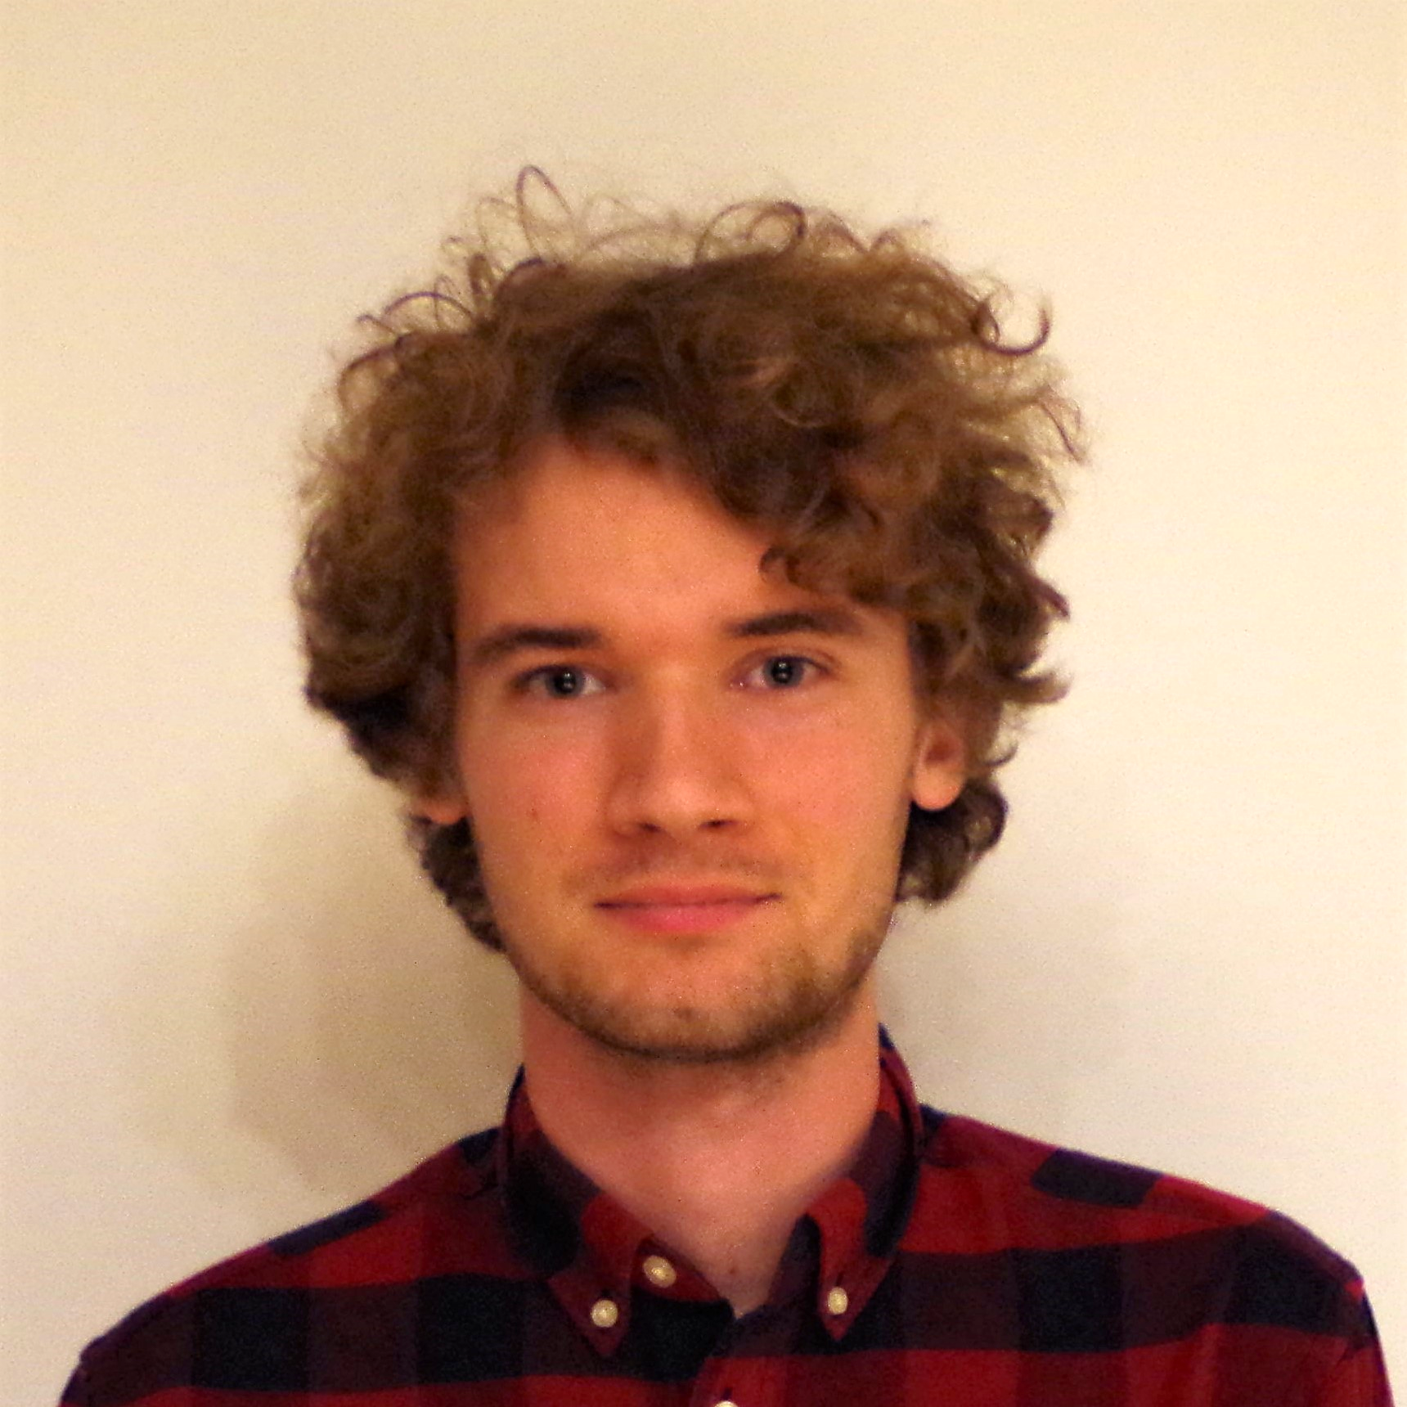
Project background
PhD research grant FWO Flanders (2019-2023)
Web- and data-based AECO projects
Data federation
Semantic data models (RDF) & sub-document identifiers (no RDF)
Modular, “plugin-based” service infrastructure
Semantic enrichment of building geometry
Front-end federation
LBDserver
Federated CDE
PBAC (access control)

Slide 3
Context: Data Federation in AEC
Project-specific data
Contextual data
Services
Data heterogeneity
Decentralised access control
Sub-document information linking
“Using a 3rd party Web service, Jeroen localises a damage pattern on a picture of Pieter, linking it to an existing building element via the 3D model of Jakob, and referring to external regulation datasets provided by the government.”

Slide 4
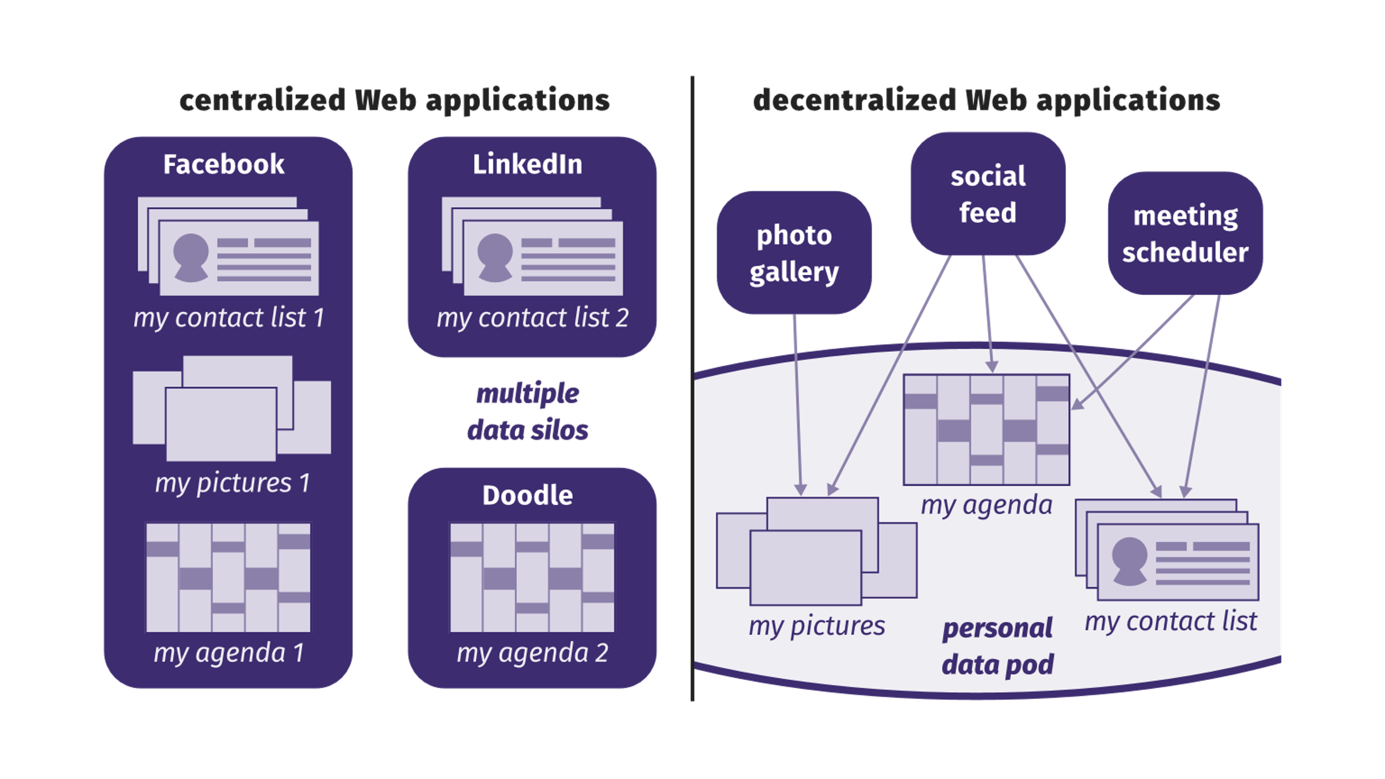
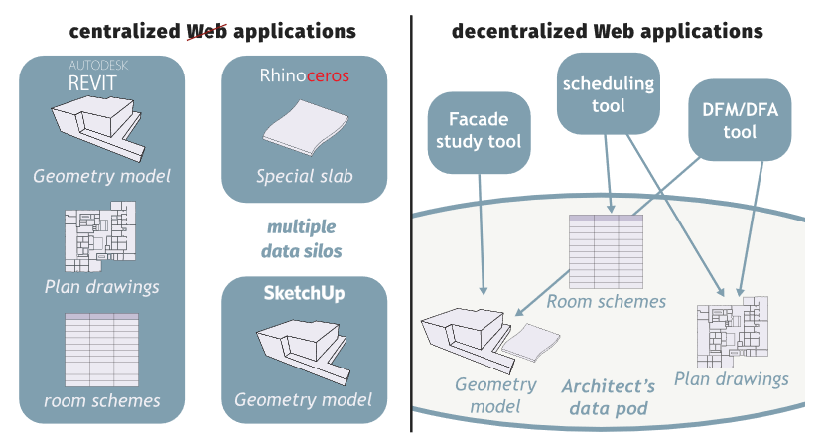
Context: Solid
Web ID: A URL that represents an actor on the Web “Web username”
Data Pod: Personal data storage linked to a Web ID Linked Data Platform (LDP) + AUTH
Identity Provider: Instance hosting your WebID (and Pod) Can be self-hosted
© Ruben Verborgh, 2018
© Mads Holten Rasmussen, 2018
Notes:
Data wiring: RDF
Data content: heterogeneous

Slide 5
Context: Technological overview of the LBDserver
DATA FEDERATION
WAC
WebID
LDP
APPLICATION
AECO-STORE
DATA FEDERATION
module federation
SERVICE
FEDERATION
W3C STANDARDS
FRONT-END
FEDERATION
OPEN API
{REST}
GraphQL
DATA INTEGRATION
ICDD
DATA FEDERATION
LBD
BCF
Notes:
How to securely store access-restricted data?
How to connect heterogeneous data in a flexible way?
How to interact with this diversity?
How to connect project-specific and contextual (open) data?

Slide 6
Topics
Local project organisation
Federated project discovery
Context lifting & “artefacts”
Artefact alignment
LBDserver demo

Slide 7
Local project organisation

Slide 8
Local project organisation
Sub-repository of data POD </lbd/{uuid}> (lbd:Container)
Project information (.meta)
Project ID
Project members
Artefact Registry (pointer)
Datasets
Main dataset
Metadata
Artefact registry “Context lifter”

Slide 9
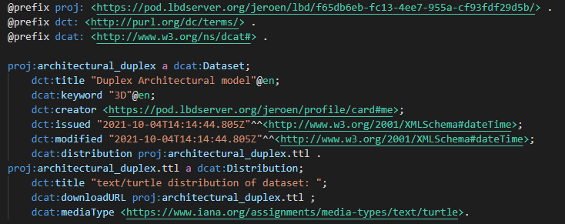
Local project organisation: metadata
Main access point for datasets (DCAT)
Dataset is dcat:Distribution
dcat:downloadURL (dump)
dcat:accessURL (e.g. SPARQL endpoint)
Additional information (phase, publication status, …) separated from main dataset

Slide 10
Local project organisation: metadata
Main access point for datasets (DCAT)
Dataset is dcat:Distribution
dcat:downloadURL (dump)
dcat:accessURL (e.g. SPARQL endpoint, specialised database service …)
Additional information (phase, publication status, …) separated from main dataset

Slide 11
Local project organisation: artefactRegistry
Connects “document-based” identifiers to “POD-wide” abstract concepts
Similar to Linkset > LinkElements > identifier & document (ICDD)
Context lifting
“Artefact” Concept that has/may have specific representations somewhere in the federated project
Every stakeholder has at least 1 artefactRegistry
global artefact URIs local identifiers in the project
global artefacts aliases (e.g. in other PODs)
fm:art5
hasLinkElement
hasDocument
hasIdentifier
le2
damage.ttl
id2
identifier
</damage.ttl#element1>

Slide 12
Global project linking: artefactRegistry
hasLinkElement
arch: art1
own:art8
hasLinkElement
hasDocument
le1
hasIdentifier
hasDocument
hasIdentifier
le3
arch.ttl
id1
fm:art5
identifier
model.gltf
id3
</arch.ttl#door1>
identifier
arch:artefactRegistry.ttl
“Brep 1”
own:artefactRegistry.ttl
hasLinkElement
hasDocument
le2
hasIdentifier
damage.ttl
id2
identifier
</damage.ttl#element1>
fm:artefactRegistry.ttl
@prefix arch: <https://archoffice.de/lbd/abc123/> .
@prefix fm: <https://fm-bureau.fr/lbd/abc123/> .
@prefix own: <https://pod.inrupt.net/lbd/abc123/> .

Slide 13
Global project linking: artefactRegistry
hasLinkElement
arch: art1
own:art8
hasLinkElement
hasDocument
owl:sameAs
le1
hasIdentifier
hasDocument
hasIdentifier
le3
arch.ttl
id1
fm:art5
identifier
model.gltf
id3
</arch.ttl#door1>
identifier
arch:artefactRegistry.ttl
“Brep 1”
own:artefactRegistry.ttl
hasLinkElement
hasDocument
le2
hasIdentifier
damage.ttl
id2
identifier
</damage.ttl#element1>
fm:artefactRegistry.ttl
@prefix arch: <https://archoffice.de/lbd/abc123/> .
@prefix fm: <https://fm-bureau.fr/lbd/abc123/> .
@prefix own: <https://pod.inrupt.net/lbd/abc123/> .

Slide 14
Front-end framework
Module federation / microfrontends
Standalone plugins
Can also be used in configuration with others (Container application)
Run-time loading dynamically load UI depending on needs
Minimal exchange of data between plugins
AUTH
Project ID
“active resources”
Currently selected elements
List of abstract artefacts
Plugin ‘knows’ which representations/manifestations it can handle

Slide 15
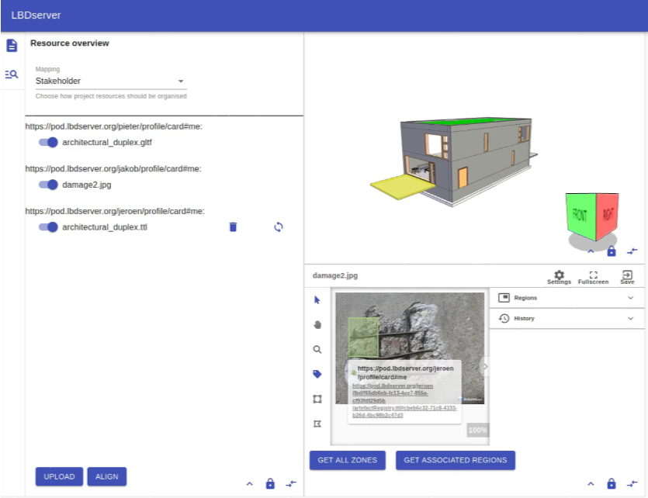
Front-end framework: configuration
https://lbd-dev.org/resourceOverview/remoteEntry.js
https://3dsolutions.be/viewerplugin/remoteEntry.js
https://lbd-dev.org/resourceOverview/remoteEntry.js
https://another.comg/imgAnnotate/remoteEntry.js

Slide 16
Front-end framework: configuration

Slide 17
Implementation: demo I

Slide 18
Implementation: demo II

Slide 19
Summary
Back-end framework connecting heterogeneous datasets “Federated multi-model”
Abstract artefacts have file-specific manifestations
Disparate UI modules can communicate with one another using abstract artefacts & filtered manifestations
UI modules of different origin can be configured in a “shopping cart” configuration
“Using several federated LBDserver UI modules, Jeroen localises a damage pattern on a picture of Pieter, linking it to an existing building element via the 3D model of Jakob, and referring to external regulation datasets provided by the government.”

Slide 20
Future work
External dataset integration
Stress test & optimisation
Network orchestration & automatisation (“POD satellites”)
Communication & data streams
Data sanitation
Data discovery
Checking & validation
Documentation (LBDserver plugins, npm API, …) “Get started as an LBDserver developer”

Slide 21
Contact
Main Research
Jeroen Werbrouck
PhD Researcher (FWO Flanders)
Ghent University | RWTH Aachen
jeroen.werbrouck@ugent.be
Promotors
Erik Mannens (Ghent University | IMEC )
Pieter Pauwels (Ghent University | TU Eindhoven)
Jakob Beetz (RWTH Aachen)
Project Info
https://lbdserver.org
https://github.com/ConSolidProject/

Slide 22
THANK YOU!

Slide 23
Appendix

Slide 24
Background concepts: UI
Plugins can run standalone & in configuration
Plugins have a dedicated topic (e.g. visualisation, query, checking …)
Configurations
loaded on runtime
straightforward developer experience (separate repo & deploy)
can be mapped to address use cases (“shopping cart”)
Container “distributes” concepts to enable communication
auth
project
active resources
Selection

Slide 25
Demo: config loading

