Slide 1
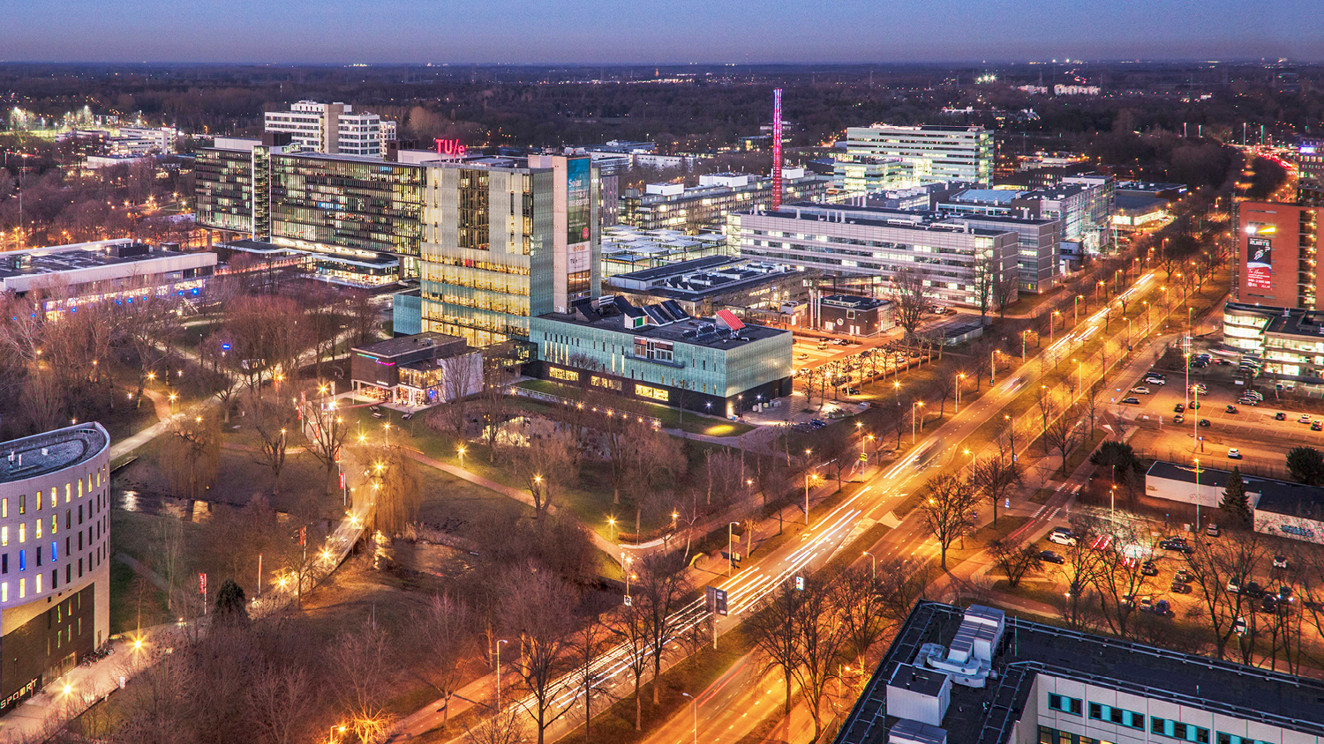
Queries on Semantic Building Digital Twins for Robot Navigation
LDAC2021 workshop on Linked Data in Architecture and Construction
11 October 2021, Luxembourg
Rens de Koning¹, Elena Torta¹, Pieter Pauwels², Bob Hendrikx¹ and René van de Molengraft¹
¹ Faculty of Mechanical Engineering, ² Faculty of Built Environment

Slide 2
Outline
Introduction: Robot Navigation and Digital Twins?
The building model: Atlas floor 8 and 9
Creating a topological and metric map
Navigation tests
Conclusion

Slide 3
Robot navigation inside buildings
Autonomous mobile robots are starting to be deployed in complex built environments where they need to navigate to complete the given tasks.
      Routing for last mile delivery (e.g. package delivery, hospital navigation)
      Emergency navigation and evacuation (e.g. fire)
      Navigation in risky environments (e.g. risk for diseases)
      Tasks in places that are difficult to reach (e.g. maintenance and inspection)
Autonomous mobile robots rely on environmental maps to do their navigation tasks:
      Topological map
      Metric map

Slide 4
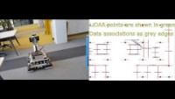

Slide 5
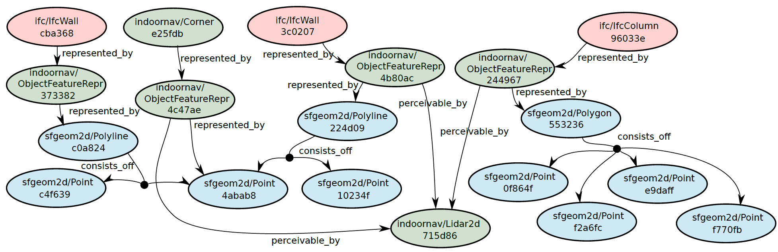
Data representation and querying
- Features are recognized from 2D LiDAR sensor output
- Features are linked to semantic building model in triple store
Hendrikx, B., Pauwels, P., Torta, E., van de Molengraft, M. J. G. R., & Bruyninckx, H. P. J. Connecting Semantic Building Information Models and Robotics: An application to 2D LiDAR-based localization. In International Conference on Robotics and Automation, ICRA 2021
https://www.youtube.com/watch?v=b7LKU3C6gCQ

Slide 6
The purpose of environmental maps
Robots use environmental maps for:
Localization: the process of determining where a mobile robot is located with respect to its environment
Path planning: to find a path from the current position to the target position.
Reactive navigation: controlling an autonomous mobile robot, which suggests making all control decisions through some light processing of the current/recent sensor data.
Notes:
In order to navigate robots rely on environmental representations of the space to be visited called maps. A map is used for different purposes during navigation, namely localization (where is the robot in the building), path planning (what is the optimal path to reach a certain destination) and when continuously update reactive navigation (i.e. compute at every sample the control commands to give to the robot to follow the computed path).
There are, on a higer level, two ways of deriving a map of the environment. SLAM (simultaneous localization and mapping)

Slide 7
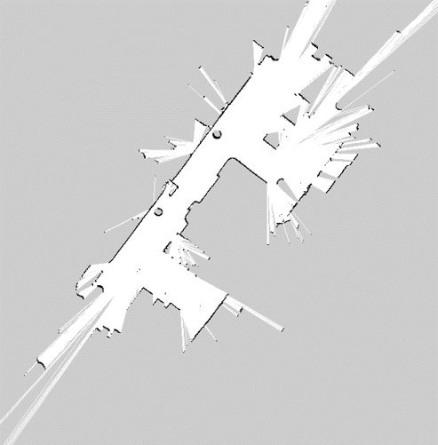
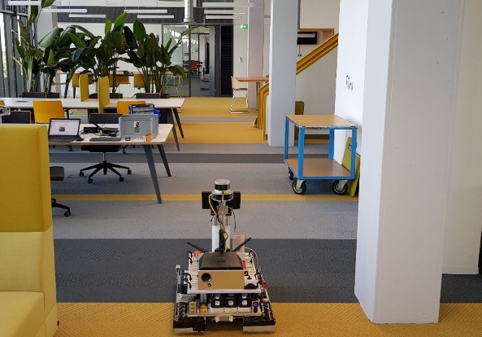
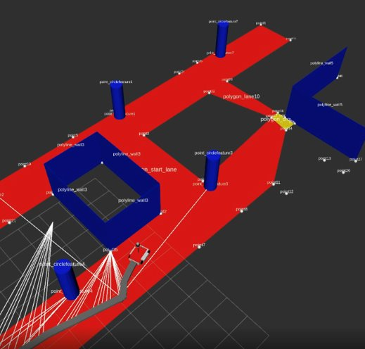
Existing methods for the creation of environmental maps
Mainstream methods exist, yet often require substantial effort and do not assume any pre-existing material.
2D laser scan of TU/e building.
Labor intensive.
Time consuming.
Movable elements present
SLAM
Manual creation
Manual map of TUe building:
Labor intensive.
Only salient features present
Notes:
In order to navigate robots rely on environmental representations of the space to be visited called maps. A map is used for different purposes during navigation, namely localization (where is the robot in the building), path planning (what is the optimal path to reach a certain destination) and when continuously update reactive navigation (i.e. compute at every sample the control commands to give to the robot to follow the computed path).
There are, on a higer level, two ways of deriving a map of the environment. SLAM (simultaneous localization and mapping)

Slide 8
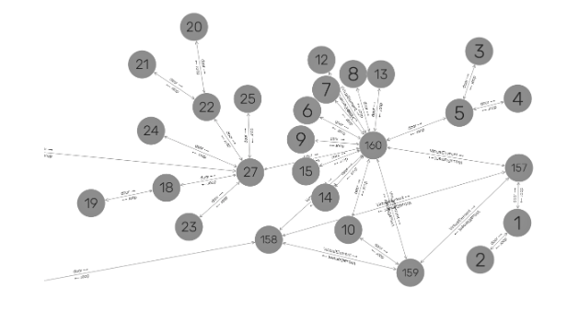
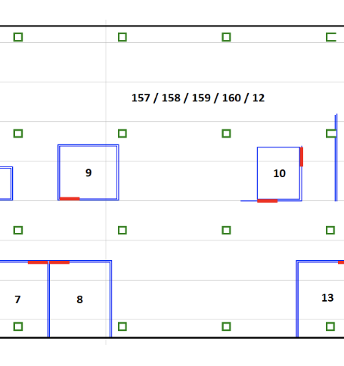
Investigation of an alternative method
SLAM
Manual creation
Semi-automatic DT-based creation
Digital Twin
Physical Twin
Notes:
In order to navigate robots rely on environmental representations of the space to be visited called maps. A map is used for different purposes during navigation, namely localization (where is the robot in the building), path planning (what is the optimal path to reach a certain destination) and when continuously update reactive navigation (i.e. compute at every sample the control commands to give to the robot to follow the computed path).
There are, on a higer level, two ways of deriving a map of the environment. SLAM (simultaneous localization and mapping)

Slide 9
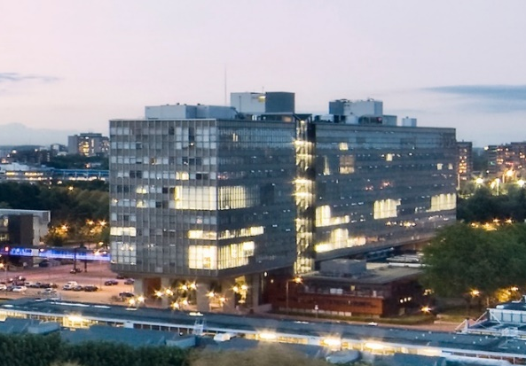
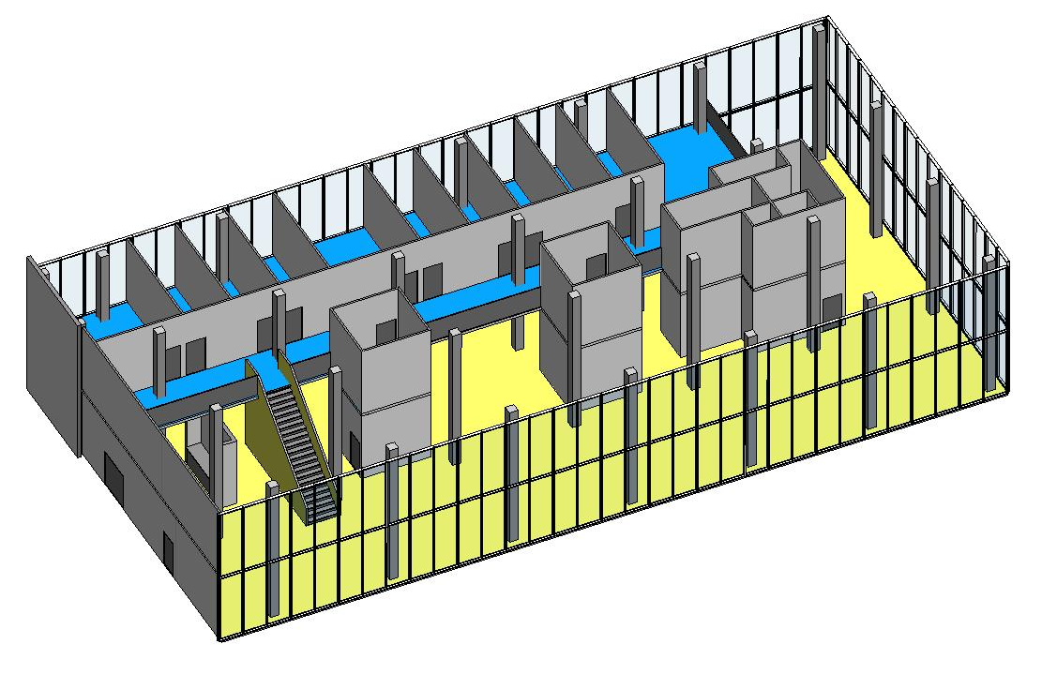
Motivation: Can robots use BIM data to derive the maps and enable informed robot navigation?
GraphDB
Linked Data Approach
TU/e Building
BIM model (Floor section)
Our approach:
The BIM model is made available as a LBD graph and stored as the core of the building’s digital twin
The robot queries the building’s digital twin to derive topological and metric maps
The robot uses maps for navigation (scoped here to the computation of the optimal path)
Notes:
The idea is to extract the data from BIM model to a GraphDB that a robot can access online.

Slide 10
Outline
Introduction: Robot Navigation and Digital Twins?
The building model: Atlas floor 8 and 9
Creating a topological and metric map
Navigation tests
Conclusion

Slide 11
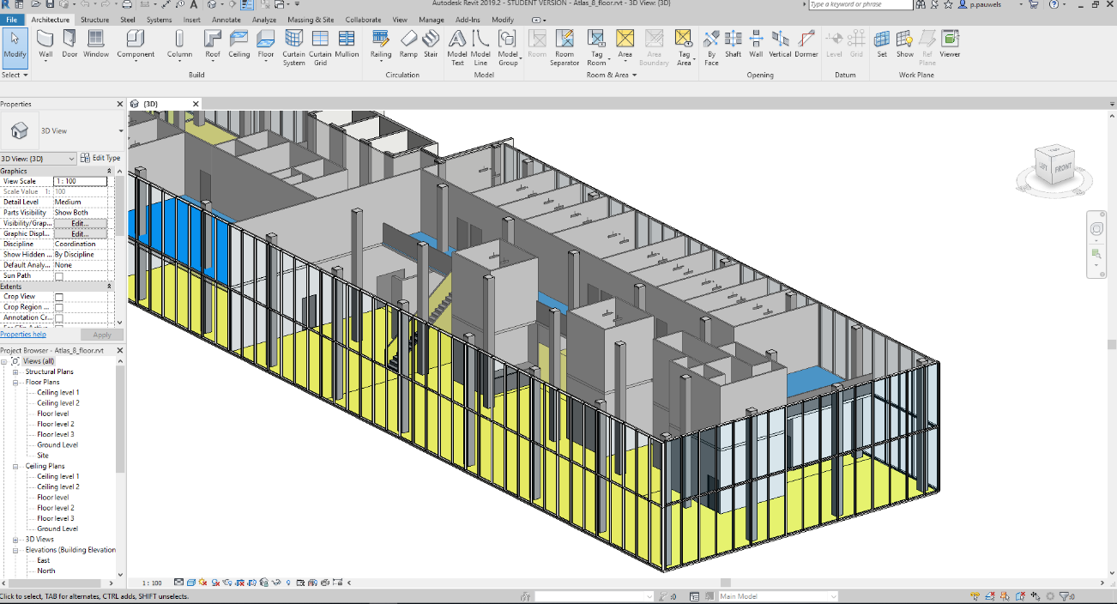
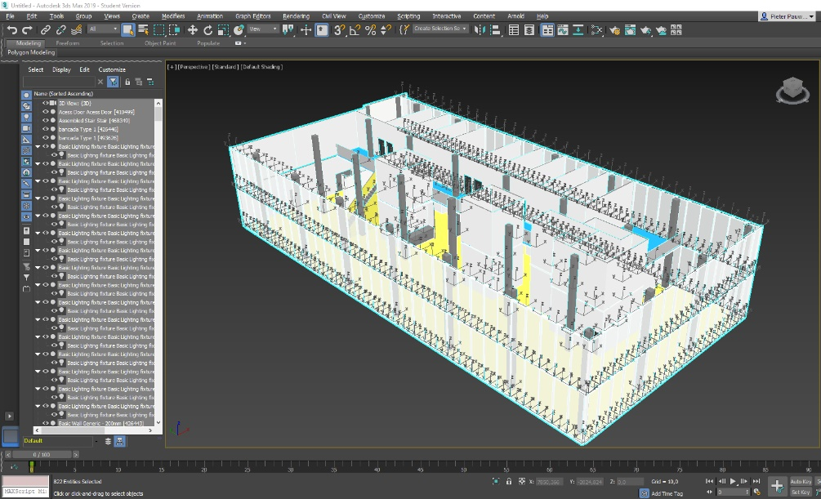
The Atlas building model
Floor 8 and 9 modelled in Autodesk Revit 2019; multiple export options available.
Angela de Barros Lima. A web-based application to integrate Building Management System sensor data and Building Information Model data to support facility management tasks, MSc Graduation Project, TU Eindhoven, 2020.
Notes:
The idea is to extract the data from BIM model to a GraphDB that a robot can access online.

Slide 12






Data flow
IFC file (.json)
Diverse data flows are available:
IFC-oriented
LBD-oriented
JSON-based
Direct
IFC file (.ttl)
IFC file (.spf)
LBD graph
(L2-3 complex, .ttl)
Topology: BOT
Product data: BEO, MEP
Properties: PROPS
Geometry: BOT + WKT
LBD graph
(L1 simple, .ttl)
BIM Model in Revit
Collada file (.dae)

Slide 13
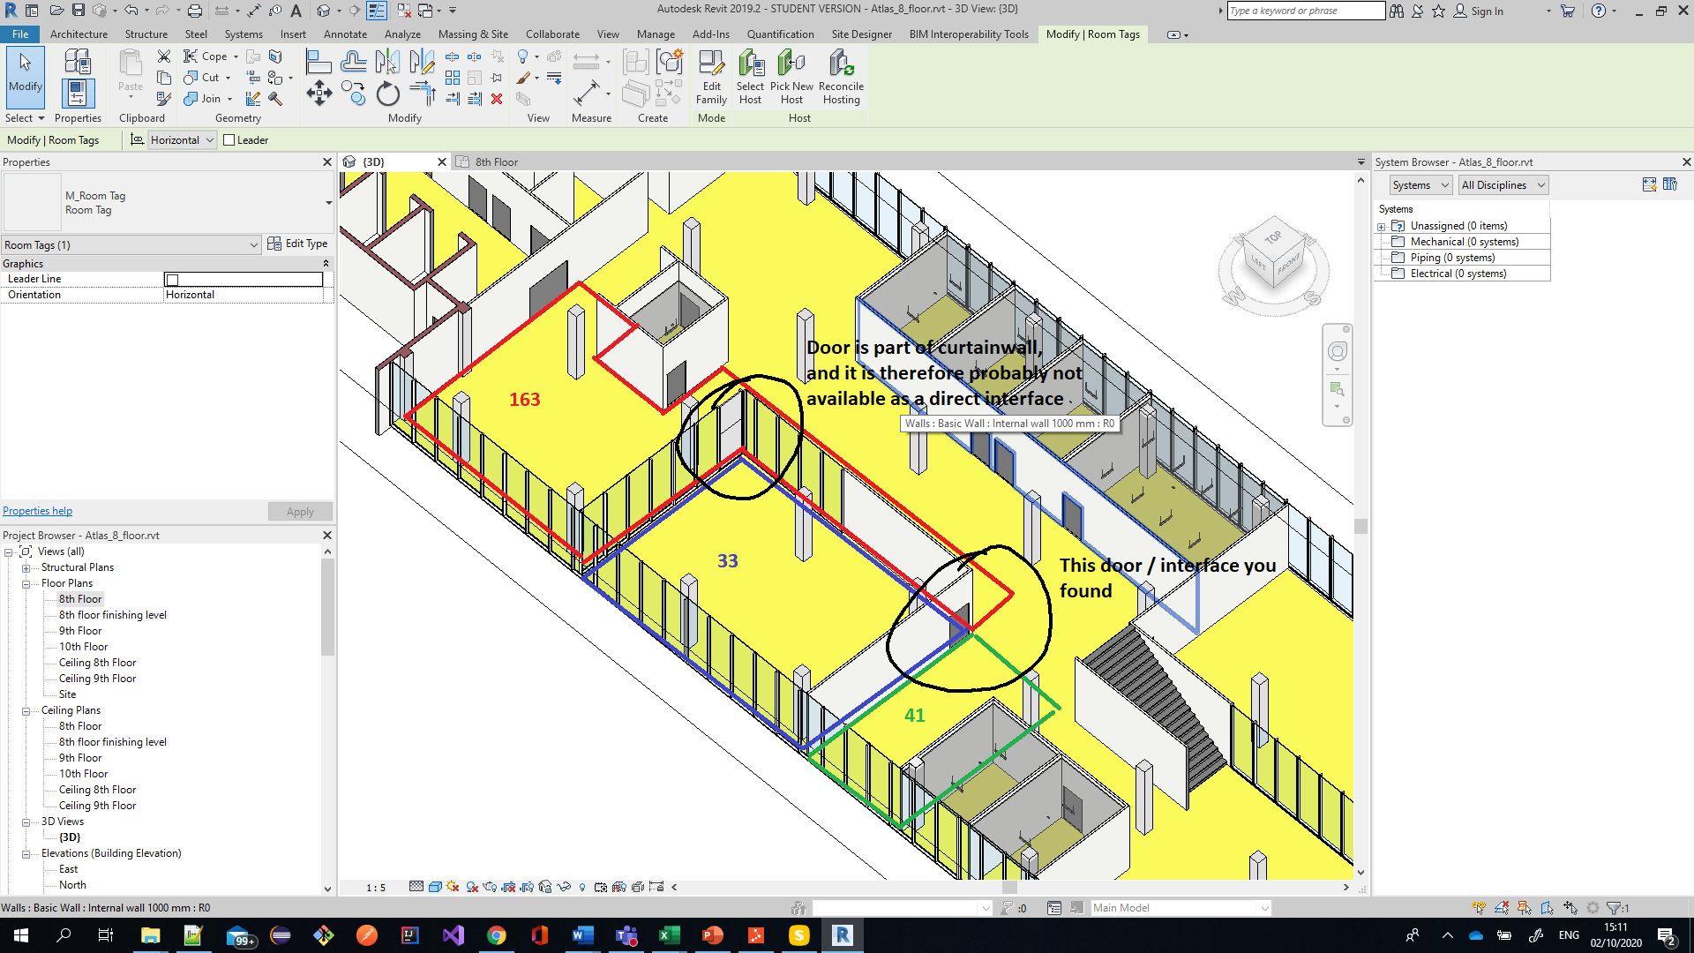
The importance of modelling conventions!
‘Boundary lines in Revit’ versus ‘Elements bounding a room’
Room transitions in case of ‘no door’ (open spaces)
Door elements that are part of a Curtain Wall

Slide 14

inst:space_2936
a bot:Space ;
bot:hasGuid "1456e859-2e9e-4e70-9341-f073adb2db88"^^xsd:string ;
bot:adjacentElement inst:slab_168435 , inst:slab_168705 , inst:wall_258992 , inst:wall_256212 , inst:wall_256401 , inst:wall_256043 , inst:wall_256043 , inst:door_283489 , inst:door_259071 , inst:slab_168435 ;
bot:containsElement inst:lightFixture_311094 , inst:sensor_311168 ;
props:name "A1.006"^^xsd:string ;
props:isExternal false ;
props:reference "A1.006 10"^^xsd:string ;
props:upperLimit "Level: Ceiling 8th Floor"^^xsd:string ;
props:level "8th Floor"^^xsd:string ;
props:computationHeight "0."^^xsd:double ;
props:area "8.27946000000001"^^xsd:double .
inst:door_283489
a bot:Element , beo:Door__DOOR ;
rdfs:label "Simple door:Simple door:513416"^^xsd:string ;
bot:hasGuid "26ac94b8-8a9f-41bb-a783-689e369a7d5b"^^xsd:string ;
props:tag "513416"^^xsd:string ;
geom:asWKT "TIN Z(((200.24010021137403 -38.3532993467975 0.0,200.24010021137403 -38.3532993467975 0.0,200.24010021137403 ... ))) " .
inst:Interface_74
a bot:Interface ;
bot:interfaceOf inst:space_2936, inst:door_283489 ;
geom:asWKT "LINESTRING (200240.100211374 -38353.2993467975, 199240.100211374 -38353.2993467975)" .
inst:Interface_75
a bot:Interface ;
bot:interfaceOf inst:space_2936, inst:wall_256043 ;
geom:asWKT "LINESTRING (202425.600211374 -38453.2993467975, 202275.600211374 -38453.2993467975)" .
Output graph (extract)

Slide 15
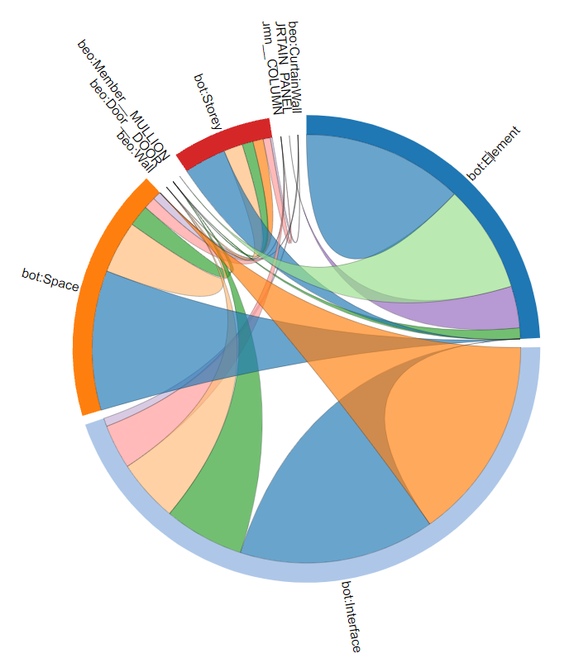
Output graph statistics
137,255 statements
136,759 explicit
496 inferred
3,263 BOT Elements
3,068 BOT Interfaces
157 BOT Spaces
32 BEO CurtainWalls
285 BEO Walls
5,776 GEOM asWKT statements

Slide 16
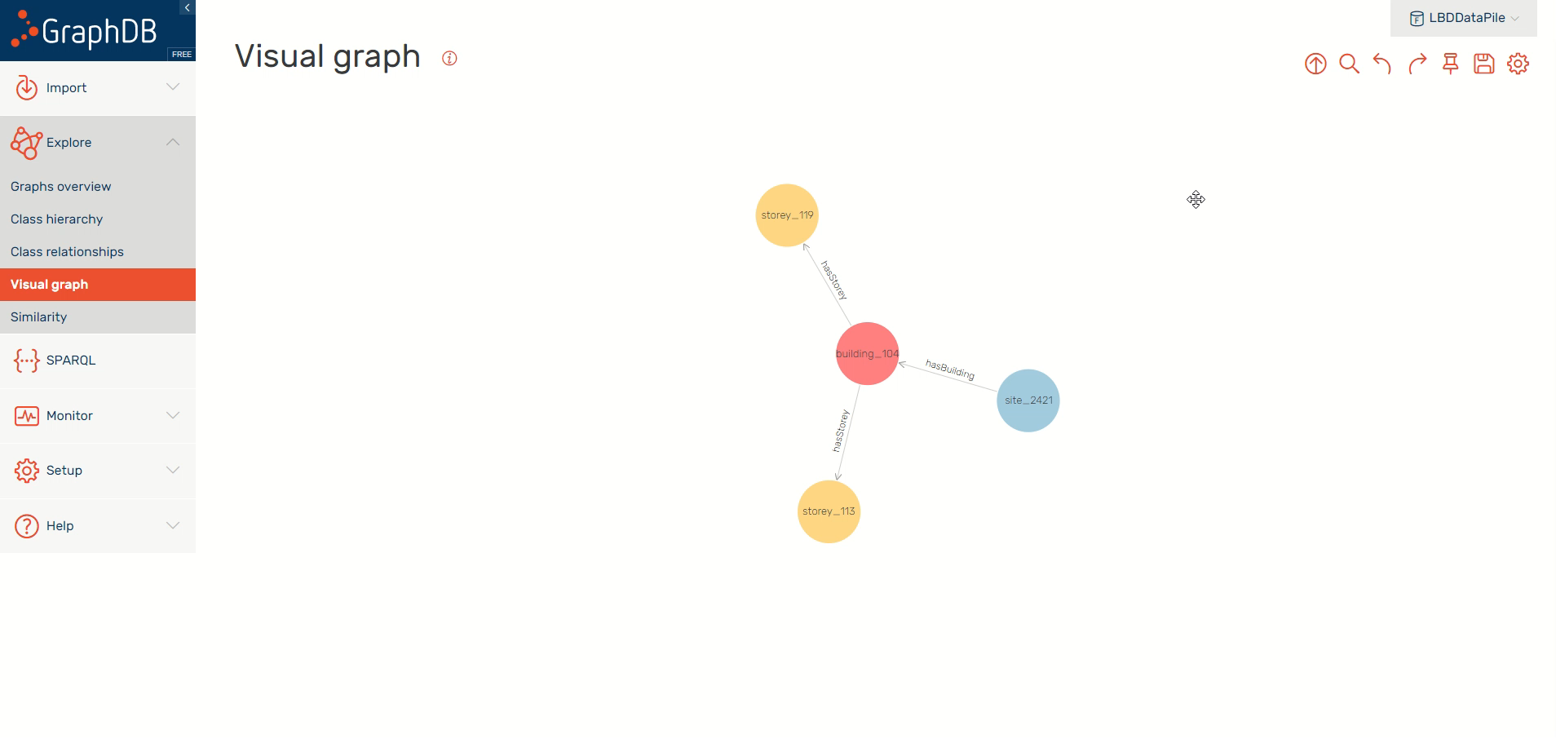

Slide 17
Outline
Introduction: Robot Navigation and Digital Twins?
The building model: Atlas floor 8 and 9
Creating a topological and metric map
Navigation tests
Conclusion

Slide 18
Topological and metric map for path planning
A topological map abstracts metric information and represents, in a bidirectional undirected graph (unlike the RDF graphs), how spaces are connected to each other.
A metric map includes all metric information needed for path planning
Topological map
Metric map

Slide 19
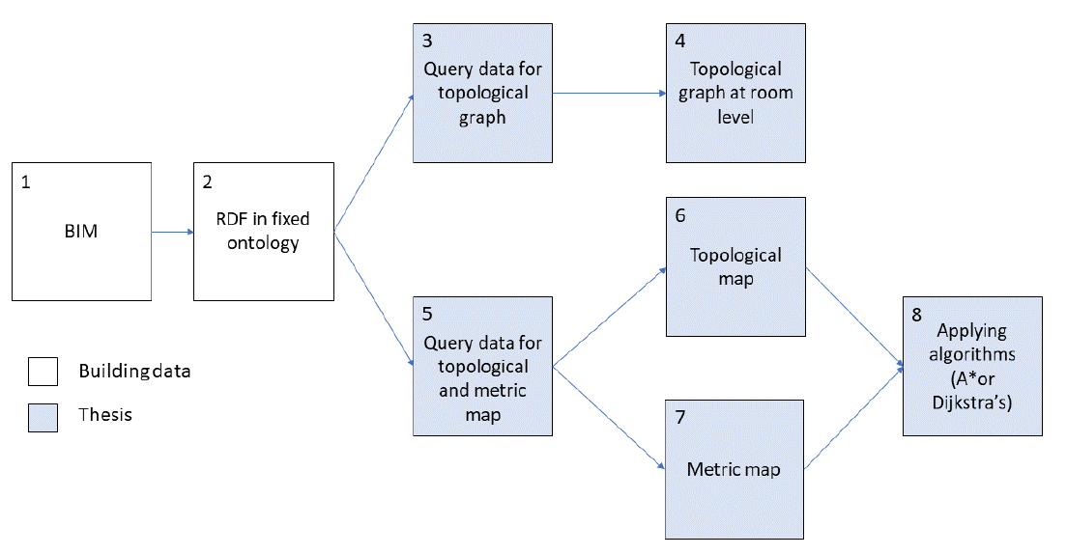
Method for creating environmental map
Key queries obtain the data from the building digital twin data
Data is parsed
A topological map is constructed based on features in the data (queries)
A metric map is constructed using the WKT data (reconstructed 2D floor plan)
Weights are calculated to store the difficulty of moving from one space to the other

Slide 20
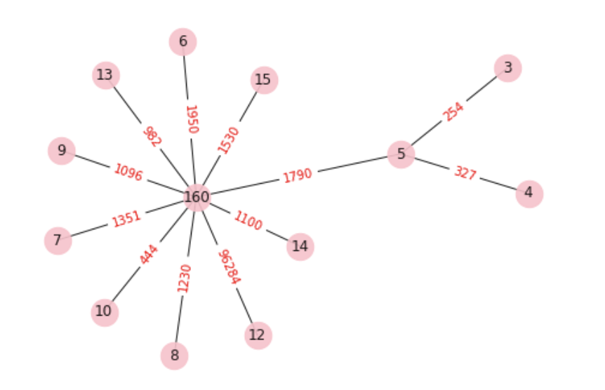
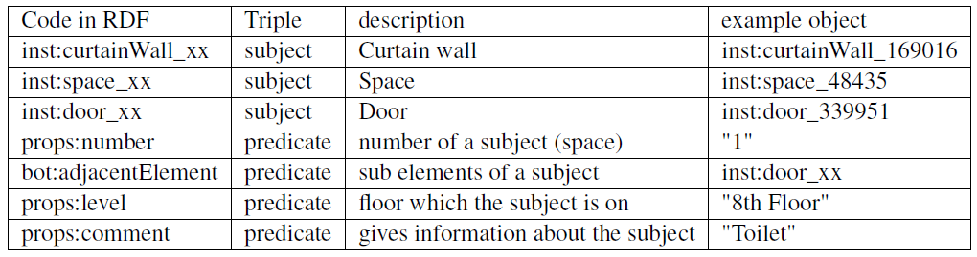
Querying for adjoining spaces and their interfaces
SELECT DISTINCT ?spaceX ?spaceY ?WKTdoor
WHERE{
# Find a space on floor 8, with an adjacent
# door and the space number
?space_a1 props:level "8th Floor".
?space_a1 bot:adjacentElement ?E_door.
?space_a1 props:number ?spaceX.
?E_door props:category "Doors".
# Find the interface of the door.
?interface a bot:Interface.
?interface bot:interfaceOf ?E_door.
?interface geom:asWKT ?WKTdoor.
# Find a space on floor 8, with the same
# adjacent door and the space number
?space_a2 bot:adjacentElement ?E_door.
?space_a2 props:level "8th Floor".
?space_a2 props:number ?spaceY.
FILTER (!SAMETERM(?space_a1 ,?space_a2 )).
}
Data useful for constructing a topological map

Slide 21
Floor map reconstruction
WKT strings and semantically defined data is used to create a floor map (= metric map)
SPARQL queries to retrieve interfaces between spaces and elements (walls, doors, windows, curtainwalls)
Collection and parsing of data
Drawing metric map
SELECT DISTINCT ?space ?WKTWall
WHERE{
?space props:level "8th Floor".
?interface a bot:Interface.
?interface bot:interfaceOf ?space, ?object.
?object a beo:Wall.
?interface geom:asWKT ?WKTWall.
}

Slide 22
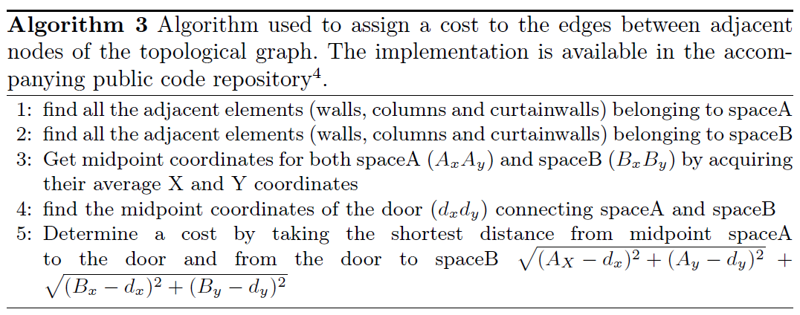
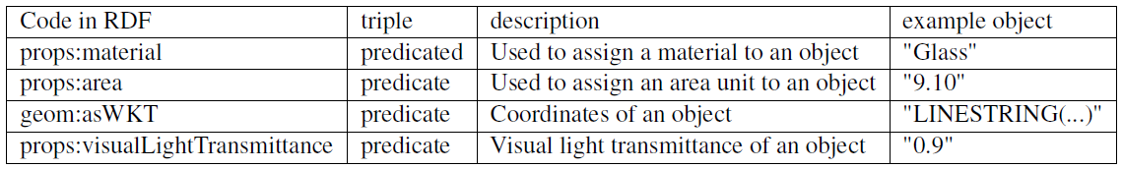

Assigning cost to travel over edges
Data useful for calculating cost of room transitions

Slide 23
Outline
Introduction: Robot Navigation and Digital Twins?
The building model: Atlas floor 8 and 9
Creating a topological and metric map
Navigation tests
Conclusion

Slide 24
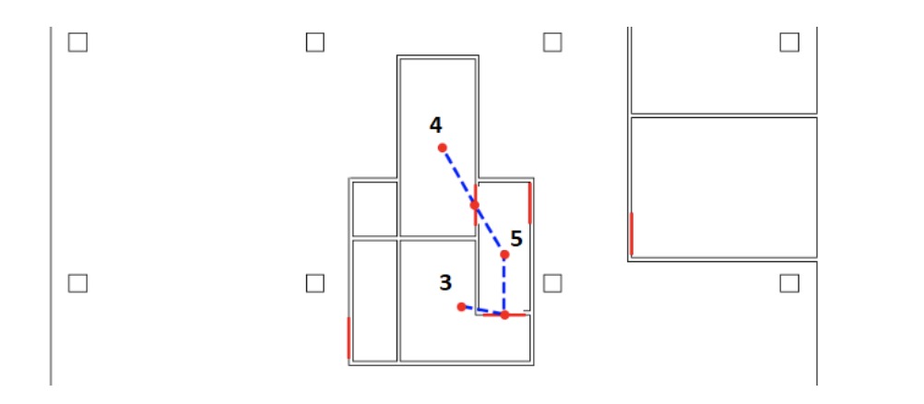
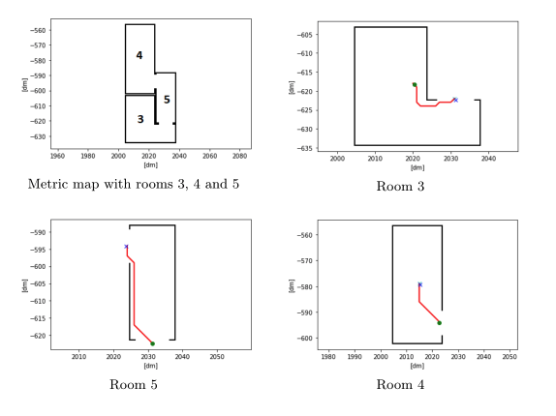
Evaluation
Determine the path to navigate from room 3 to room 4. Topological map is used to define sequence of rooms. Metric map is used to generate a path within each room.
Sequence of rooms
Desired path per room
A* Algorithm

Slide 25
Outline
Introduction: Robot Navigation and Digital Twins?
The building model: Atlas floor 8 and 9
Creating a topological and metric map
Navigation tests
Conclusion

Slide 26
Conclusion: main contributions
Workflow from BIM tool to Digital Twin to Robot Navigation
Environmental map:
  We presented queries to extract topological and metric maps from a building digital twin automatically populated with data from a BIM model
  We used the derived maps to compute optimal paths for robot navigation
Tests performed show good results

Slide 27
Conclusion: future work
Mismatches between the model and reality are to be expected. Robots are potentially able to check and update the building digital twin.
The semantic data of the building digital twin can be further used for humans’ intention prediction or to treat the navigation problem at a higher semantic level.
Providing and following BIM-specific modelling guidelines will significantly reduce the effort to export the data to the building digital twin

Slide 28
Thank you
Queries on Semantic Building Digital Twins for Robot Navigation
Questions?:
Pieter Pauwels, p.pauwels@tue.nl
Elena Torta, e.torta@tue.nl
Rens de Koning¹, Elena Torta¹, Pieter Pauwels², Bob Hendrikx¹ and René van de Molengraft¹
¹ Faculty of Mechanical Engineering, ² Faculty of Built Environment

