Slide 1
Ontology approach for LOD-sensitive BIM-data management Janakiram Karlapudi, Prathap Valluru, Karsten Menzel
Janakiram Karlapudi, MSc.
Institute of Construction Informatics, TU Dresden, 01069 Dresden, Germany
source: ontotext
CIBW78 - LDAC 2021 Conference
Presented in Linked Data in Architecture and Construction (LDAC 2021), Luxembourg
11-15 October 2021

Slide 2
Contents
Contents
Introduction & Background
Ontology approach
Demonstration
Validation
Conclusion & Futurework

Slide 3
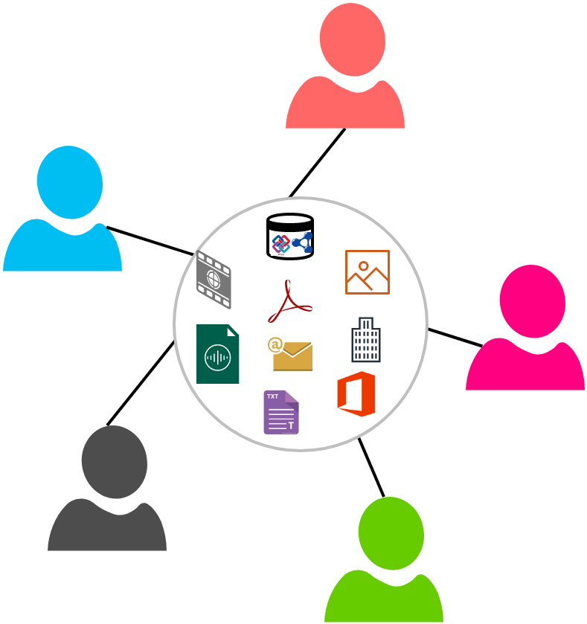
Introduction
The AEC industry is a collaborative environment
involves multiple disciplines and
activities throughout the Building Lifecycle Stages (BLS).
The collaboration
requires
an iterative and cooperated exchange of information;
enables
needed information for a specific discipline;
restricting the information exchange to the identified level of need;
substantially, improves the building design over BLS.
The technical developments in the BIM process
improve the collaboration through;
definition of discipline-based process maps;
information requirements for their execution

Slide 4
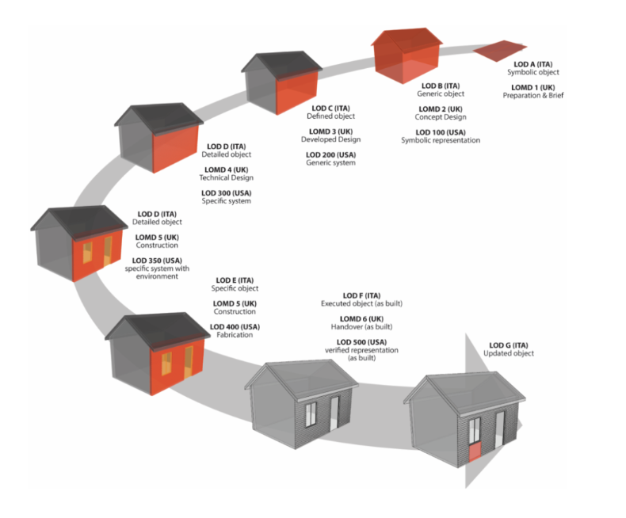
Introduction
LOD concepts to the BIM process
required level of data export or import parameters
increase the quality and reliability of the BIM data
allows the stakeholder to understand the usability and limitation of the available information
source: https://rebim.io/level-of-detail-or-development-lod-in-bim/
Country | LOD means | Subtype | Scale
USA | Level of Development | LOD: As Designed | LOD 100, LOD 200, LOD 300, LOD 350, LOD 400
 |  | LOD: As Built | LOD 500
UK | Level of Definition | LOD: Level of Detail | LOD 1, LOD 2, LOD 3, LOD 4, LOD 5, LOD 6
 |  | LOI: Level of Information | LOI 1, LOI 2, LOI 3, LOI 4, LOI 5, LOI 6
Italy | Level of Development of Objects | LOG – Geometrical Objects | LOG A, LOG B, LOG C, LOG D, LOG E, LOG F, LOG G
 |  | LOI – Information Objects | LOI A, LOI B, LOI C, LOI D, LOI E, LOI F, LOI G

Slide 5
Motivation
Lack of an approach for
flexible definition of data requirements at certain LOD levels based on the project needs,
addressing the diverse LOD systems (USA, UK, Italy, etc.).
Versitality of data requirements needed for a specific process
is also not allowed to specify a specific LOD level for a BIM model
To develop a common and flexible LOD approach that can
accommodate different LOD systems in BIM data management
allows different practitioners and organizations to work under a common platform irrespective of project, location and requirements.
also aimed to enable the user-based or project-based requirement specification for each LOD level.

Slide 6
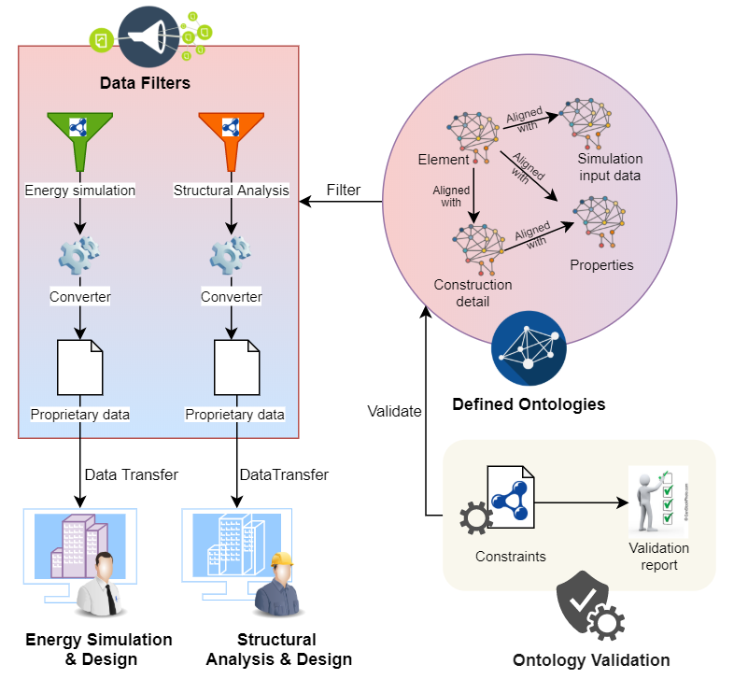
Related Research – Ontology approach
Linked data and ontology concepts
flexibility, compliance and alignment
logical reasoning and knowledge inferencing.
Representation of building data in ontologies enables the stakeholders
to store the data in machine interpretable manner
Infering the new information using axioms
This ontological approach is also easily adaptable and applicable to the present BIM process
BOT, ifcOWL, etc.

Slide 7
Related Research – Information management
In the area of information management, the support for LODs centers around the challenge to represent
(1) various LOD systems,
(2) multiple versions of information
(3) the connections of LOD-specific data to processes.
LOD framework | LOD sensitive BIM data | LOD framework to processes
CQ1 - What is the relation between the LOD sub-type to the LOD scale? | CQ4 - What is the value for the object properties in previous levels? | CQ5 - From which source the value of “Wall width” is extracted?
CQ2 – How do LOD levels (LOD scale) are related to each other?
 |  | CQ6 - What level of properties are required for a specific activity?
CQ3 - How do LOD scales are defined based on the LOD system?

Slide 8
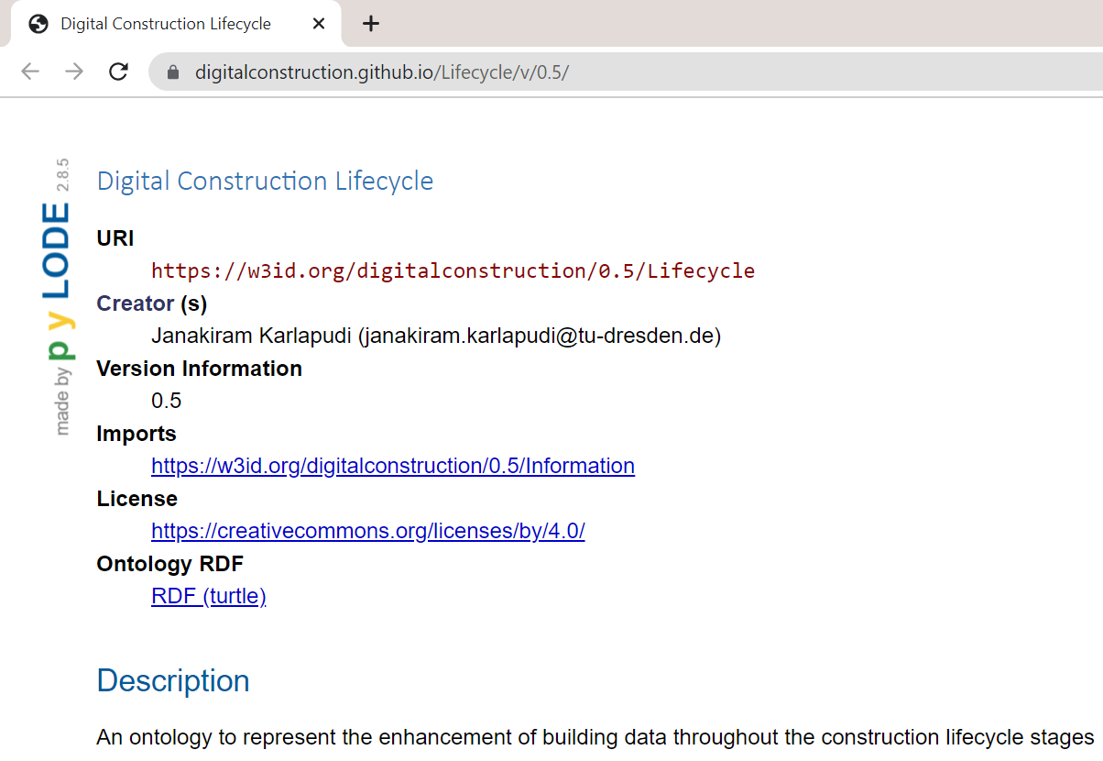
Ontology Specifications
Digital Construction Lifecycle Ontology
Prefix:-
dicl
https://w3id.org/digitalconstruction/0.5/Lifecycle#
Gihub repository:-
https://digitalconstruction.github.io/Lifecycle/v/0.5/
other BIM4EEB ontologies:
dice – digital construction entities
dicv – digital construction variable
dicp – digital construction process
dici – digital construction information
https://digitalconstruction.github.io/v/0.5/index.htm

Slide 9
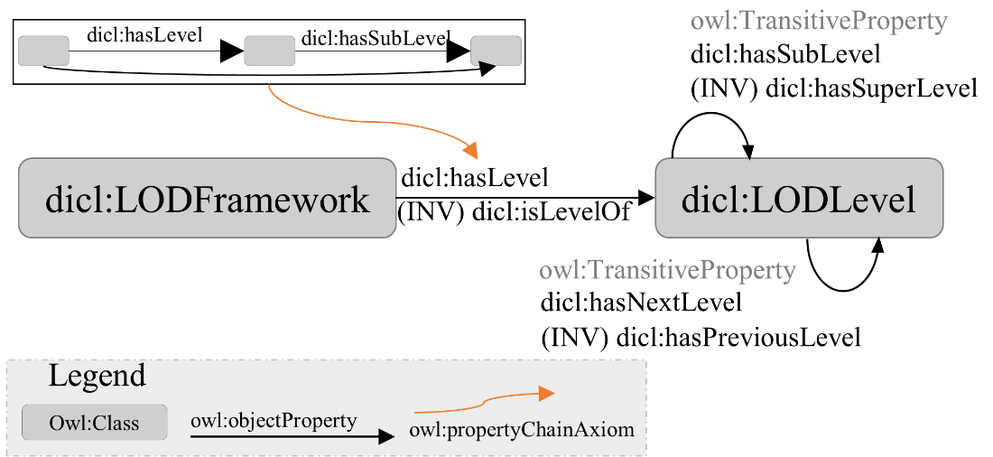
Ontology-based LOD representation
Methodological ontology schema
different LOD systems
Aim:
accommodate the different standards of representations

Slide 10
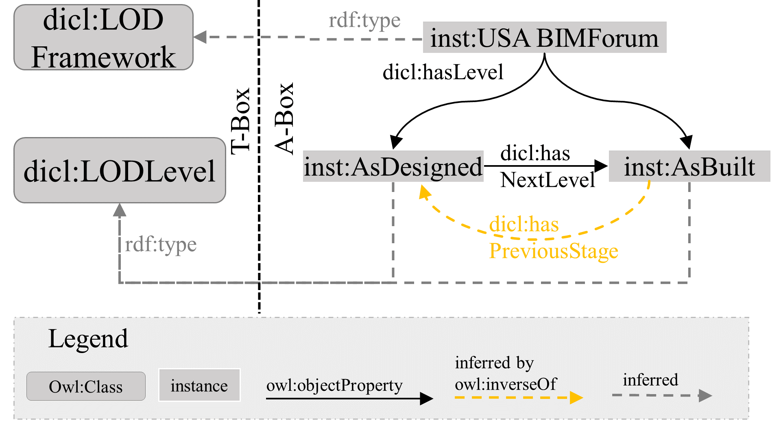
Initial Demonstration
For a clear understanding of the ontological schema functionality
a demonstration is considered.
This is based on BIMForum LOD framework.
Country | LOD means | Subtype | Scale
USA | Level of Development | LOD: As Designed | LOD 100, LOD 200, LOD 300, LOD 350, LOD 400
 |  | LOD: As Built | LOD 500

Slide 11
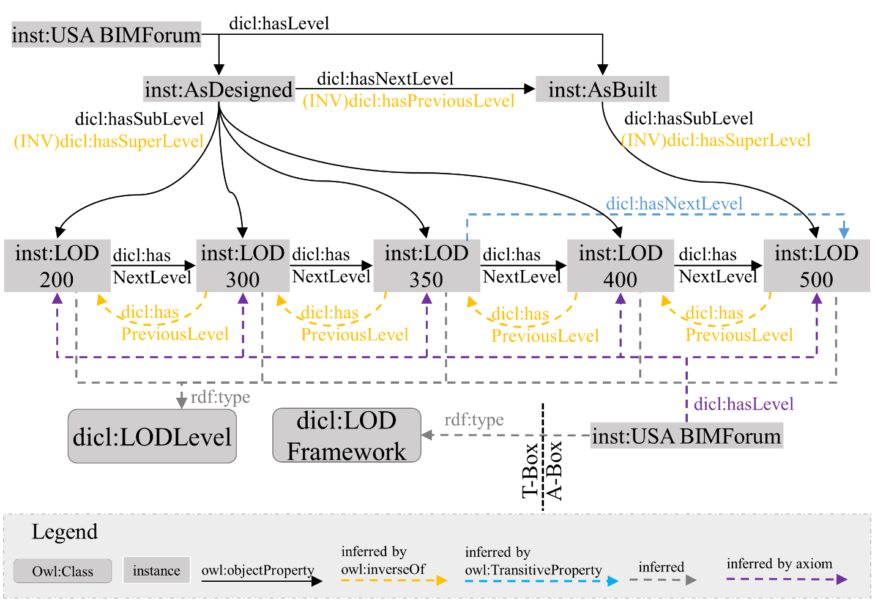
Initial Demonstration
Country | LOD means | Subtype | Scale
USA | Level of Development | LOD: As Designed | LOD 100, LOD 200, LOD 300, LOD 350, LOD 400
 |  | LOD: As Built | LOD 500

Slide 12
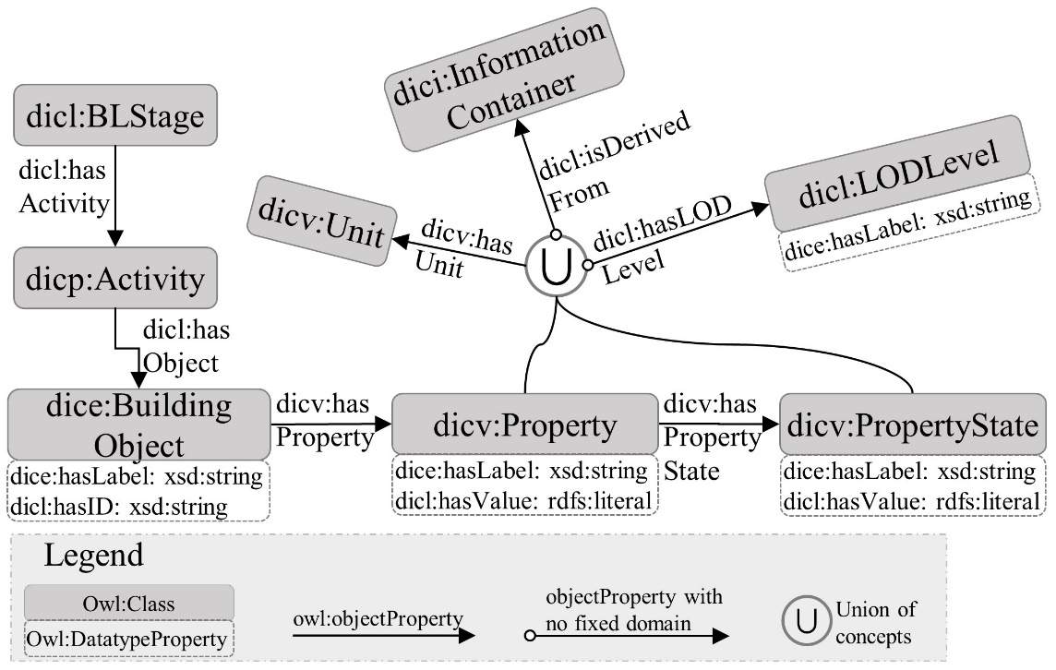
BIM Data Representation and Management
Building data in a LOD-sensitive manner
Identifiers of objects are not LOD sensitive, but
All properties of objects can be LOD sensitive

Slide 13
Demonstration

Slide 14
Basic Validation
Query 1:- What are the LOD scale for USA Level of Development (LOD) system?
SPARQL Profile | Query Results
SELECT ?System ?Sub_type ?Scale Where { ? System dicl:hasLevel ?Sub_type . ?Sub_type dicl:hasSubLevel ?Scale . FILTER(?System =inst:USA_BIMForum). } | ?System | ?Sub_type | ?Scale
 | USA_BIMForum | AsDesigned | LOD200
 | USA_BIMForum | AsDesigned | LOD300
 | USA_BIMForum | AsDesigned | LOD350
 | USA_BIMForum | AsDesigned | LOD400
 | USA_BIMForum | AsBuilt | LOD500
Query 2:- What is the relationship between LOD200 and LOD500?
SPARQL Profile | Query Results
SELECT ?Level1 ?relation ?Level2 Where { ?Level1 ?relation ?Level2 . FILTER(?Level1=inst:LOD200 && ?Level2=inst:LOD500) } | ?Level1 | ?relation | ?Level2
 | LOD200 | dicl:hasNextLevel | LOD500

Slide 15
Basic Validation
Query 3:- What is the relationship between the USA LOD system and LOD Scale?
SPARQL Profile | Query Results
SELECT ?System ?relationship ?Scale Where { ?System dicl:hasLevel ?Sub_type . ?Sub_type dicl:hasSubLevel ?Scale . ?System ?realtionship ?Scale . FILTER(?System=inst:USA_BIMForum) . } | ?System | ?relationship | ?Scale
 | USA_BIMForum | dicl:hasLevel | LOD200
 | USA_BIMForum | dicl:hasLevel | LOD300
 | USA_BIMForum | dicl:hasLevel | LOD350
 | USA_BIMForum | dicl:hasLevel | LOD400
 | USA_BIMForum | dicl:hasLevel | LOD500
Query 4:- What is the value of “Wall width” in different LOD levels?
SPARQL Profile | Query Results
SELECT ?Wall ?Width ?Level Where { ?Object dice:hasLabel ?Wall . ?Object dicv:hasProperty/dicv:hasPropertyState ?PS . ?PS dicv:hasValue ?Width . ?PS dicl:hasLODLevel ?Level . } | ?Wall | ?Width | ?Level
 | BasicWall:500+.. | 352 | LOD300
 | BasicWall:500+.. | 348 | LOD350

Slide 16
Conclusion
The paper presents an ontological approach for effective representation of various LOD systems and their corresponding levels through the demonstration example.
With the defined and inherited knowledge capabilities of the developed ontology approach evidently represents:
its applicability and
functionalities representing the BIM data in different LOD levels.
The ontological representation of the LOD sensitive data not only allows the users to access and work inside one specific LOD but enable
to access the history of values,
to check the consistency and possible deviations between objects at different LODs,
to maintain the rules for validating it against the requirements of subsequent activities.

Slide 17
Future Work
Development of project based application use cases
to increase the practical value of the ontology
validation of required BIM data in the context of different LOD levels using SHACL constraints
extension of the methodology corresponding to the representation and management of building object’s geometrical data

Slide 18
References
Abualdenien, J., Borrmann, A.: Multi-LOD model for describing uncertainty and checking requirements in different design stages. In: Karlshøj, J., Scherer, R. (eds.) eWork and eBusiness in Architecture, Engineering and Construction, pp. 187–195. CRC Press. London (2018).
Abualdenien, J., Borrmann, A.: A meta-model approach for formal specification and consistent management of multi-LOD building models. Advanced Engineering Informatics 40(4), pp. 135–153 (2019).
Karlapudi, J., Menzel, K., Törmä, S., Hryshchenko, A., and Valluru, P. (2020). "Enhancement of BIM Data Representation in Product-Process Modelling for Building Renovation." Product Lifecycle Management Enabling Smart: 17th ifip wg 5.1, F. Nyffenegger, J. Ríos, L. Rivest, and A. Bouras, eds., Springer, [S.l.], 738–752.
Xu, Z., Abualdenien, J., Liu, H., Kang, R.: An IDM-Based Approach for Information Requirement in Prefabricated Construction. Advances in Civil Engineering 2020, pp. 1–21 (2020).
Pauwels, P., Zhang, S., and Lee, Y.-C. (2017). "Semantic web technologies in AEC industry: A literature overview." Automation in Construction, 73, 145–165.
BIMFORUM: Level of Development (LOD) Specification Part I & Commentary - For Building Information Models and Data (2020). BIMFORUM.
PAS 1192-2: Specification for information management for the capital/delivery phase of construction pro-jects using building information modelling (2013). BSI Standards Limited.
UNI 11337-4: Building and civil engineering works – Digital management of building information process – Part 4: Evolution and development of information within models documents and objects (2017).

Slide 19
Acknowledgement
This research is part of the EU project entitled “BIM4EEB – BIM-based fast toolkit for the Efficient rEnovation in Buildings”
This project is supported and funded by European Union’s H2020 research and innovation program under grant agreement No 820660.
The authors gratefully acknowledge the support and funding from the European Union.
The content of this publication reflects the author view only and the Commission is not responsible for any use that may be made of the information it contains.

Slide 20
Thank you so much for your kind attention!
Janakiram Karlapudi, MSc (janakiram.karlapudi@tu-dresden.de)
Institute for Construction Informatics, TU Dresden, 01069 Dresden, Germany
CIBW78 - LDAC 2021 Conference
Presented in Linked Data in Architecture and Construction (LDAC 2021), Luxembourg
11-15 October 2021

