Slide 1
Interoperability between BIM and GIS through open data standards: An overview of current literature
Eyosias Guyo^{1,2}, Timo Hartmann¹, Lucian Ungureanu¹
1. Technische Universität Berlin, Berlin, Germany
2. Trimble Solutions Oy, Espoo, Finland
CIB W78 - LDAC 2021 Joint Conference
11-15 October 2021, Luxembourg
This work was supported by the CBIM-ETN funded by the European Union’s Horizon 2020 research and innovation programme under the Marie Skłodowska-Curie grant agreement No 860555.

Slide 2
Introduction
Construction and operation of buildings influence their environment
Environmental aspects affect the planning, construction and operation of buildings.

Slide 3
Introduction
BIM allows representation of data regarding all building elements.
GIS allows representation of spatial data regarding a certain environment including buildings
BIM
GIS

Slide 4
Introduction
Cooperation between BIM & GIS is important to manage the built environment.

Slide 5
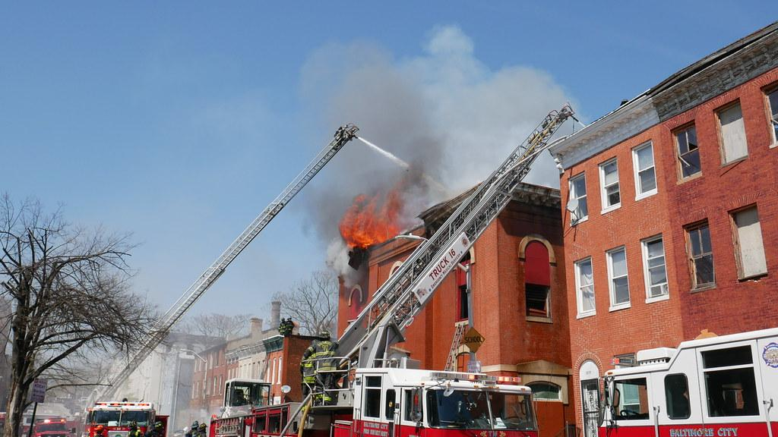
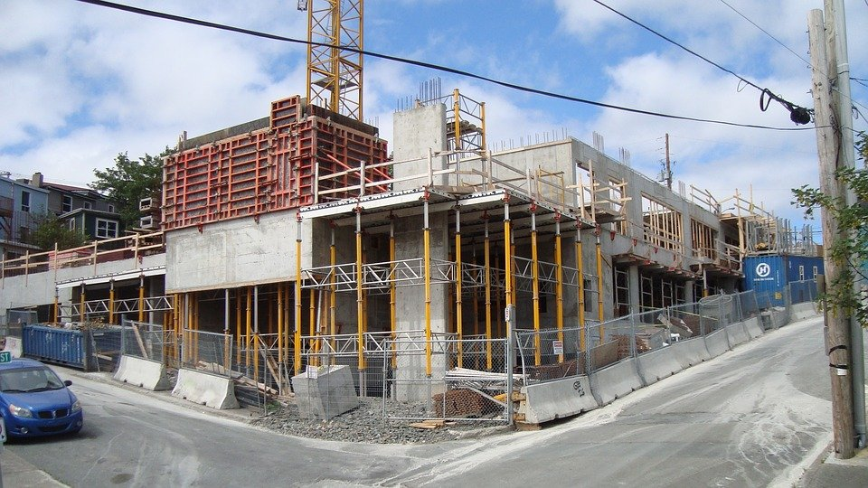
Use Cases
Building emergency management
(Amirebrahimi et al., 2015)
(Tashakkori et al., 2015)
(El-Mekawy et al., 2012)
Urban design
(El-Mekawy et al., 2012)
(Jusuf et al., 2017)
(Wang et al., 2019)
Monitoring construction activities
(Irizarry et al., 2013)
(Wang et al., 2019)

Slide 6
Introduction
BIM & GIS have significant differences
Original purpose
Data structure,
Geometry representation,
Level of development,
Coordinate system they use

Slide 7
Introduction
3 Levels of BIM / GIS integration (Amirebrahimi et al., 2015)
Application level integration
Process level integration
Data level integration (Interoperability through (open) data standards)

Slide 8
Introduction
The objective of this paper:
Investigate previous BIM / GIS interoperability approaches
Determine approaches with the most potential to improve interoperability
Identify challenges and future research directions

Slide 9
Working definition of Interoperability
Define interoperability based on:
IEEE Standard Glossary of Software Engineering Terminology (IEEE , 1990)
Information Technology – Vocabulary (ISO/IEC, 2015)

Slide 10
Working definition of Interoperability
Interoperability: “The ability of two or more systems or components to exchange information and to use the information that has been exchanged”.
Integration: “The process of combining software components, hardware components, or both into an overall system”.
Conversion: “Modification of existing software to enable it to operate with similar functional capability in a different environment”.
Interoperability: The capability to communicate, or exchange data between different functional units in a manner that demands the user to have little or no knowledge regarding each unit.
Integration: “progressive assembling of system components into the whole system”
Conversion: Changing “the representation of data from one form to another, without changing the information conveyed”.
IEEE
ISO/IEC

Slide 11
Working definition of Interoperability
It is not conversion or modification of data representation
It is not combining or assembling data models into one
It is the ability to communicate and exchange information between different tools and use the information exchanged.

Slide 12
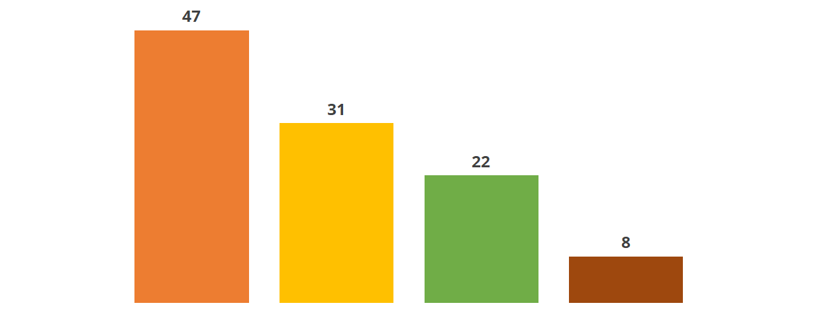
Interoperability through open data standards
Open data standards were selected by running a term co-occurrence analysis.
CityGML
IFC
IndoorGML
LandInfra

Slide 13
© Ordnance Survey Limited 2021
No single open data standard can support all data exchange from BIM and GIS.

Slide 14
Connecting BIM and GIS data standards
Researchers have been attempting to overlap or connect open data standards with one another
Data standard conversion
Data standard integration
Linked data approach

Slide 15
Data Standard Conversion
Convert one data standard into another
IFC & CityGML
IFC
CityGML

Slide 16
Data Standard Conversion
de Laat & van Berlo (2011)
Unidirectional conversion of geometry and semantic information from IFC to CityGML
Deng et al. (2016)
Bidirectional exchange of geometrical information between IFC and CityGML
Unidirectional transformation of semantic information from IFC to CityGML
Both studies created new CityGML extensions (ADEs)

Slide 17
Data Standard Conversion
Donkers et al. (2016)
Unidirectional conversion to convert geometric and semantic information from IFC to CityGML LOD3
Teo & Yu (2017)
Extract indoor building information from IFC into IndoorGML

Slide 18
Data Standard Conversion
Some commercial software tools provide data conversion services.
Feature Manipulation Engine (FME)
Yu & Teo (2014) and Jusuf et al. (2017)
ArcGIS and its data interoperability extension
Amirebrahimi et al. (2015) and Tashakkori et al., (2015)

Slide 19
Data Standard Conversion
Unidirectional conversion neglects the other half of the information exchange
The process alters and modifies the original data model.
Outputs are not always supported by the target software tools.
Therefore, these studies fall short of meeting the requirements of interoperability.

Slide 20
2. Data Standard Integration
Integrate both BIM and GIS data into a single unified model or database.
IFC & CityGML
IFC
CityGML
IFC + CityGML

Slide 21
2. Data Standard Integration
El-Mekawy et al. (2012)
Unified building model (UBM) where all classes and concepts from IFC and CityGML would be aggregated.
Implement using ArcGIS
Wyszomirski & Gotlib (2020)
Combine data from IFC and CityGML models and store it in a single database.

Slide 22
2. Data Standard Integration
Reduce data loss by integrating IFC and CityGML data standards together instead of converting.
Data ownership and intellectual property rights issues.
The proposed methods favor GIS tools.
Therefore, do not sufficiently satisfy the requirements of interoperability.

Slide 23
3. Linked data approach
Linked data approaches to link BIM and GIS data standards.
IFC & CityGML
IFC
CityGML

Slide 24
3. Linked data approach
Linked data approaches to link BIM and GIS data standards.
IFC & CityGML
Semantic web technologies
IFC
(OWL)
(OWL)
CityGML

Slide 25
3. Linked data approach
Karan et al. (2016)
Developed an ontological representation of IFC and linked that to selected existing GIS ontologies.
Using SPARQL, information could be retrieved from the combined dataset.
ifcXML - BIM tools.
CSV - GIS tools.
Use case: monitoring construction supply chain

Slide 26
3. Linked data approach
Vilgertshofer et al. (2017)
Converting IFC and CityGML into web ontology language (OWL)
Establishing a link between them.
Used SPARQL to query data from IFC and CityGML.
Use case: Tunnel model
Hor et al. (2018)
Developed a semantic graph database framework using IFC and CityGML

Slide 27
3. Linked data approach
Original data remained unchanged.
Only selected data was transferred instead of all the data.
Results could be created in formats that can be used by both BIM and GIS tools.
These characteristics make the linked data approaches exceedingly favorable for interoperability.

Slide 28
3. Linked data approach
The technologies require some understanding of graph mathematics, graph databases structure and related tools
Ontologies developed by multidisciplinary professionals may lead to inconsistency.

Slide 29
3. Linked data approach
IFC schema is available in OWL ontology (ifcOWL)
Geospatial data can also be represented in the semantic web using standards such as GeoSPARQL and stRDF.

Slide 30
Summary
Definition of interoperability
Open data standards from BIM and GIS
Approaches to align open data standards
Data standard conversion
Data standard integration
Linked data approach
The use of linked data methods was identified as a promising approach to improve interoperability.

Slide 31
Future Direction
Wider discussion of interoperability.
Investigate more methods of interoperability.

Slide 32
References
1. Pauwels, P. and Terkaj, W., EXPRESS to OWL for construction industry: Towards a recommendable and usable ifcOWL ontology, Autom. Constr., vol. 63, pp. 100–133, (2016), doi: 10.1016/j.autcon.2015.12.003.
2. Wyszomirski, M. and Gotlib, D., A Unified Database Solution to Process BIM and GIS Data, Appl. Sci., vol. 10, no. 23, (2020), doi: 10.3390/app10238518.
3. Wang, H., Pan, Y., and Luo, X., Integration of BIM and GIS in sustainable built environment: A review and bibliometric analysis, Automation in Construction, vol. 103. Elsevier B.V., pp. 41–52, (Jul. 01, 2019), doi: 10.1016/j.autcon.2019.03.005.
4. Zhu, J., Wright, G., Wang, J., and Wang, X., A Critical Review of the Integration of Geographic Information System and Building Information Modelling at the Data Level, ISPRS Int. J. Geo-Information, vol. 7, no. 2: 66, (2018), doi: 10.3390/ijgi7020066.
5. Irizarry, J., Karan, E. P., and Jalaei, F., Integrating BIM and GIS to improve the visual monitoring of construction supply chain management, Autom. Constr., vol. 31, pp. 241–254, (2013), doi: 10.1016/j.autcon.2012.12.005.
6. Amirebrahimi, S., Rajabifard, A., Mendis, P., and Ngo, T., A data model for integrating GIS and BIM for assessment and 3D visualisation of flood damage to building, in CEUR Workshop Proceedings, (2015), vol. 1323, pp. 78–89.
7. Tashakkori, H., Rajabifard, A., and Kalantari, M., A new 3D indoor/outdoor spatial model for indoor emergency response facilitation, Build. Environ., vol. 89, pp. 170–182, (2015), doi: 10.1016/j.buildenv.2015.02.036.
8. El-Mekawy, M., Östman, A., and Hijazi, I., A unified building model for 3D urban GIS, ISPRS Int. J. Geo-Information, vol. 1, no. 2, pp. 120–145, (2012), doi: 10.3390/ijgi1020120.
9. Jusuf, S., Mousseau, B., Godfroid, G., and Soh, J., Path to an Integrated Modelling between IFC and CityGML for Neighborhood Scale Modelling, Urban Sci., vol. 1, no. 3: 25, (2017), doi: 10.3390/urbansci1030025.
10. Karan, E. P., Irizarry, J., and Haymaker, J., BIM and GIS Integration and Interoperability Based on Semantic Web Technology, J. Comput. Civ. Eng., vol. 30, no. 3, (2016), doi: 10.1061/(asce)cp.1943-5487.0000519.

Slide 33
References
11. Herle, S., Becker, R., Wollenberg, R., and Blankenbach, J., GIM and BIM: How to Obtain Interoperability Between Geospatial and Building Information Modelling?, PFG - J. Photogramm. Remote Sens. Geoinf. Sci., vol. 88, no. 1, pp. 33–42, (2020), doi: 10.1007/s41064-020-00090-4.
12. International Organization for Standardization, Advanced automation technologies and their applications — Requirements for establishing manufacturing enterprise process interoperability — Part 1: Framework for enterprise interoperability (ISO 11354-1:2011). (2011).
13. The Institute of Electrical and Electronics Engineers (IEEE), IEEE Standard Glossary of Software Engineering Terminology. (1990).
14. International Organization for Standardization (ISO), ISO/IEC 2382:2015 Information technology — Vocabulary, 1st ed. (2015).
15. International Organization for Standardization (ISO), ISO/IEC 19941:2017 Information technology — Cloud computing — Interoperability and portability. (2017).
16. Laakso, M. and Kiviniemi, A., The IFC standard - A review of history, development, and standardization, J. Inf. Technol. Constr., vol. 17, pp. 134–161, (2012).
17. Vilgertshofer, S., Amann, J., Willenborg, B., Borrmann, A., and Kolbe, T. H., Linking BIM and GIS models in infrastructure by example of IFC and CityGML, in ASCE International Workshop on Computing in Civil Engineering 2017, (2017), pp. 133–140, doi: 10.1061/9780784480823.017.
18. Open Geospatial Consortium, OpenGIS City Geography Markup Language (CityGML) Encoding Standard, Version 2.0.0. (2012).
19. Biljecki, F., Kumar, K., and Nagel, C., CityGML Application Domain Extension (ADE): overview of developments, Open Geospatial Data, Softw. Stand., vol. 3, no. 1: 13, (2018), doi: 10.1186/s40965-018-0055-6.
20. de Laat, R. and van Berlo, L., Integration of BIM and GIS: The Development of the CityGML GeoBIM Extension, (2011), pp. 211–225.
21. Deng, Y., Cheng, J. C. P., and Anumba, C., Mapping between BIM and 3D GIS in different levels of detail using schema mediation and instance comparison, Autom. Constr., vol. 67, pp. 1–21, (2016), doi: 10.1016/j.autcon.2016.03.006.
22. Gröger, G. and Plümer, L., CityGML - Interoperable semantic 3D city models, ISPRS Journal of Photogrammetry and Remote Sensing, vol. 71. pp. 12–33, (Jul. 2012), doi: 10.1016/j.isprsjprs.2012.04.004.

Slide 34
References
23. International Organization for Standardization (ISO), ISO 16739-1:2018 Industry Foundation Classes (IFC) for data sharing in the construction and facility management industries — Part 1: Data schema. (2018).
24. Pauwels, P., Zhang, S., and Lee, Y.-C., Semantic web technologies in AEC industry: A literature overview, Autom. Constr., vol. 73, pp. 145–165, (2017), doi: 10.1016/j.autcon.2016.10.003.
25. Open Geospatial Consortium, OGC ® IndoorGML 1.1. (2020).
26. Kim, J. S., Yoo, S. J., and Li, K. J., Integrating IndoorGML and CityGML for indoor space, vol. 8470. Springer Verlag, (2014).
27. Srivastava, S., Maheshwari, N., and Rajan, K. S., Towards generating semantically-rich indoorgml data from architectural plans, in International Archives of the Photogrammetry, Remote Sensing and Spatial Information Sciences - ISPRS Archives, (2018), vol. 42, no. 4, pp. 591–595, doi: 10.5194/isprs-archives-XLII-4-591-2018.
28. Kang, H. K. and Li, K. J., A standard indoor spatial data model - OGC IndoorGML and implementation approaches, ISPRS Int. J. Geo-Information, vol. 6, no. 4, (2017), doi: 10.3390/ijgi6040116.
29. Kumar, K., Labetski, A., Ohori, K. A., Ledoux, H., and Stoter, J., Harmonising the OGC standards for the built environment: A CityGML extension for Landinfra, ISPRS Int. J. Geo-Information, vol. 8, no. 6, (2019), doi: 10.3390/ijgi8060246.
30. OGC, OGC ® Land and Infrastructure Conceptual Model Standard (LandInfra). Paul Scarponcini, (2016).
31. Kumar, K., Labetski, A., Ohori, K. A., Ledoux, H., and Stoter, J., The LandInfra standard and its role in solving the BIM-GIS quagmire, Open Geospatial Data, Softw. Stand., vol. 4, no. 1, (2019), doi: 10.1186/s40965-019-0065-z.
32. Gilbert, T. et al., Built environment data standards and their integration: an analysis of IFC, CityGML and LandInfra, (2020). doi: https://www.buildingsmart.org/buildingsmart-international-bsi-and-open-geospatial-consortium-ogc-release-bim-and-gis-integration-paper/.

Slide 35
References
33. Donkers, S., Ledoux, H., Zhao, J., and Stoter, J., Automatic conversion of IFC datasets to geometrically and semantically correct CityGML LOD3 buildings, Trans. GIS, vol. 20, no. 4, pp. 547–569, (2016), doi: 10.1111/tgis.12162.
34. Teo, T. A. and Yu, S. C., The extraction of indoor building information from bim to OGC indoorgml, in International Archives of the Photogrammetry, Remote Sensing and Spatial Information Sciences - ISPRS Archives, (2017), vol. 42, no. 4/W2, pp. 167–170, doi: 10.5194/isprs-archives-XLII-4-W2-167-2017.
35. Yu, S.-C. and Teo, T.-A., The Generalization of Bim/Ifc Model for Multi-Scale 3D Gis/Citygml Models, in Proceedings of the 35th Asian Conference on Remote Sensing, Nay Pyi Taw, Myanmar, (2014), pp. 27–31.
36. Granholm, L. and Törmä, S., Using Linked Data to facilitate smooth and effective workflow in a federated model environment, in Proceedings of the 2019 Workshop on Linked Building Data and Semantic Web Technologies (WLS2019), (2019), pp. 45–52.
37. Hor, A. E. H., Sohn, G., Claudio, P., Jadidi, M., and Afnan, A., A semantic graph database for BIM-GIS integrated information model for an intelligent urban mobility web application, in ISPRS Annals of the Photogrammetry, Remote Sensing and Spatial Information Sciences, (2018), vol. 4, no. 4, pp. 89–96, doi: 10.5194/isprs-annals-IV-4-89-2018.
38. Hitzler, P., Parsia, B., Patel-schneider, P. F., and Rudolph, S., OWL 2 Web Ontology Language Primer, W3C Recommendation, (2012). https://www.w3.org/TR/owl2-primer/.
39. Schreiber, G. and Raimond, Y., RDF 1.1 Primer, W3C Working Group Note 24 June 2014, (2014). https://www.w3.org/TR/rdf11-primer/ (accessed Jul. 22, 2021).
40. Open Geospatial Consortium, OGC GeoSPARQL-A geographic query language for RDF data. (2012).
41. Koubarakis, M. and Kyzirakos, K., Modeling and Querying Metadata in the Semantic Sensor Web: The Model stRDF and the Query Language stSPARQL, in The Semantic Web: Research and Applications, (2010), pp. 425–439.

Slide 36
Thank you!
Eyosias Dawit Guyo
eyosias.guyo@trimble.com

