Slide 1
Real-Time Building Performance Monitoring using Semantic Digital Twins
Alex Donkers – PhD Candidate at Eindhoven University of Technology – a.j.a.donkers@tue.nl
Dujuan Yang, Bauke de Vries, Nico Baken

Slide 2
BSC ARCHITECTURE, URBANISM & BUILDING SCIENCES TU/e
MSC CONSTRUCTION MANAGEMENT & ENGINEERING TU/e
PHD CANDIDATE TU/e x KPN
Bauke de Vries, Nico Baken & Dujuan Yang
linktr.ee/AlexDonkers
in/AlexDonkers
@Alex_Donkers

Slide 3
Virtual representation
(Update
(data)
Update (information)
Indoor environment
Notes:
The talk today focusses on the indoor climate and how the building could improve this climate.
Growing importance
IEQ influences user satisfaction
IEQ influences workplace satisfaction
Influences productivity
Influences student learning performance
Bad IEQ results in health issues, e.g. asthma and increasing short-absence of knowledge workers and Sick Building Syndrome symptoms.

Slide 4
Mean radiant temperature
Background noise level
Relative humidity
Clothing level
Communication privacy
Surface temperature
Air velocity
Reverberation time
Thermal comfort
Weather information
Acoustic comfort
Geometry of rooms and elements
Indoor Environmental Quality
Building topology
Visual comfort
Sociodemographics
Air quality
Glare
Metabolic rate
Natural ventilation
Natural light
Particulate matter
CO2 level
Artificial light
Activity level
Mood
Mechanical ventilation
Visual privacy
Occupant preferences

Slide 5
Mean radiant temperature
Sun intensity
Sun azimuth
Height of the sun
Surface tilt
Surface azimuth
T_{s,3}
$$T_{mr}=\frac{\sum_{i=0}^{n}{(T_{s,i}∗A_{s,i})}}{\sum_{i=0}^{n}{(A_{s,i})}}$$
$$T_{mr}=mean radiant temperature$$
$$T_{s,i}=surface temperature$$
$$A_{s,i}=surface area$$
A_{s,2} *
T_{s,2}
Thermal transmittance
T_{s,5}
T_{s,4}
T_{s,1}
Indoor air temperature
Indoor air velocity
Indoor heat transfer coefficient
Outdoor air temperature
Outdoor air velocity
Outdoor relative humidity
Notes:
To show the complexity of monitoring IEQ:

Slide 6
TOPOLOGY
Rooms
Elements
How they relate to each other
Challenge
STATIC PROPERTIES
Geometry
Material characteristics
Integrate the heterogeneous information related to indoor environmental quality assessments.
DYNAMIC PROPERTIES
Sensor data
Weather data
Notes:
To generalize this, we typically distinguish three data categories.
…
To perform the previous calculation, we would need a homogeneous representation of data.

Slide 7
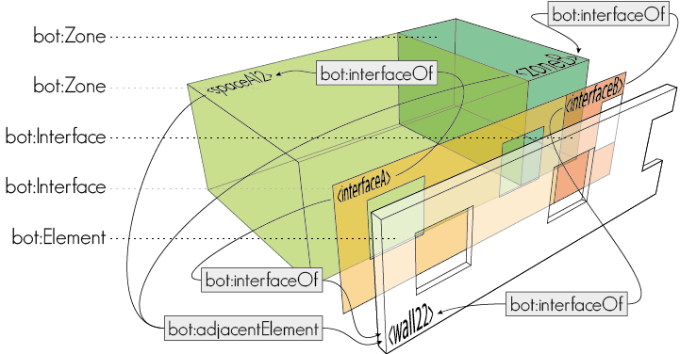
Building Topology Ontology (BOT)

Slide 8
Approaches to describe property values
READ MORE
Tang et al. (2019)
GRAPH DATABASE
GRAPH DATABASE
:Building
:Building
:hasSpace
:hasSpace
:Room
:Room
:hasSensor
:hasSensor
:Sensor01
:observes
:Temperature
:Sensor01
:observes
:Temperature
:timeSeriesReference
“InfluxDB-S01”
:hasResult
:hasResult
:Observation01
:Observation02
:value
:time
:value
:time
TIME-SERIES DATABASE
S01,21,1630575705
S01,21,1630575706
S01,22,1630575709
“21”
“1630575705”
“21”
“1630575706”
Notes:
First approach is good for static properties
Second is better for

Slide 10
Static and dynamic properties
ONTOLOGIES FOR STATIC PROPERTIES
Ontology for Property Management (OPM)
BIM Design Ontology (BIMDO)
Building Product Ontology (BPO)
ONTOLOGIES FOR DYNAMIC PROPERTIES
Semantic Sensor Network Ontology (SSN)
Sensor, Observation, Sample and Actuator (SOSA)
Smart Applications REFerence Ontology (SAREF)
Brick
:FeatureOfInterest
:Sensor
:Property
:Observation
:Property
:PropertyState
Value
:FeatureOfInterest
:Result
Value

Slide 11
Building Performance Ontology
BOP
https://w3id.org/bop
Based on design patterns and best practices of 70 ontologies
Homogeneously describing static and dynamic property values
Implements 4 levels of detail
Versioning of properties
Property sets
Generic upper ontology & use-case specific lower-level ontologies

Slide 12
Building Performance Ontology
UPPER ONTOLOGY
rdfs:subClassOf
owl:ObjectProperty
owl:DatatypeProperty
rdfs:Class
rdfs:Literal
Platform
Class
hosts min 1/
isHostedBy max 1
Literal
implementsProcedure/
implementedBy
hasSubExecutor/
isSubExecutorOf
Procedure
Executor
executesOn/
isExecutedBy
hasExternalDatabase/
isDatabaseOf
Database
usesProcedure/
isUsedFor
executedBy/
performsExecution
Execution
hasExecutedProperty /
hasExecution
Property
containsProperty /
ispartOfPropertySet
PropertySet
hasSubProperty/
isSubPropertyOf
hasFeatureOfInterest/
isFeatureOfInterestOf
hasProperty min 1/
isPropertyOf min 1
FeatureOfInterest
hasResult/
isResultOf
hasComplexProperty/
isComplexPropertyOf
hasPropertyState/
isPropertyStateOf
hasDataPoint/
isDataPointOf
hasSimpleResult max 1
hasSimpleProperty
hasSimplePropertyState
Unit
hasSimpleUnit max 1
Result
hasValue max 1
Value
hasUnit max 1/
isUnitOf
hasID max 1
ID
Unit
DataPoint
prov:generatedAtTime
TimeOfGeneration
Input
Output
UserDefined
^^xsd:dateTime

Slide 13
Building Performance Ontology
SENSOR PATTERN
rdfs:subClassOf
owl:ObjectProperty
owl:DatatypeProperty
rdfs:Class
rdfs:Literal
Platform
Class
hosts min 1/
isHostedBy max 1
Literal
implementsProcedure/
implementedBy
hasSubSensor/
isSubSensorOf
Procedure
Sensor
observes/
isObservedBy
hasExternalDatabase/
isDatabaseOf
Database
usesProcedure/
isUsedFor
observedBy/
performsObservation
Observation
hasObservedProperty /
hasObservation
Property
containsProperty /
ispartOfPropertySet
PropertySet
hasSubProperty/
isSubPropertyOf
hasFeatureOfInterest/
isFeatureOfInterestOf
hasProperty min 1/
isPropertyOf min 1
FeatureOfInterest
hasResult/
isResultOf
hasComplexProperty/
isComplexPropertyOf
hasPropertyState/
isPropertyStateOf
hasDataPoint/
isDataPointOf
hasSimpleResult max 1
hasSimpleProperty
hasSimplePropertyState
Unit
hasSimpleUnit max 1
Result
hasValue max 1
Value
hasUnit max 1/
isUnitOf
hasID max 1
ID
Unit
DataPoint
prov:generatedAtTime
TimeOfGeneration
Input
Output
UserDefined
^^xsd:dateTime

Slide 14
Building Performance Ontology
ACTUATOR PATTERN
rdfs:subClassOf
owl:ObjectProperty
owl:DatatypeProperty
rdfs:Class
rdfs:Literal
Platform
Class
hosts min 1/
isHostedBy max 1
Literal
implementsProcedure/
implementedBy
hasSubActuator/
isSubActuatorOf
Procedure
Actuator
actsOn/
isActuatedBy
hasExternalDatabase/
isDatabaseOf
Database
usesProcedure/
isUsedFor
actuatedBy/
performsActuation
Actuation
hasActuatedProperty /
hasActuation
Property
containsProperty /
ispartOfPropertySet
PropertySet
hasSubProperty/
isSubPropertyOf
hasFeatureOfInterest/
isFeatureOfInterestOf
hasProperty min 1/
isPropertyOf min 1
FeatureOfInterest
hasResult/
isResultOf
hasComplexProperty/
isComplexPropertyOf
hasPropertyState/
isPropertyStateOf
hasDataPoint/
isDataPointOf
hasSimpleResult max 1
hasSimpleProperty
hasSimplePropertyState
Unit
hasSimpleUnit max 1
Result
hasValue max 1
Value
hasUnit max 1/
isUnitOf
hasID max 1
ID
Unit
DataPoint
prov:generatedAtTime
TimeOfGeneration
Input
Output
UserDefined
^^xsd:dateTime

Slide 15
Building Performance Ontology
STATIC PROPERTY PATTERN
rdfs:subClassOf
owl:ObjectProperty
owl:DatatypeProperty
rdfs:Class
rdfs:Literal
Platform
Class
hosts min 1/
isHostedBy max 1
Literal
implementsProcedure/
implementedBy
hasSubExecutor/
isSubExecutorOf
Procedure
Executor
executesOn/
isExecutedBy
hasExternalDatabase/
isDatabaseOf
Database
usesProcedure/
isUsedFor
executedBy/
performsExecution
Execution
hasExecutedProperty /
hasExecution
Property
containsProperty /
ispartOfPropertySet
PropertySet
hasSubProperty/
isSubPropertyOf
hasFeatureOfInterest/
isFeatureOfInterestOf
hasProperty min 1/
isPropertyOf min 1
FeatureOfInterest
hasResult/
isResultOf
hasComplexProperty/
isComplexPropertyOf
hasPropertyState/
isPropertyStateOf
hasDataPoint/
isDataPointOf
hasSimpleResult max 1
hasSimpleProperty
hasSimplePropertyState
Unit
hasSimpleUnit max 1
Result
hasValue max 1
Value
hasUnit max 1/
isUnitOf
hasID max 1
ID
Unit
DataPoint
prov:generatedAtTime
TimeOfGeneration
Input
Output
UserDefined
^^xsd:dateTime

Slide 16
TAKE ME THERE
github.com/AlexDonkers/OpenSmartHome
Open Smart Home
Apartment in Germany
Original dataset by Schneider and Rasmussen http://doi.org/10.5281/zenodo.1244602
Sensor data: temperature, brightness, relative humidity
.ttl in BOP-vocabulary

Slide 17
Convert to linked data
Link to external DB
TOPOLOGY
Rooms
Elements
:Room_01
bop:FeatureOfInterest
12:00 21
12:10 21
12:20 22
12:40 21
bot:adjacentElement
bot:adjacentElement
:Wall_02
bop:FeatureOfInterest
:Wall_01
bop:Platform
STATIC PROPERTIES
Geometry
Material characteristics
:TemperatureSensor_01
bop:Sensor
bop:hosts
bop:hasProperty
:Wall_02_Length
bop:Property
bop:hasPropertyState
_:bn
bop:Result
bop:hasValue
“12.0”
bop:hasUnit
:M
bop:Unit
DYNAMIC PROPERTIES
Sensor data
Weather data
:Room_01_Temperature
bop:Property
bop:hasPropertyState
“OSH_T_0001”
:R01_T_Point
bop:DataPoint
bop:hasID
:DEG_C
bop:Unit, unit:DEG_C
:OSH_TSDB
ofo:Database
bop:hasUnit
bop:isDataPointOf
RULES AND REGULATION
PMV
PPD
PYTHON
Real-time thermal comfort monitoring

Slide 18
Workflow
Open Smart Home
Sensor Data
ASHRAE-55
Revit
RVT
CSV
PDF
manual conversion
manual conversion
IFC
InfluxQL INSERT commands
RDF
manual conversion
IFC-to-LBD converter
GraphDB
InfluxDB
GraphDB
RDF Turtle
inspired by
RDF Turtle
Sensor data
RDF
SPARQLwrapper library
influxdb library
SPARQLwrapper library
Python
Python script
Query linked building data
Query time-series data
Query regulations
Thermal Comfort
pythermalcomfort
Notes:
This workflow could be generalized for many use-cases in the operational phase of buildings.

Slide 19
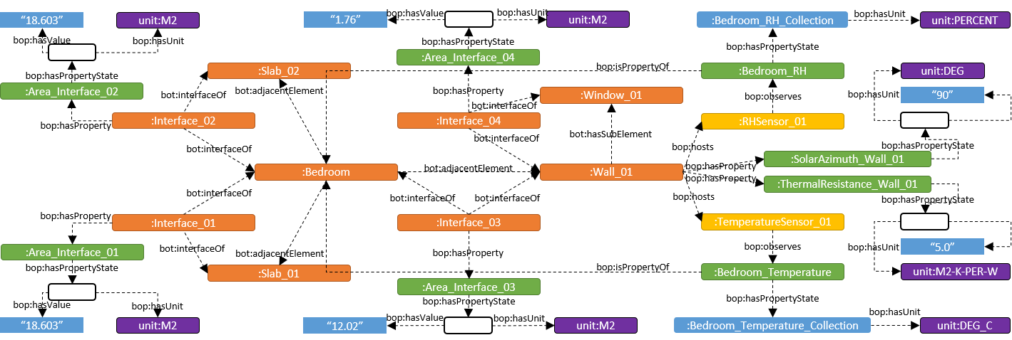
Open Smart Home

Slide 20
TEMPERATURE GraphDB
graph_url = "http://localhost:7200/repositories/OpenSmartHomeRepository"
sparql = SPARQLWrapper(graph_url)
sparql.setQuery("""PREFIX props: <https://w3id.org/props#>
PREFIX quantitykind: <http://qudt.org/vocab/quantitykind/>
PREFIX bot: <https://w3id.org/bot#>
PREFIX bop: <https://w3id.org/bop#>
PREFIX : <https://research.tue.nl/nl/persons/alex-ja-donkers#>
SELECT ?property ?datapoint ?database
WHERE {
?room bop:hasSimplePropertyState "Bedroom" ;
bot:containsElement ?sensor .
?sensor bop:observes ?property .
?property a quantitykind:Temperature ;
bop:hasPropertyState ?datapoint .
?datapoint bop:isDataPointOf ?database .
} """)

Slide 21
TEMPERATURE InfluxDB
client = InfluxDBClient(host='localhost', port=8086)
client.switch_database(database)
resultset = client.query(
'SELECT ‘ + property + ’ FROM ’ + datapoint + ‘ WHERE time <= ‘ + str(maxTime) + ‘ AND time > ‘ + str(minTime) + ‘ ORDER BY time DESC LIMIT 1’)
value = list((resultset.get_points(measurement=datapoint)))
temperature = value[0]['value']
Notes:
Here, I selected a minTime and maxTime. But we can also query the most recent value and make a continuous loop in Python with a certain frequency (e.g. every 10 minutes).

Slide 22
GEOMETRY GraphDB
sparql.setQuery("""PREFIX props: <https://w3id.org/props#>
PREFIX quantitykind: <http://qudt.org/vocab/quantitykind/>
PREFIX bot: <https://w3id.org/bot#>
PREFIX bop: <https://w3id.org/bop#>
PREFIX beo: <http://pi.pauwel.be/voc/buildingelement#>
PREFIX : <https://research.tue.nl/nl/persons/alex-ja-donkers#>
SELECT ?room ?wall ?interface ?interfaceWidthValue
WHERE {
?room bop:hasSimplePropertyState "Bedroom" ;
bot:adjacentElement ?wall .
?wall a beo:Wall .
?interface bot:interfaceOf ?room, ?wall ;
bop:hasProperty ?width .
?width a quantitykind:Width ;
bop:hasPropertyState / bop:hasValue ?interfaceWidthValue
} """)

Slide 23
Results: PMV and PPD

Slide 24
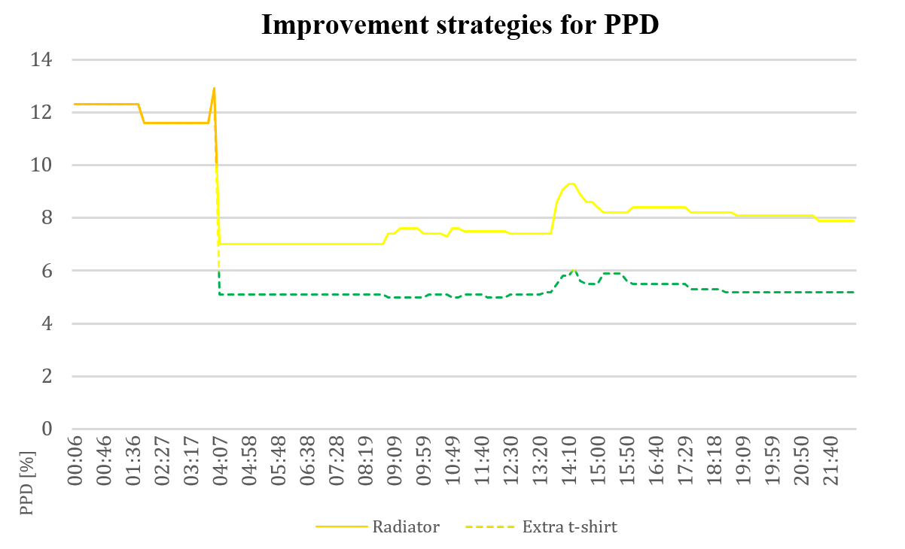
Results: PMV and PPD improvements

Slide 25
Conclusions
IEQ affects occupants' satisfaction, health and productivity
IEQ assessments use heterogeneous data
BOP enables the integration of topological building information with static and dynamic property values
A python script used the integrated data to perform real-time thermal comfort assessments using the Open Smart Home
Based on the available data, significant improvements of the IEQ performance are possible

Slide 26
Next up
17:30:22
Your feedback has been processed
v
v
CO2

Slide 27
Future research directions
Occupant data
Pattern recognition
System control
Conversion tools
Ontology alignment

Slide 28
Online documentation
TAKE ME THERE
w3id.org/bop

Slide 29
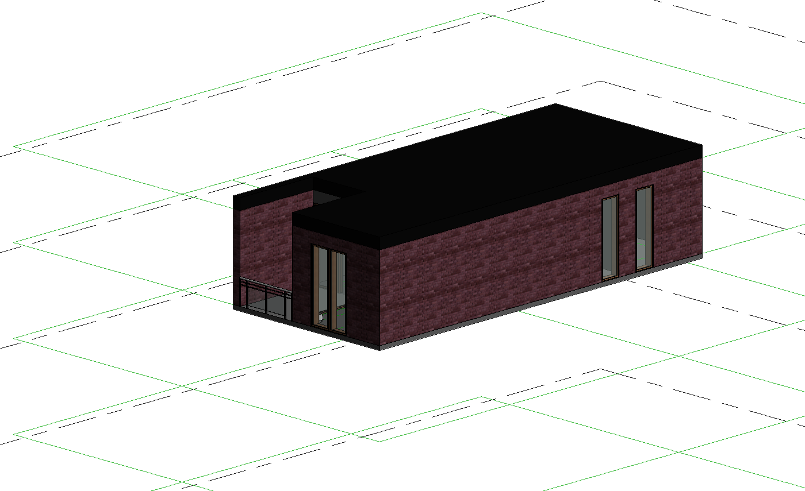
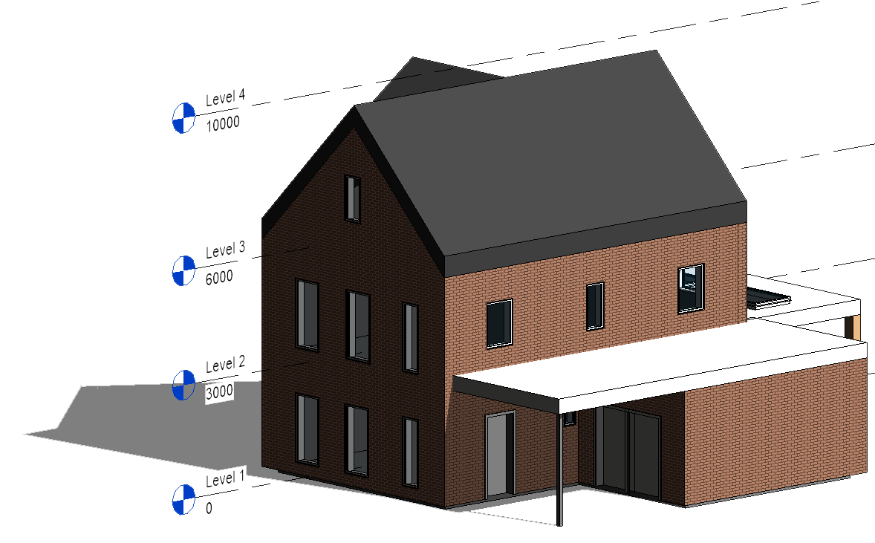
Online documentation
TAKE ME THERE
w3id.org/bop
UPPER ONTOLOGY
BOP x OPEN DIGITAL TWINS
USE-CASE SPECIFIC ONTOLOGIES
Sensor pattern
Actuator pattern
Static properties pattern
OPEN SMART HOME
Various file formats (.rvt, .ttl, .dae, .gltf)
Sensor data
CSV-to-InfluxDB converter
EXAMPLES
Using BOP in practice
Use-case specific example graphs
Example queries
TWO UPCOMING PROJECTS
Open Flat Open Family Home
ALIGNMENTS TO OTHER ONTOLOGIES

Slide 30
Alex Donkers – PhD Candidate at Eindhoven University of Technology – a.j.a.donkers@tue.nl
Dujuan Yang, Bauke de Vries, Nico Baken
Notes:
This paper contributes to the long-term goal of improving IEQ in buildings and reducing the gap between measured and perceived IEQ.
Ultimately, we should improve the quality of life in our buildings

