Slide 1
Towards defining Data Usage Restrictions in the Built Environment
Gonzalo Gil | LDAC 2020 | 2020/06/17

Slide 2
01 Motivation
02 Challenges
03 The RESPOND Approach
04 Conclusions

Slide 3
01 Motivation
02 Challenges
03 The RESPOND Approach
04 Conclusions

Slide 4
Motivation
On the COVID-19
“We need to Flatten the Curve for ensuring that this keeps us from surpassing the statewide capacity for intensive care beds”
Fernando Simón
Spanish Health Emergency Head

Slide 5
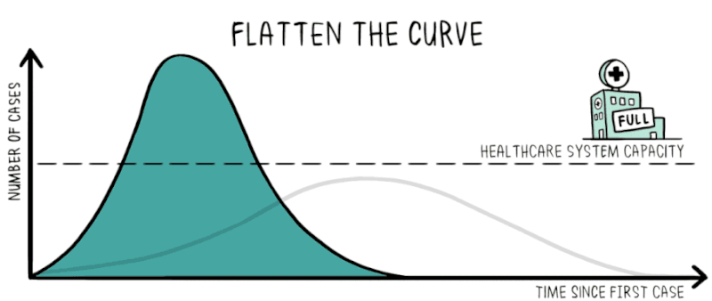
Motivation

Slide 6
Motivation
Goal: Balance Energy Supply and Demand
How: Change user Consumption Habits
Via Incentives
Demand Response as a solution for
Flattening the Energy Demand Curve

Slide 7
Motivation
Exploitation of Building Data is essential for User Engagement
Users are reluctant to share their Personal Data
Main issue
Solution
A Trustworthy Ecosystem is needed

Slide 8
Motivation

Slide 9
01 Motivation
02 Challenges
03 The RESPOND Approach
04 Conclusions

Slide 10
Distributed Data Usage Control
3
RELIABILITY
Provider
Consumer
1
Data Usage Requirements
IMPLEMENTATION
2
Data Usage Policies
ENFORCEMENT
Interpretable Worldwide
Technology-dependent Enforceable
Notes:
One of the main issues regarding distributed data usage control is that usage decisions are performed at distributed consumer infrastructures where providers lose data control.
Therefore:
First, those data usage requirements that could be negotiated by providers and consumers in different formats (e.g. human-language) must be at a first instance interpretable worldwide and then translated to be attached to the respective data and enforceable by any technology that could be used at distributed consumer systems.
Second, once data arrives at consumer infrastructure, the attached data usage policies must be enforceable by the respective technology.
Finally, as usage decisions are performed out of providers boundaries, reliability must be provided.
In this work, we have focus on the first main point. Specifically in the field related to the specification of data usage requirements to make them interpretable worldwide.

Slide 11
Data Usage Requirements Specification
1
Domain-agnostic
data usage requirements
2
Domain-specific assets
Time
Cardinality
Purpose of usage
…
Conditions
INDUSTRY
HEALTHCARE
Actions
Data updates
System interactions
BUILDING
3
Formal specification of domain-agnostic data usage requirements in the Built Environment
Notes:
Data Usage Requirements Specification related challenge recognize three issues to be solved:
(Formal specification of domain-agnostic data usage requirements) As previously pointed out, all those data usage requirements that could be negotiated must be interpretable by each of the machines involved regardless of the data usage control technology used. Thus, they must be formally specified.
(Domain-specific assets identification and specification) Providers used to limit data usage based on assets rather than specific data points. Therefore, domain-specific assets must be specified to be interpretable by each of the machines involved and assignable for any purpose.
(Formal specification of domain-agnostic data usage requirements in specific domains) Once domain-agnostic data usage requirements and domain-specific assets are specified, a specification must be defined to provide applicability to specified data usage requirements in specific domains.
In this work, focus is placed on the formal specification of data usage requirements for the built environment through ontologies based on the IDSA approach for the specification of domain agnostic data usage requirements and the RESPOND approach for the specification of built-environment related assets.

Slide 12
01 Motivation
02 Challenges
03 The RESPOND Approach
04 Conclusions

Slide 13
RESPOND Use Case
Notes:
The RESPOND project aims to deploy an interoperable solution that allows building occupants to optimize their energy consumption through a mobile app.
To do so, on the one hand, third-party analytic services developed by Tekniker and PUPIN needs building monitored data. Whereas Tekniker needs the electrical demand and the temperature measured every 5 seconds and 30 seconds respectively by several appliances to develop the electrical demand forecast and comfort temperature services, PUPIN needs the electrical production and Tekniker’s electrical demand forecast to develop the electrical production forecast and electrical optimized profile services, respectively.
On the other hand, the user will visualize the results generated from the third anaclitic services to be able to optimize its energy consumption. These results are the electrical demand forecast and the mean value of the last temperatures measured within the building from Tekniker’s services and the electrical production forecast and optimized profile for PUPIN’s services.

Slide 14
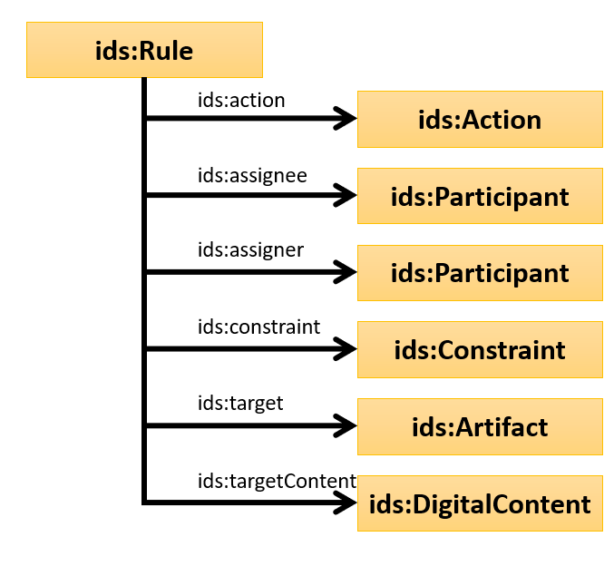
IDSA Ontology
Notes:
As previously said, the specification proposed for domain-agnostic data usage requirements is based on the IDSA ontology.
The IDSA define an Information model where, among other components within the IDSA, data usage requirements are specified in a domain agnostic-way through an ontology. This specification is based on the ODRL Information Model. ODRL is a W3C recommended policy expression language for the description of machine-readable formats.
In this ontology, the concept of contract is defined as a subclass of policy which is an abstract a set of rules which describes actions that a stakeholder is allowed, disallowed or obligated to perform on a digital content under certain circumstances.

Slide 15
RESPOND Ontology

Slide 16
The RESPOND Approach
:irishSite
:tek
ids:assignee
:contractTek_Aran01
bot:hasBuilding
ids:prohibition
ids:assigner
:aran01
:prohibition01
bot:hasElement
ids:targetContent
ids:action
:aran_01_electricityMeter
saref:measuresProperty
:aran_01_demand
ids:DISTRIBUTE

Slide 17
01 Motivation
02 Challenges
03 The RESPOND Approach
04 Conclusions

Slide 18
Conclusions
The high energy consumption is a big concern in the Built Environment
Buildings monitored data sharing plays a key role for the development and implementation of energy optimization services in the Built Environment
Nevertheless, users are reluctant to exchange their private data if data sovereignty is not provided
From this work, a step forward the development of a trustworthy ecosystem where data sovereignty is provided has been taken

Slide 19
Towards defining Data Usage Restrictions in the Built Environment
Thank you for your attention !
Gonzalo Gil
gonzalo.gil@tekniker.es
This presentation is co-funded by the European Commission under the “H2020-EE-2017-PPP Integration of Demand Response in Energy Management Systems while ensuring interoperability through Public Private Partnership” under Grant agreement No. 768619

