Slide 1
Common Data Environments for the Information Container for linked Document Delivery
18.06.2020
Madhumitha Senthilvel
Jyrki Oraskari
Jakob Beetz

Slide 2
Presentation Outline
Context - BIM4REN
Challenges
ICDD
CDE
DIN-SPEC
OpenAPI
LDP
Use case CDE and ICDD
Comparison
Implementation: Use case
Conclusions & Future Work
Notes:
Here is the presentation overview. I’d be kickstarting my presentation with a brief overview of the context based on which it developed, the challenges associated with it, elaborating what ICDD and CDE are, intro to three CDEs and our work done, ending with the conclusions and future work.

Slide 3
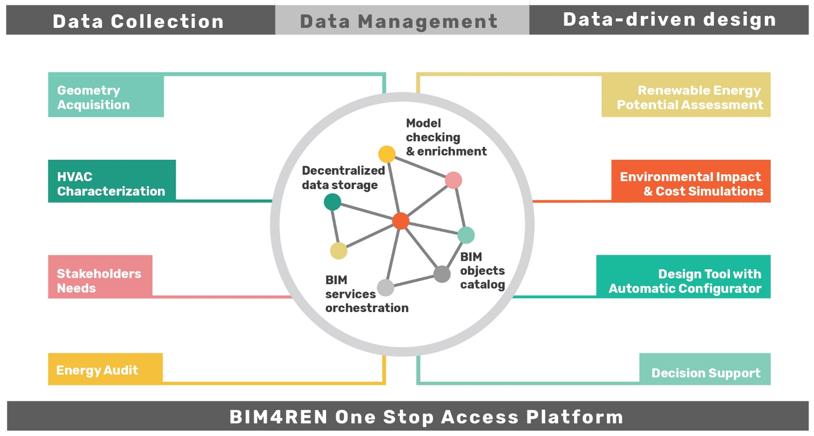
BIM4Ren
Online framework for renovation-oriented BIM (H2020)
Interconnecting heterogeneous information sources and tools represented as services
Toolchains real-world renovation scenarios
23 partners across Europe
Practitioners, Developers, Researchers
Notes:
To set the context, I’d like to introduce BIM4Ren, an acronym, for BIM for Renovation. It is a H2020 project, of which we are part of. This project focuses on development of a one-stop access platform, facilitating data collection, management and service orchestration. In short, it’s basically focusing on interconnecting heterogenous information, with tools such that they can be services interconnected with each other. I started my PhD at the same time as the project began, which is 2018. Two years in, and after collecting, analyzing use-cases and user-stories, and identifying that Linked Data approach is the way forward to achieve the project goals, we are now at the drawing board for implementing the One Stop Access Platform.

Slide 4
Context
Linking information
One Stop Access Platform (Common Data Environment)
Notes:
To do this we need to look at two concepts in particular: Linking Information and the One Stop Access Platform , or in other words, the Common Data Environment

Slide 5
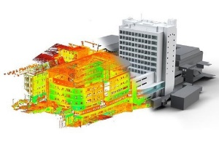
Linking Heterogenous Information
Plan drawings
Point Clouds
Documents
How to semantically relate this information?
Images
IFC files
Spreadsheets
Notes:
Linking Information is the core of what Linked Data also tries to address:

Slide 6
Linking Heterogeneous Information
Plan drawings
Point Clouds
Documents
How to semantically relate this information?
Images
IFC files
Spreadsheets
Notes:
Given heterogeneous information (url/file), how do we link information in an common environment. While there were methods to create links between files, there standardization to those methods. Thus, even though we can link them and supply the linking information in RDF, we’d still need another set of information from the author on what exactly is meant by the terminologies used in the links.

Slide 7
Linking Heterogeneous Information – Information Container for linked Document Delivery (ICDD)
Plan drawings
Point Clouds
Documents
ICDD
How to semantically relate this information?
Images
IFC files
Spreadsheets
Notes:
This was the case till a few months back. With the publishing of ICDD, we now have a standard which specifies a structure for storing and linking such heterogeneous information

Slide 8
Information Container for linked Document Delivery* (ICDD) –ISO 21597
based on Dutch COINS standard
Industry-driven development with first publication in 2015
flexible standard for the exchange of BIM information
Use of several existing open BIM and GIS standards
Integration of document-oriented information with object-oriented information
Based on OWL/RDF Semantic Web technologies
Contains definitions
Container OWL Ontology
Linkset OWL ontology
Describe document data with nodes
Link them
Information linking on sub-document level
Container-like Structure
Terminologies
* formerly Information Container for Data Drop
Notes:
Formerly called Information Container for Data Drop, this standard is based on the Dutch COINS standard. On the right, the image describes the structure of what ICDD standard proposes: Which consists mainly of: A Container-like structure, a set of definitions for both documents and the links between them.

Slide 9
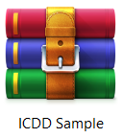
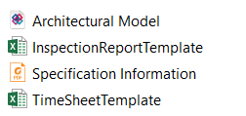
Information Container for linked Document Delivery (ICDD)
Defines Documents + Links between them
Defines Concepts
Container Concepts
Link Concepts
Stores linkset files
Contains all documents defined in the index
Notes:
The typical structure of an ICDD consist of 4 parts: An Index file which contains declaration of documents, their type, version etc. and the link between documents, and to which container these documents belong to. In order to define the properties, the Container and Link Classes & their properties are defined in the Ontology folder. The “Payload triples” folder shall be used for storing Linkset files and may include sub-folders. To make this clearer, I’ll show an example now.

Slide 10
Information Container for linked Document Delivery (ICDD)
ICDDSample:Container1
a <https://standards.iso.org/iso/21597/-1/ed-1/en/Container#ContainerDescription> ;
ct:containsDocument ICDDSample:ArchitecturalModel,
ICDDSample:SpecificationInformation,
<………………………………………………………………………….> ;
ct:containsLinkset <https://standards.iso.org/iso/21597/-1/ed-1/en/AnnexA/usecase1B/requirements/index#ls90158300-f42f-4eee-bb8c-562fc5b253ab> ;
ct:versionID "1" ;
ct:description "ICDD showcase 1b: ICDD model requirement container with an updated IDS and links between documents" ;
ct:publishedBy ICDDSample:User1 ;
ICDD:ArchitecturalModel
a ct:InternalDocument ;
ct:name “ArchitecturalModel" ;
ct:versionID "1" ;
ct:description “Model Version 2" ;
ct:filename “ArchitecturalModel.ifc" ;
ct:createdBy ICDDSample:Madhu ;
ct:creationDate "2018-05-28T14:13:28.167"^^xsd:dateTime ;
ct:filetype “ifc“;
extendedlinkset:IsMemberOf ICDDSample:SpecificationInformation.
<https://standards.iso.org/iso/21597/-1/ed-1/en/AnnexA/usecase1B/requirements/links#le33bae0ff-193d-4d26-bc4c-2536eec20706>
a linkset:LinkElement ;
linkset:hasDocument ICDDSample:ArchitecturalModel ;
ct:creator ICDDSample:Madhu
ct:creationDate "2018-05-28T14:13:28.167"^^xsd:dateTime ;
ct:versionID "1" ;
ct:versionDescription "first version" .
Notes:
Here, the index file contains “Container1” which specifies that it contains two documents: an architecturalmodel and a specificationInformation. Further into the code, it also defines what kind of document the ArchitecturalModel is, according to the Container Object Classes defined by ICDD standard. This very document is also stored in the linkset file as a payload triple.

Slide 11
Information Container for linked Document Delivery (ICDD)
ICDDSample:Container1
a <https://standards.iso.org/iso/21597/-1/ed-1/en/Container#ContainerDescription> ;
ct:containsDocument ICDDSample:ArchitecturalModel,
ICDDSample:SpecificationInformation
<………………………………………………………………………….> ;
ct:containsLinkset <https://standards.iso.org/iso/21597/-1/ed-1/en/AnnexA/usecase1B/requirements/index#ls90158300-f42f-4eee-bb8c-562fc5b253ab> ;
ct:versionID "1" ;
ct:description "ICDD showcase 1b: ICDD model requirement container with an updated IDS and links between documents" ;
ct:publishedBy ICDDSample:User1 ;
ICDD:ArchitecturalModel
a ct:InternalDocument ;
ct:name “ArchitecturalModel" ;
ct:versionID "1" ;
ct:description “Model Version 2" ;
ct:filename “ArchitecturalModel.ifc" ;
ct:createdBy ICDDSample:Madhu ;
ct:creationDate "2018-05-28T14:13:28.167"^^xsd:dateTime ;
ct:filetype “ifc“;
extendedlinkset:IsMemberOf ICDDSample:SpecificationInformation.
<https://standards.iso.org/iso/21597/-1/ed-1/en/AnnexA/usecase1B/requirements/links#le33bae0ff-193d-4d26-bc4c-2536eec20706>
a linkset:LinkElement ;
linkset:hasDocument ICDDSample:ArchitecturalModel ;
ct:creator ICDDSample:Madhu
ct:creationDate "2018-05-28T14:13:28.167"^^xsd:dateTime ;
ct:versionID "1" ;
ct:versionDescription "first version" .
Notes:
These two code snippets from the index and the links file define the document ArchitecturalModel.ifc and how it is linked to another document called Specification Information.

Slide 12
Information Container for linked Document Delivery (ICDD)
ADVANTAGES:
DISADVANTAGES:
No semantic classification of identifier types
No implementation environments yet
Bridges Linked Data research and industry “document-based” practice
Ability to combine multiple exchange standards in a coherent way
Notes:
ICDD’s advantage lies in the fact that it address the primary way in which the AEC industry exchange data: file/document based. It also provides a standardized way to combine and exchange heterogeneous information. Of course, it has it’s own limitations. The identifier types that it defines, has limited machine reasoning, and since it’s relatively new, there are not yet implementations available. Implementing ICDD in a decentralized environment brings us to the which kinds of Common Data Environments we need to look at for achieving this.

Slide 13
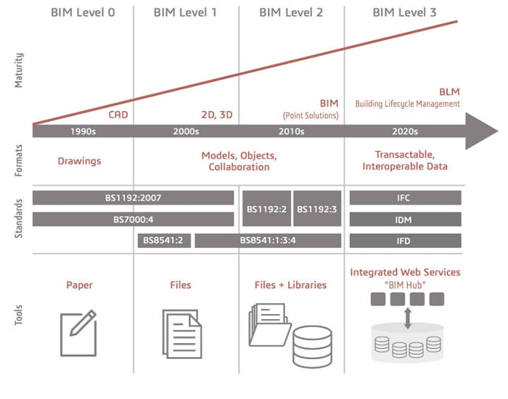
BIM Maturity Levels
Notes:
The BIM Maturity levels by the UK Mandate gives a roadmap of BIM implementation based on formats, standards and tools employed.

Slide 14
BIM Maturity Levels & Common Data Environments
CDE - essential step in BIM implementation
Collect, manage and share information
Individual models produced by different stakeholders do not interact, they have clear authorship and remain separate.
Create links
ICDD
CDE
ICDD
Notes:
ICDD addresses the file based approach of information sharing and collaboration, while CDE, can be seen as part of Level 3, enabling Integrated Web Services. Essentially, CDE’s form an essential step in moving forward. Since the Data in CDE do not interact, we can use ICDD as a means to create links between these information “files”.

Slide 15
Common Data Environments (CDEs)
Linked Data Platform (LDP)
DIN SPEC 91391-2
OpenCDE-API
German Initiative
buildingSMART Initiative
W3C recommendation
Defines requirements:
CDE (Part 1)
exchange between different CDEs (Part 2)
Basic components & tasks, minimum scope, additional functionalities and their applications
Interfacing for data exchange : requirements? Protocol? Data structures?
Simplifying the exchange between programs used in construction project
Defines a standard set of techniques used for creating clients and servers that work with RDF resources over
HTTP:
Create,
Read,
Update,
Delete Linked Data
LDP: client/server/client+server
Interactive flow (user interacts with web page)
Non-Interactive flow not defined yet
Oracle Aconex implementation
Notes:
So, we started looking at three existing specifications for CDEs. DIN SPEC: A german initiative, consisting of two parts, each of which define the requirements for a CDE, along with open data exchange between different CDE platforms. In brief, they define the basic components & tasks of a CDE, their minimum scope, possible additional functionalities, and applications for these functionalities. Secondly, it defines the concept of interface for such an environment, what are the requirements, protocol and data structures for making it possible.
OpenCDE-API is a buildingSMART initiative. supports two flows: interactive and non- interactive. In the interactive flow, the user interacts with a web page (the client environment) directly. For example, a model author uses a client tool to upload model versions to the server manually. In the non-interactive flow, greater flexibility is available for implementing more dynamic features and workflows. The non-interactive server-to-server flows are still at the concept level. There is a publicly available OpenAPI 3.0 specification for the server interface available
LDP: started from IBM’s search for reading-writing Linked Data. It focuses on the use of HTTP to Create, Read, Update, and Delete Linked Data Resources (files/documents) that are part of a collection (folder). For this, the W3C recommendation contains information on what resource content notations and content serialization formats should be used, how a client can handle changes to resources, container issues including data and meta-data retrieval (using GET) updating containers (using POST).

Slide 16
Mapping CDE Container concepts to ICDD
ICDD
DIN SPEC 91391-2
OpenCDE-API
LDP
ContainerDescription
ct:versionID
ct:description
ct:ContainsDocument
ct:ContainsLinkset
Linkset
ct:filename
InternalDocument
ct:name
ct:format
ct:creationDate

Slide 17
Mapping ICDD Concepts to CDE
DIN SPEC 91391-2
OpenCDE-API
LDP
Linked data is not mentioned
Only interaction flow is available
User interaction is needed
Implementation available: Oracle Aconex
ICDD can be published
Flexible metadata
Two types of Containers: Basic, Direct
Implementation available: Solid
No known implementations
ICDD can be published
Only meta-links between documents in containers
Details left for the designers of the technical implementation
Notes:
Upon mapping, we found that while there are definitely variations in the level of specification provided, all three of them have provisions to implement ICDD. They contain meta-links between documents in containers, but the details of these are left to the implementers. Thus, ICDD’s definitions can definitely help in standardized definition of meta and sub-document links.

Slide 18
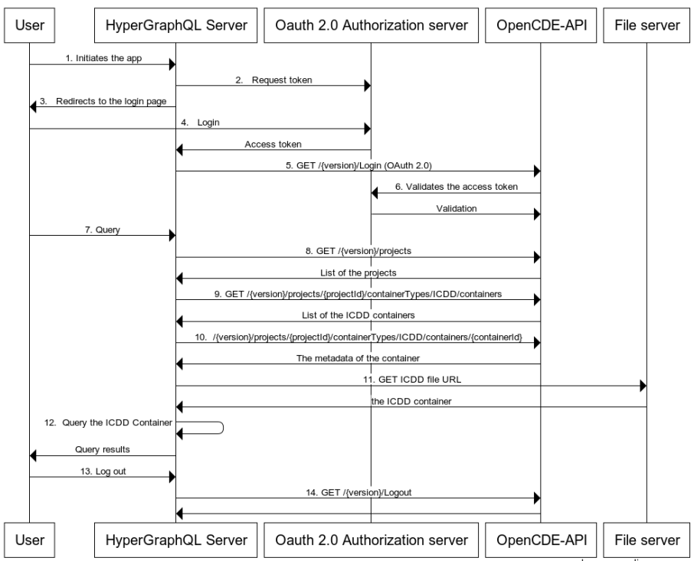
Accessing ICDD Containers in CDE
OpenCDE-API
Notes:
Having established that we can publish ICDD in all the three CDEs, we move on to the next part: Accessing the data in the containers through the CDE. The sequence diagrams shown explain how the data is accessed through navigating the specifications defined in DIN-SPEC. 1-6 OAuth 2.0 login is handled. GraphQL query is given in 7. The steps 8-12: this part is using three facts: first, like shown by Wittern et al. in a wrapper can be implemented to expose REST APIs as GraphQL, GraphQL can federate other GraphQL endpoints, and HyperGraphQL can be used to expose ICDD data content. Such sequencing was done also for OpenCDE API and LDP.

Slide 19
Comparison
DIN SPEC 91391-2
OpenCDE-API
LDP
Meta-data based
metadata is flexible
Can express ICDD metadata
Meta-data focussed on HTTP operations + two types of container specs
Onus on implementer:
syntax of the values returned by REST call,
Supported OData filters.
interactive flow limits the possible automation
assumes a user feeding metadata interactively cannot be copied or mapped from the ICDD container like in the DIN SPEC 91391-2
Broad Container ontology and specification ->creator discretion
No explicit mention of linked data
defines a set of rules for HTTP operations, some based on RDF -> Linked Data

Slide 20
Conclusion + Future Work
ICDD Container + link specs – extensions for above CDEs
OpenCDE-API & LDP roadmap for standardizing CDE + implementation features
Need implementations!
CDE + ICDD + GraphQL

Slide 21
Thanks for your
attention!

Slide 22
References
LDP implementations - w3c wiki, https://www.w3.org/wiki/LDP_Implementations Bader, S.R., Wolf, A., Keppmann, F.L.: Evaluation environment for linked data web services. In: SEMANTICS Workshops (2017) Beckett, D., McBride, B.: Rdf/xml syntax specification (revised). W3C recommendation 10(2.3) (2004) Berners-Lee, T.: Linked Data - Design Issues (Jun 2008), https://www.w3.org/DesignIssues/LinkedData.html Berners-Lee, T., Prud’hommeaux, E., Carvalho, M., Verborgh, R.: Solid (2017), https://solid.mit.edu/ Bizer, C., Heath, T., Berners-Lee, T.: Linked data - the story so far. International Journal on Semantic Web and Information Systems 5, 1–22 (2009) Bizer, C., Heath, T., Berners-Lee, T.: Linked data-the story so far. Semantic services, interoperability and web applications: emerging concepts pp. 205–227 (2009) Bizer, C., Heath, T., Berners-Lee, T.: Linked data. Evolving the Web into a Global Data Space (2011) Boxall, E.: Common data environment (cde): What you need to know for starters. https://blogs.oracle.com/construction-engineering/common-data-environmentcde-tutorial (2018), [Online; accessed 11-Fev-2029]
Chappell, D.: Introducing odata. Data Access for the Web, The Cloud, Mobile Fielding, R., Gettys, J., Mogul, J., Frystyk, H., Masinter, L., Leach, P., BernersLee, T.: Hypertext transfer protocol–http/1.1 (1999) Fielding, R.T., Gettys, J., Mogul, J.C., Nielsen, H.F., Masinter, L., Leach, P.J., Berners-Lee, T.: Hypertext transfer protocol – http/1.1. RFC 2616, RFC Editor (June 1999), http://www.rfc-editor.org/rfc/rfc2616.txt, [Online; accessed 06-June- 2019] Fuchs, S., Katranuschkov, P., Scherer, R.: A framework for multi-model collaboration and visualisation. Proc. ECPPM 2010 pp. 115–120 (2010) Hausenblas, M.: Linked data applications. First Community Draft, DERI (2009) Information container for linked document delivery — Exchange specificaton – Part 1: Container (Mar 2018) Information container for linked document delivery — Exchange specificaton – Part 2: Dynamic semantics (Mar 2018)

Slide 23
References
Katz, P.: Appnote. TXT—. ZIP file format specification, version 2 (1993) Malhotra, A., Arwe, J., Speicher, S.: Linked data platform specification. W3C Recommendation (2015) Manola, F., Miller, E., McBride, B., et al.: Rdf primer. W3C recommendation 10(1-107), 6 (2004)
Richards, Richards, M.: Building information management: A standard framework and guide to bs 1192, bsi standards (2010) Schapke, S.E.: jyrkioraskari/MMC: buildingSMART MMC MultimodellContainer (Mar 2020). https://doi.org/10.5281/zenodo.3727286, https://doi.org/10.5281/zenodo.3727286 Scherer, R.J., Katranuschkov, P.: Context capturing of multi information resources for the data exchange in collaborative project environments (2019)
Scherer, R.J., Schapke, S.E.: A distributed multi-model-based management information system for simulation and decision-making on construction projects. Advanced Engineering Informatics 25(4), 582–599 (2011) Seaborne, A., Manjunath, G., Bizer, C., Breslin, J., Das, S., Davis, I., Harris, S., Idehen, K., Corby, O., Kjernsmo, K., et al.: Sparql/update: A language for updating rdf graphs. W3c member submission 15 (2008) Senthilvel, M.: jyrkioraskari/icdd-hypergraphql: Zenodo (May 2020). https://doi.org/10.5281/zenodo.3846727, https://doi.org/10.5281/zenodo.3846727 Speicher, S., Arwe, J., Malhotra, A.: Linked data platform 1.0. W3C Recommendation, February 26 (2015) Werbrouck, J., Senthilvel, M., Beetz, J., Pauwels, P.: Querying heterogeneous linked building datasets with context-expanded graphql queries. In: 7th Linked Data in Architecture and Construction Workshop. pp. 21–34 (2019) Wittern, E., Cha, A., Laredo, J.A.: Generating graphql-wrappers for rest (-like) apis. In: International Conference on Web Engineering. pp. 65–83. Springer (2018)

Slide 24
Mapping CDE Container concepts to ICDD
ICDD
DIN SPEC 91391-2
OpenCDE-API
LDP
ContainerDescription
ct:versionID
ct:description
ct:ContainsDocument
ct:ContainsLinkset
Linkset
ct:filename
InternalDocument
ct:name
ct:format
ct:creationDate

