Slide 1
PATTERN-BASED ACCESS CONTROL
IN A DECENTRALISED COLLABORATION ENVIRONMENT
LDAC 2020
JEROEN WERBROUCK
AUTHORS : Jeroen Werbrouck - Ruben Taelman - Ruben Verborgh - Pieter Pauwels - Jakob Beetz - Erik Mannens

Slide 2
introduction
M. Sc. in Engineering: Architecture (Ghent University 2018)
BIM4Ren / LBDserver (2018-2019)
FWO researcher (2019-…)
Erik Mannens, Jakob Beetz, Pieter Pauwels, Ruben Verborgh
Ghent University / RWTH Aachen University

Slide 3
The solid project
Solid (derived from "social linked data") is a proposed set of conventions and tools for building decentralized social applications based on Linked Data principles. Solid is modular and extensible and it relies as much as possible on existing W3C standards and protocols.
[https://solid.mit.edu]
[1]
i
https://solidproject.org/

Slide 4
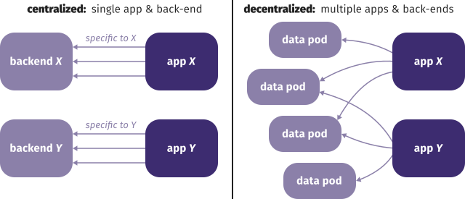
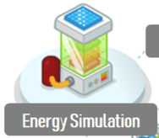
The solid project
Agents store data on a personal POD, either self-hosted or hosted by a provider
Identification by webID*
Linked Data Platform (LDP)** specification PODs organised as a folder structure
Web application SDK
Structural Office
HVAC Office
Architect Office
Geospatial dataset
[2, 3]
i
*https://www.w3.org/wiki/WebID || **https://www.w3.org/TR/ldp/

Slide 5
The Consolid project
Solid for Construction
Stakeholder PODs & Project metadata POD & open data Distributed building projects
“LBD bots” acting on decentralised models
Extended Distributed Building Model
accessibility checker
Owner
Architect
Government
Geospatial
Surveyor
Structure
Neighbourhood reasoner
Product
FM
HVAC
Consultant
Collision checker
Distributed Building Model

Slide 6
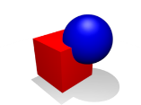
What is a (con)solid pod?
https://bob.his-office.org/
GEOMETRY.STEP
PROFILE
CARD.TTL
STRUCTURE_LBD.TTL
.ACL
PUBLIC
SOME_IMG.JPG
PRIVATE
ORIGINAL.IFC
SHAPES.TTL
CONSOLID
PROJECT_1
INDEX.TTL
INBOX
PROJECT_2
.ACL
NANOCREDENTIALS

Slide 7
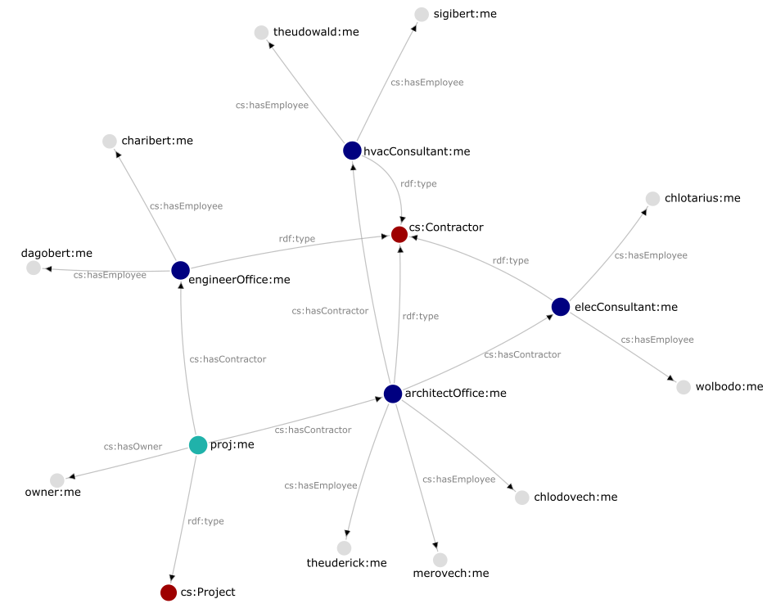
pbac
Complex networks of stakeholders, subcontractors, employees …
Accessing distributed and heterogeneous data
Pattern-based access control
Properties of the requesting actor LDAC 2020
Properties of the requested resource
Other contextual information
?

Slide 8
requirements
Authentication WebID
Authorisation Web Access Control (WAC)
Immutable statements Nanopublications
Trust Digital signatures
Rules and validation SHACL
Connecting framework PBAC

Slide 9
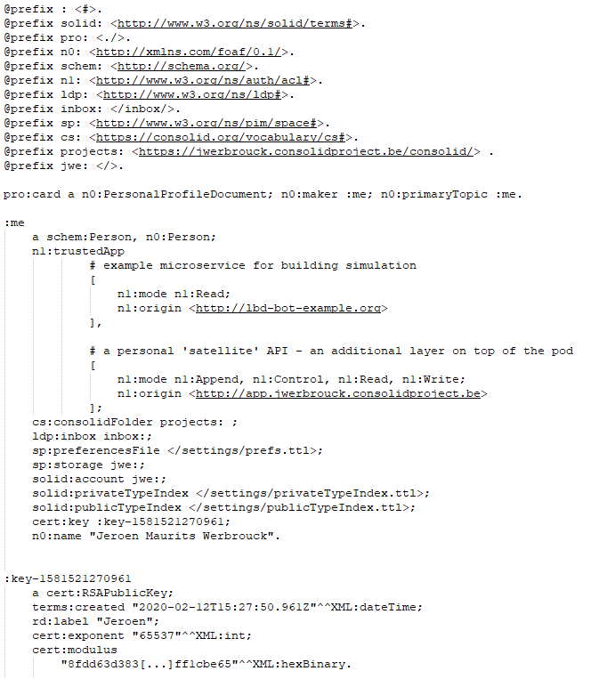
Web-id
Id: denotes
card: describes
Identification of actors/bots/… using a personal URL
Solid Coupled with a data POD
Card: Basic information about the actor
E.g.: https://jwerbrouck.consolidproject.be/profile/card#me

Slide 10
wac
W3C / Solid: Web Access Control*
‘ACL’ resource: RDF (Turtle) document
Access Control List
Folder/Resource specific
Identification by WebID (individuals or groups) WebID-OIDC**
Access modes: Read, Write, Append, Control
Granularity: LDP resource (image, named graph, …)
i
*https://github.com/solid/web-access-control-spec || **https://github.com/solid/webid-oidc-spec

Slide 11
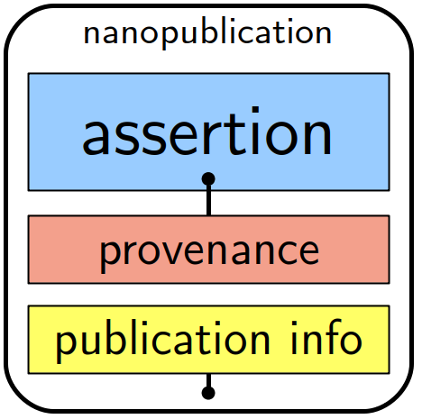
nanopublications
Fixed set of named graphs (TRIG)*
ASSERTION The actual statements
PROVENANCE Explains why
PUBLICATION INFO Adds authority layer
“Freeze” with digital signature and Trusty URIs**
Provenance contains signature and authorship
URI of the Nanopublication contains hash of content
In context of certificates: “Nanocredentials” ?
[4]
i
T. Kuhn et al., 2013 & 2014
*http://nanopub.org || **http://trustyuri.net

Slide 12
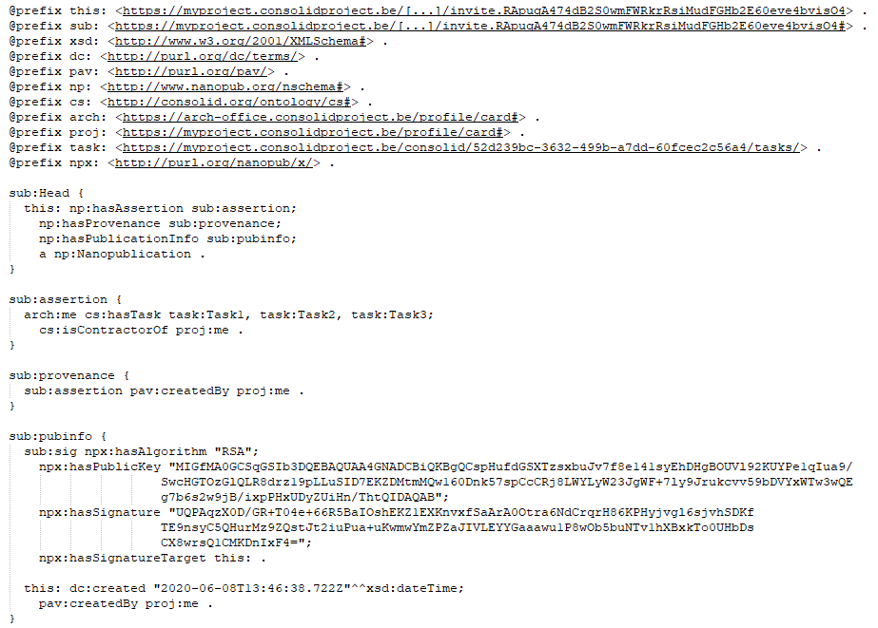
Nanopublications
Trusty uri (artifact)
Makes the publication immutable
assertion
Explicit statements about a certain actor (web ID)
provenance
“Why the assertion is true”
Publication info
Public key expressed in web id
Signing authority

Slide 13
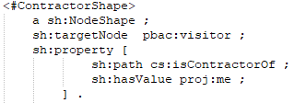
shacl
SHApes Constraint Language*
Closed-world validation of RDF statements
“If it is not explicitly mentioned, it is not true”
“Shapes” describe the requirements a resource should fulfil to be valid (in context of the shape)
EXAMPLE SHAPE 1
a bot:Site instance must have exactly 1 zero point
EXAMPLE SHAPE 2 :
A visitor must be a contractor within the project
pbac:visitor changes to the WebID of the visitor at runtime
i
*https://www.w3.org/TR/shacl/

Slide 14
Pbac framework
Patterns in the Nanopublications should fit the patterns expressed in the SHACL shapes
Extends the ACL specification
pbac:DynamicRule identifies the access rule
pbac:hasShape refers to the shape template
pbac:hasTrustedAuthority refers to the webID of the actor(s) that signed the Nanocredential
“Vanilla” acl
PBAC extension

Slide 15
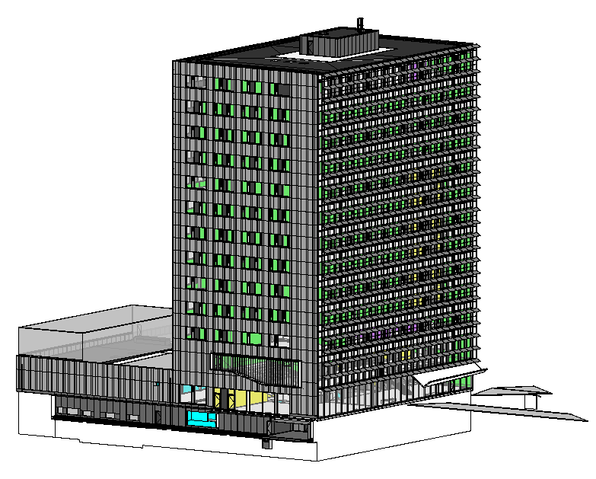
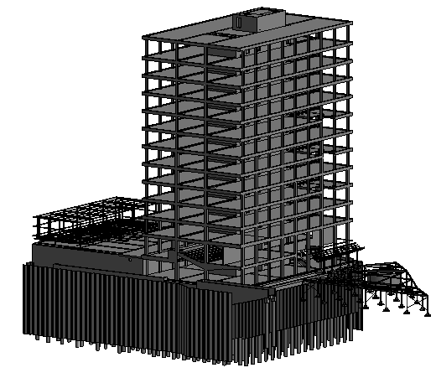
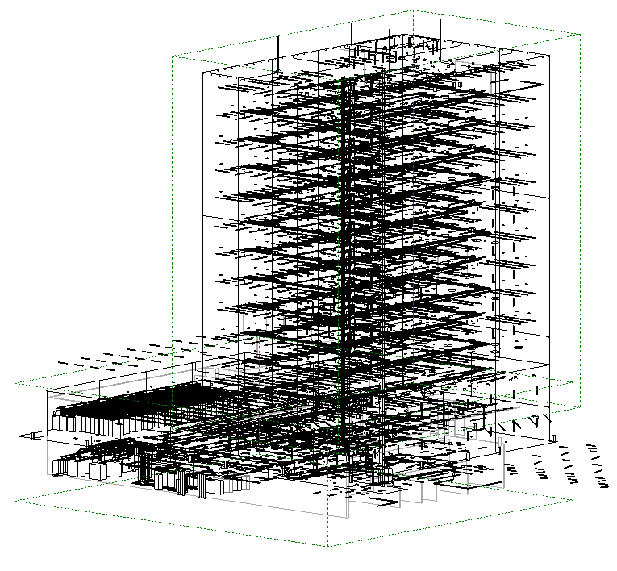
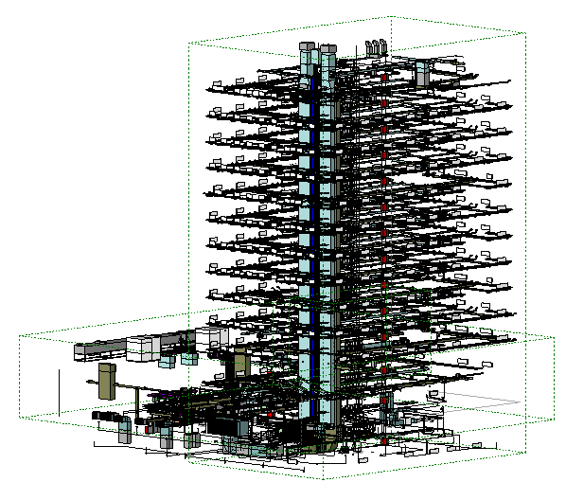
Use case
PROJECT POD
ACL: “all stakeholders and occupants”
ACL: “only #me and people assigned to project tasks 1, 3, or 4”
Architect
Struc. Eng.
Electr. consultant
HVAC consultant
?
Query
employee
ACL: “only #me
and direct project stakeholders”
ACL: “only #me, the architectural office and the structural engineering office”
i
Use case: iGent Tower, Ghent, Belgium

Slide 16
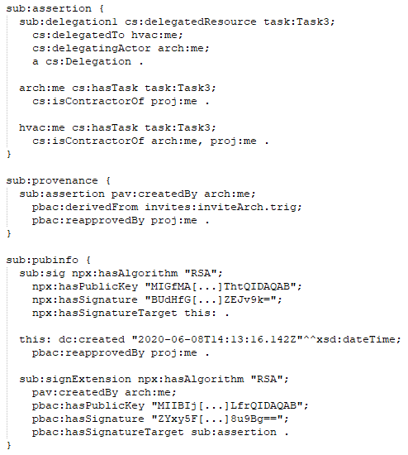
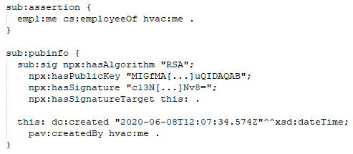
Use case: delegation
PROJECT POD
1
Architect Office
1
2
Based upon np
HVAC consultant
Signing np
By project
3
Signing assertion
By arch
employee
Only one of the signing authorities can generate the trusty URI (project WebID satellite Main trusted authority)
!

Slide 17
Use case
1
fetching necessary nanopublications:
HVAC employee
Authenticates with WebID (browser)
Dashboard APP
HVAC office POD*
(GET) np: project stakeholdership
Resource: NP
HEADERS:
nanopublication1:
assertion: #me employeeOf hvacOffice#me
pubinfo: signed by hvacOffice#me
PBAC extension
Visitor must be employee of HVAC office
trustedAuthority: hvacOffice#me
(response) np: project stakeholdership
VALID: OK
HEADERS:
nanopublication2:
assertion: hvacOffice#me contractorOf theProject#me
hvacOffice#me hasTask task:Task3
pubinfo:
signedBy architect#me
approvedBy project#me
i
*ALTERNATIVE: direct request to the project POD/API (both issuer and receiver keep a copy NP) – project API as a proxy to the rest of the project

Slide 18
Use case
2
Query:
Dashboard APP
Struc. Eng. POD
GET resource(s) of interest
Resource: Structural model
HEADERS:
nanopublication1:
assertion: #me employeeOf hvacOffice#me
pubinfo: signedBy hvacOffice#me
nanopublication2:
assertion: hvacOffice#me contractorOf theProject#me
hvacOffice#me hasTask task:Task3
pubinfo:
signedBy architect#me
approvedBy theProject#me
PBAC extension
Visitor must be employee of structure office OR be responsible for Tasks 1, 3 or 4.
trustedAuthority: theProject#me
RESponse: structural model lbd
VALID: OK
E.g. query with Comunica* (SPARQL, GRAPHQL-LD …)
i
*ALTERNATIVE: direct request to the project POD/API (both issuer and receiver keep a copy NP) – project API as a proxy to the rest of the project

Slide 19
recap
Authentication WebID
Authorisation Web Access Control (WAC)
Immutable statements Nanopublications
Trust Digital signatures
Rules and validation SHACL
Connecting framework PBAC

Slide 20
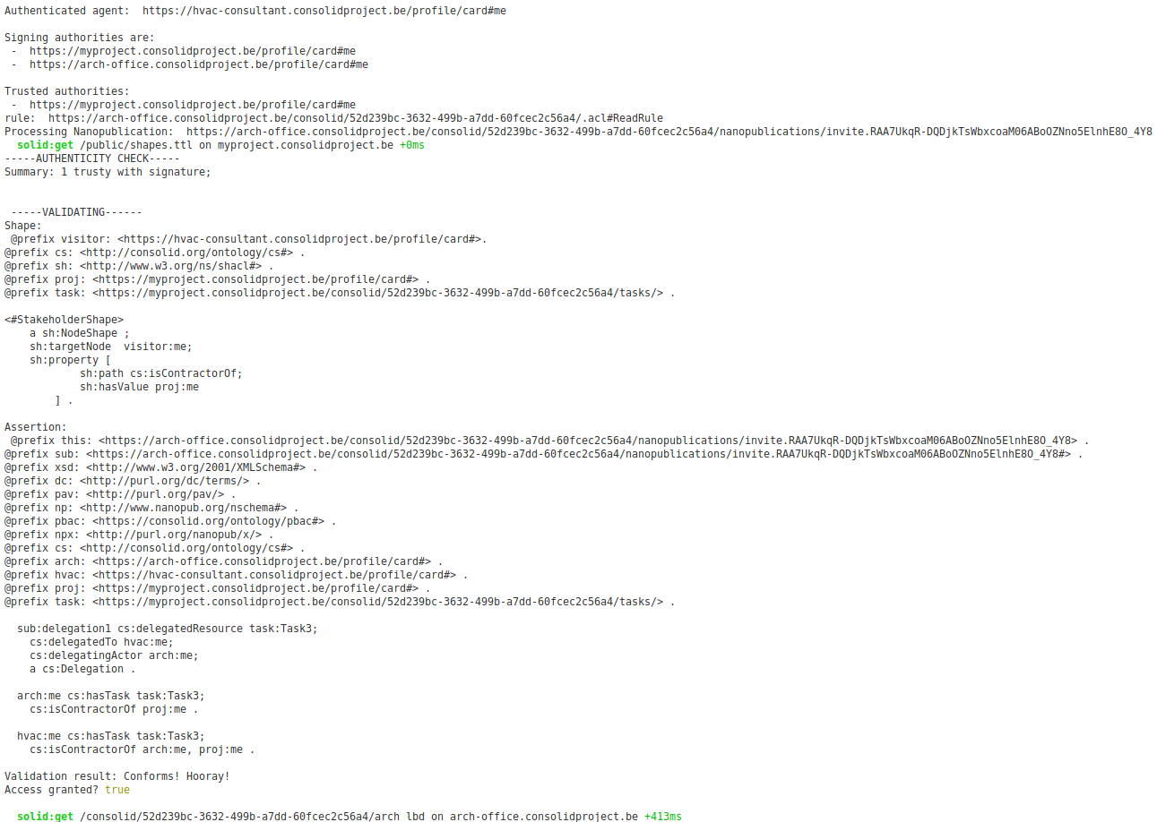
Recap: authentication

Slide 21
Recap: trust

Slide 22
Recap: immutable statements

Slide 23
Recap: ACCESS RULES

Slide 24
Recap: validation

Slide 25
Generalisation of pbac
AECO-specific implementation:
Project WebID acts as the main trusted authority
Chain discovery is bypassed if every NP is signed by Project WebID
ALTERNATIVE: Project hierarchy may help in chain discovery
General implementation:
Chain discovery involving multiple actors in a non-hierarchical way?
Publicness of shapes?
Shape – assertion relationship?

Slide 26
Future work
REMAINING QUESTIONS:
General applicability?
Contextual patterns (resource, task, current project phase …)?
Chain discovery and traversal?
Maximise trust in the project WebID (who controls this POD?)
Degree of centralisation?
IMPLEMENTATION
Improve checking and authorship verification functionality
Employee delegation
Shape or NP templating
ConSolid Dashboard implementation
Geometry linking (query via geometric UI)

Slide 27
Thank you
This research is funded by the Research Foundation Flanders (FWO) in the form of a personal Strategic Basic (SB) Research grant (grant no. 1S99020N).

Slide 28
further reading
Werbrouck, J., Pauwels, P., Beetz, J., van Berlo, L.: Towards a decentralised common data environment using linked building data and the solid ecosystem. In: 36th CIB W78 2019 Conference. pp. 113-123 (2019), https://biblio.ugent.be/publication/8633673.
Oraskari, J., Törmä, S.: Access control for web of building data: Challenges and directions. In: eWork and eBusiness in Architecture, Engineering and Construction: ECPPM 2016: Proceedings of the 11th European Conference on Product and Process Modelling (ECPPM 2016), Limassol, Cyprus, 7-9 September 2016. p. 45. CRC Press (2016),
Kirrane, S., Mileo, A., Decker, S.: Access control and the resource description framework: A survey. Semantic Web 8(2), 311-352 (2017), http://www.semantic-web-journal.net/system/files/swj1280.pdf.
Kuhn, T., Barbano, P.E., Nagy, M.L., Krauthammer, M.: Broadening the scope of nanopublications. In: Extended Semantic Web Conference. pp. 487-501. Springer (2013), https://link.springer.com/content/pdf/10.1007/978-3-642-38288-8_33.pdf.
Kuhn, T., Dumontier, M.: Trusty uris: Veriable, immutable, and permanent digital artifacts for linked data. In: European semantic web conference. pp. 395-410. Springer (2014), https://arxiv.org/pdf/1401.5775.pdf.
IMAGE SOURCES:
[1] https://solid.mit.edu/
[2] https://ruben.verborgh.org/
[3] https://www.slideshare.net/berlotti/bim-bots
[4] http://nanopub.org/

